Slide 1
Elon Academy
Welcome Back!

Slide 2
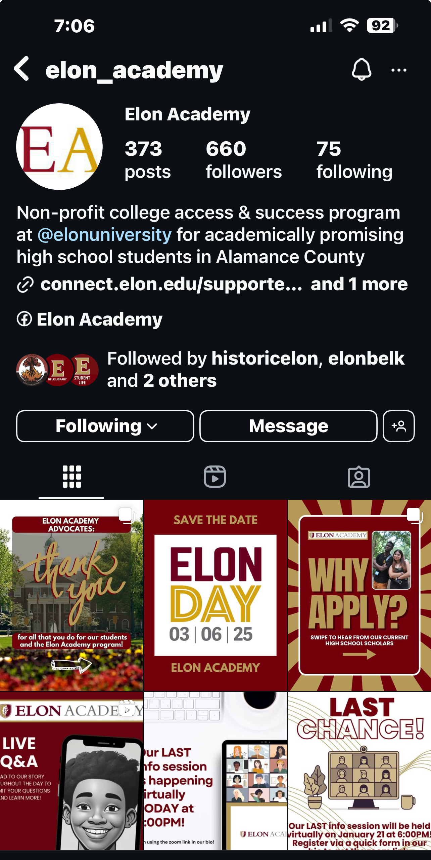
We need your help with social media!
Would you like to share your Elon Academy experience with others on social media?
Come connect with Emily today!
Don’t forget to engage with us on Instagram and Facebook, by liking, engaging with, and sharing our content!

Slide 3
As you come in today... Please help us thank a donor!
As you entered, you should have received a piece of paper and pen. Take a few moments to reflect upon the impact the Elon Academy has had on you (and your family). Please write a letter sharing your story and thanking a donor for the opportunities and experiences you have had by being an Elon Academy Scholar.

Slide 4
Alizah Williams: Appalachian State University, Campbell University, Catawba College, East Carolina University, Emory & Henry University, Guilford College, North Carolina A&T State University, North Carolina Central University, UNC Asheville, UNC Charlotte, UNC Greensboro, University of Memphis, UNC Pembroke, Wingate University, Western Carolina University, Winston-Salem State University Angela Diaz Cruz: Elon University, George Mason University, UNC Charlotte, UNC Greensboro, Western Carolina University
Anette Cruz: Appalachian State University, Campbell University, East Carolina University, Elon University, High Point University, North Carolina State University, UNC Chapel Hill, UNC Greensboro, UNC Wilmington, Rhodes College, Wingate University Arasi Mack: Appalachian State University, East Carolina University, Elizabeth City State University, North Carolina A&T State University, UNC Greensboro, UNC Pembroke, Washington College, Wingate University, Winston-Salem State University Ariel Jaklin: Campbell University, East Carolina University, Elon University, Ferrum College, Liberty University, Longwood University, North Carolina Central University, UNC Greensboro, Virginia Tech, Western Carolina University Ava Richardson: Bridgewater University, East Carolina University, Campbell University, Catawba College, Duquesne University, Guilford College, Hawaii Pacific University, Long Island University, Pfeiffer University, UNC Greensboro, UNC Pembroke, UNC Wilmington, University of Pittsburgh, Western Carolina University Berenice Sanchez: Appalachian State University, Elon University, North Carolina A&T State University, North Carolina State University, UNC Charlotte, UNC Greensboro, UNC Wilmington, Wingate University
Bryson Sellars: East Carolina University, Elon University, Guilford College, Greensboro College, North Carolina A&T State University, North Carolina Central University, UNC Charlotte, UNC Greensboro, UNC Pembroke, UNC Wilmington, Western Carolina University, Wingate University, Winston-Salem State University
A BIG CONGRATULATIONS TO OUR ELON ACADEMY SCHOLARS ON ALL OF YOUR COLLEGE ACCEPTANCES!!!
240+ ACCEPTANCES… AND COUNTING!

Slide 5
Our Next Saturday Program:
March 15, 2025 for ALL Scholars!
And RHO Families!

Slide 6
Don’t forget:
For Saturday programs, be sure to park at the Innovation Quad or Colonnades lots. Otherwise, there is a chance you could be ticketed or towed.
Check your Elon email 2-3 times a week
Let’s be sure to leave things better than we found it - places and people. We should always be mindful and respectful of others and the space(s) we are in.
To meet with your CAT Mentor at least once each month!

Slide 7
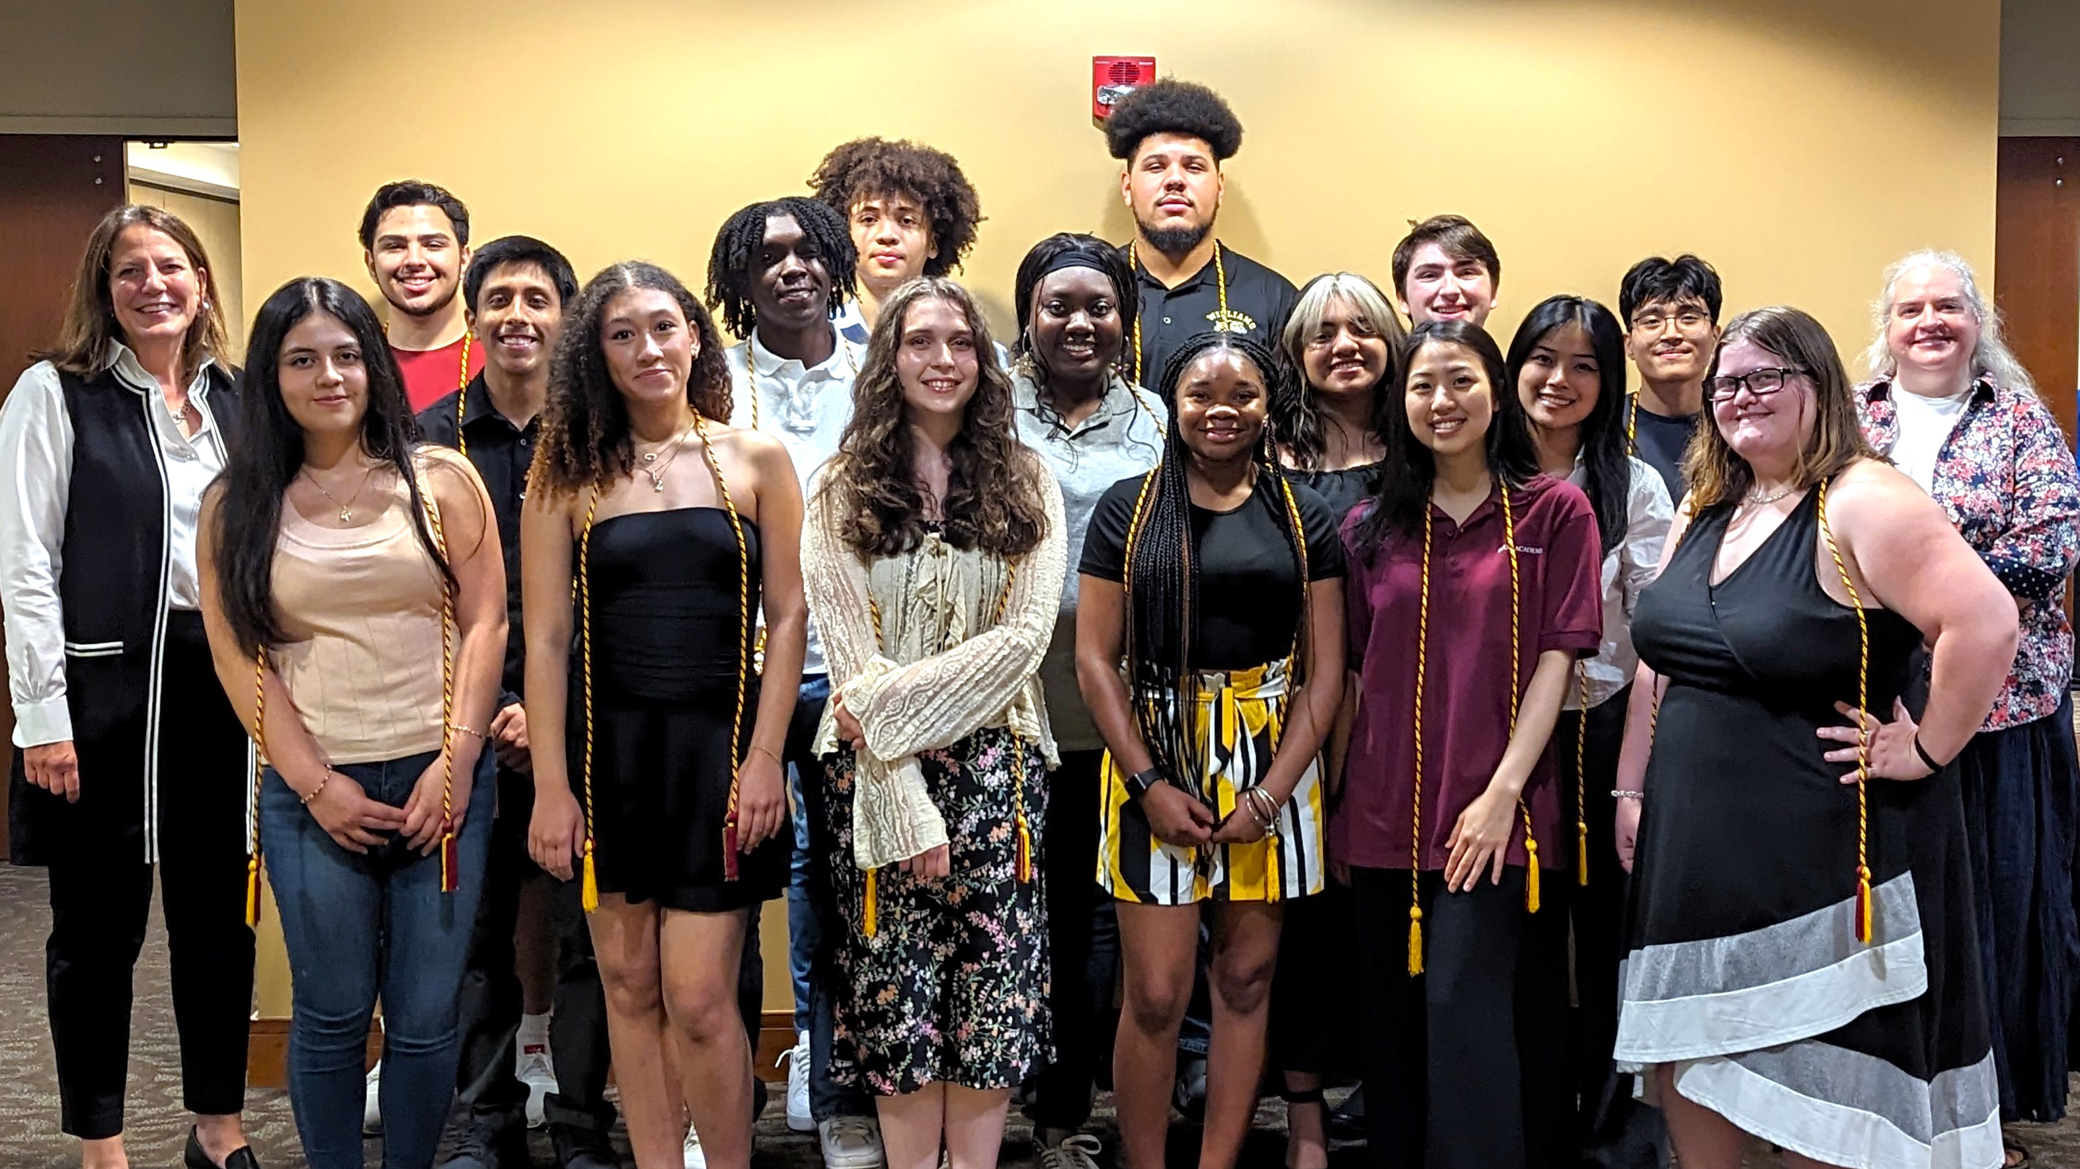
Rho’s President’s Reception
Wednesday, May 7
5:00 - 6:00pm
SAVE THE DATE!

Slide 8
Don’t forget you have access to Elon University resources & amenities!
Use your Phoenix Card on campus to:
Access the Belk Library and check out books, use resources, and more!
Access the Campus Recreation Center!
Act as a ticket to student activities, athletics, and cultural events on campus!

Slide 9
As you come in today... Please help us thank a donor!
As you entered, you should have received a piece of paper and pen. Take a few moments to reflect upon the impact the Elon Academy has had on you (and your family). Please write a letter sharing your story and thanking a donor for the opportunities and experiences you have had by being an Elon Academy Scholar.

Slide 10
Camila Benitez: Appalachian State University, Campbell University, East Carolina University, Elon University, ​Guilford College, UNC Charlotte, UNC Greensboro, Wingate University
Cayden Watkins: Appalachian State University, Campbell University, East Carolina University, Lenoir-Rhyne University, North Carolina Central University, Pfeiffer University, UNC Charlotte, UNC Greensboro, UNC Pembroke, Western Carolina University
Christian Garcia Leon: Appalachian State University, Campbell University, East Carolina University, UNC Greensboro, Wingate University
Christopher Mendez-Garcia: Campbell University, East Carolina University, Elon University, Guilford College, High Point University, New York Institute of Technology, North Carolina A&T State University, UNC Greensboro, UNC Pembroke, UNC Wilmington, Wingate University
Giselle Montes: Bowie State University, East Carolina University, Elizabeth City State University, Fayetteville State University, Florida Southern University, Long Island University, Louisiana State University, Montclair State University, North Carolina A&T State University, North Carolina Central University, Queens University of Charlotte, Rutgers University, SUNY Buffalo State University, Towson University, University of Arizona, University of North Texas, University of Tampa, University of West Georgia, Winston-Salem State University
Hector Perez Rodriguez: Appalachian State University, Campbell University, East Carolina University, Elizabeth City State University, Elon University, High Point University, North Carolina A&T State University, North Carolina State University, UNC Charlotte, UNC Greensboro, Western Carolina University, Wingate University
Jeriahel Wiley: UNC Pembroke, William Peace University, Wingate University
Jacob Navarrete-Perez: Elon University, Johnson & Wales University, Methodist University, North Carolina A&T State University, UNC Charlotte, UNC Greensboro, UNC Wilmington
A BIG CONGRATULATIONS TO OUR ELON ACADEMY SCHOLARS ON ALL OF YOUR COLLEGE ACCEPTANCES!!!
240+ ACCEPTANCES… AND COUNTING!

Slide 11
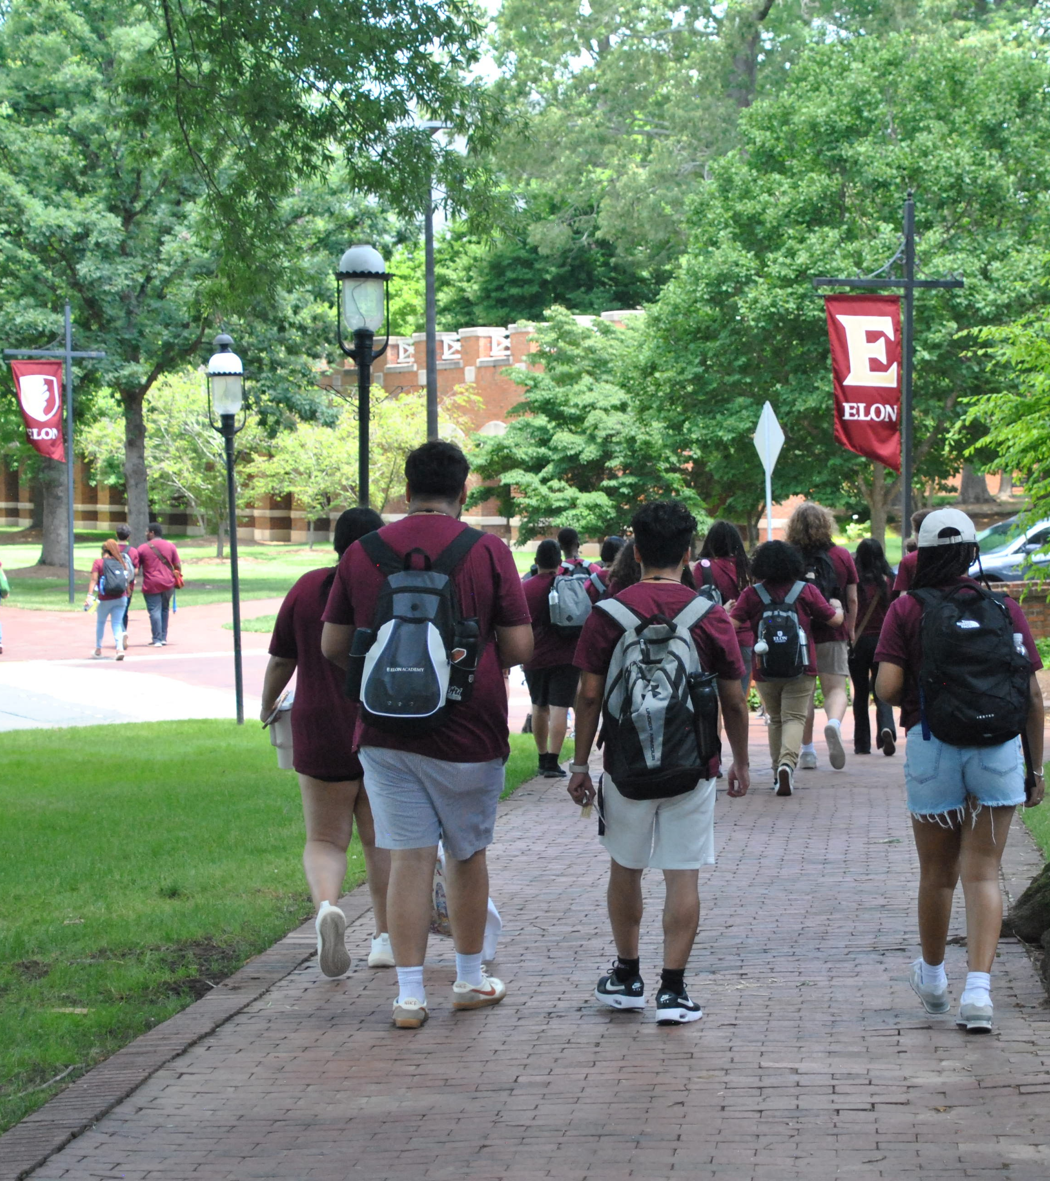
Upcoming Saturday Programs
March 15, 2025 = ALL SCHOLARS, Rho Families
April 12, 2025 = ALL SCHOLARS
*All important dates can be found on our website: www.elon.edu/elonacademy
**Be sure to arrive early and bring your Phoenix Card!

Slide 12
ACT & SAT Reminders:
SOPHOMORES:
Take the PSAT and/or Pre-ACT this year and send these to Coach Rob!
JUNIORS:
Take the SAT and ACT, and be sure to send your scores to Gaby as soon as possible!
Connect with your High School Guidance Counselor to learn more about fee waivers!

Slide 13
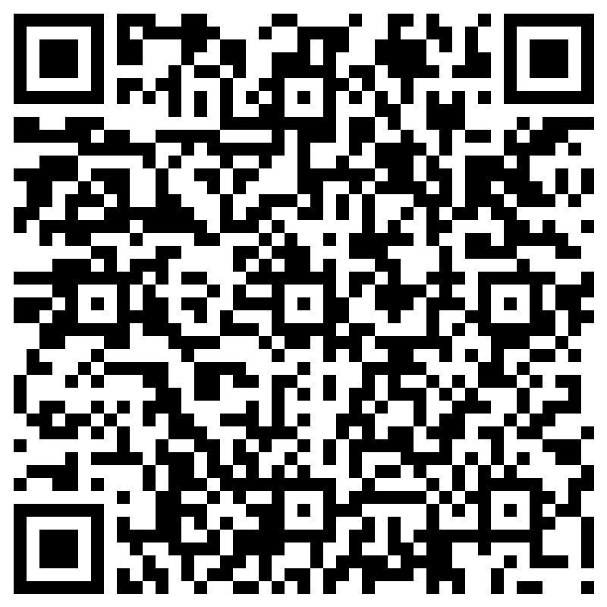
Think you might want an academic coach?
Remember – you can request an academic coach for any high school class you’d like support with and/or prep for the ACT and/or SAT!
Connect with Gaby (gvazquez3@elon.edu)
Last chance to request a coach:
March 15, 2025

Slide 14
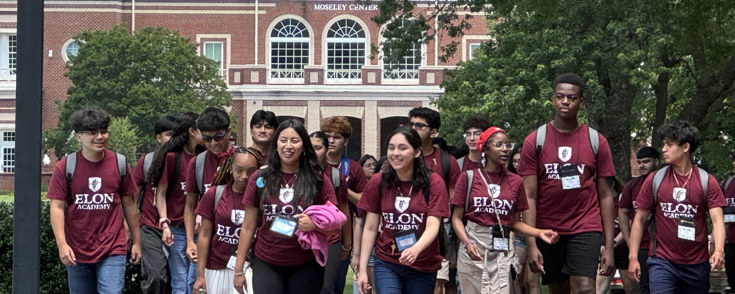
Summer Program
SAVE THE DATE!
June 15 – July 3

Slide 15
As you come in today... Please help us thank a donor!
As you entered, you should have received a piece of paper and pen. Take a few moments to reflect upon the impact the Elon Academy has had on you (and your family). Please write a letter sharing your story and thanking a donor for the opportunities and experiences you have had by being an Elon Academy Scholar.

Slide 16
Jason Leon: Appalachian State University, Methodist University, UNC Charlotte, UNC Greensboro, Wingate University
Kim Martinez: Appalachian State University, Elizabethtown College, James Madison University, North Carolina A&T State University, North Carolina State University, UNC Charlotte, UNC Greensboro, UNC Pembroke, Western Carolina University, Winston Salem State University
Kojo Jones: Truman University, UNC Charlotte, UNC Pembroke, Wingate University
Landon Blackburn: Hawaii Pacific University, UNC Pembroke, University of Alaska Fairbanks
Laney Danzeisen: Catawba College, College of Charleston, Texas A&M University, University of Alaska Fairbanks
Mareli Aureoles: East Carolina University, Elon University, Pfeiffer University, UNC Chapel Hill, UNC Greensboro, UNC Pembroke
Payton Wimbish: Elon University, North Carolina A&T State University, North Carolina Central University, Western Carolina University, UNC Asheville, UNC Charlotte, UNC Greensboro, UNC Pembroke
Noah Butler: Appalachian State, Coastal Carolina University, East Carolina University, New York Institute of Technology, UNC Charlotte
Ryan Jones: Champlain University, Rochester Institute of Technology, UNC Charlotte, UNC Pembroke, Western Carolina University
Vincente Pedreros Uribe: Elon University, UNC Charlotte, UNC Wilmington
Zainab Elizibair: East Carolina University, Howard University, New York Institute of Technology, North Carolina A&T State University, North Carolina State University, Truman State University, UNC Chapel Hill, UNC Charlotte, UNC Greensboro, University of Memphis
A BIG CONGRATULATIONS TO OUR ELON ACADEMY SCHOLARS ON ALL OF YOUR COLLEGE ACCEPTANCES!!!
240+ ACCEPTANCES… AND COUNTING!

Slide 18
Upcoming Opportunities at Elon!
CULTURAL & SOCIAL EVENTS
Blood Done Sign My Name
Tuesday, February 25th at 2:00pm 7:30pm
Carnaval Celebration
Wednesday, February 26th at 5:30pm
A Space Odyssey
Wednesday, February 26th at 7pm
The Wonder of Wetlands-Stories from the Field
Thursday, February 27th at 7:30pm
The Wild Robot
Friday, February 28 at 8pm, Saturday, March 1 at 8pm and 10:30pm
The Color Purple (& Q&A with Actress Phylicia Pearl Mpasi)
Tuesday, March 4 at 7pm
ELON DAY!
Thursday, March 6 ALL DAY!
Emanation - Spring Dance Concert
Friday, March 7th at 7:30pm, Saturday, March 8th at 2:00pm, 7:30pm, Sunday, March 9th at 2:00pm
Megamind
Friday, March 7 at 10:30pm, Saturday, March 8 at 8pm and 10:30pm
U.S. Navy Band 2025 National Tour
Wednesday , March 12th at 7:30pm
Harness a Breakthrough Mindset
Thursday, March 13th at 7:00pm
ATHLETIC EVENTS
Women’s Basketball:
VS Drexel University Sunday, February 23 at 1pm
VS North Carolina A&T State University, March 2nd at 1pm
Softball:
VS Sacred Heart on Saturday, March 1 at 11am
VS UNCG on Saturday, March 1 at 1:30pm and Sunday, March 2 at 4pm
VS Hofstra on Friday, March 7 at 4:30pm, Saturday March 8 at 2 pm, and Sunday March 9 at 12 pm
Baseball:
VS Binghamton on Sunday, February 23 at 1pm
VS Brown on Friday, February 28 at 4pm, Saturday, March 1 at 2pm, and Saturday, March 2 at 1pm
VS Charleston Southern on Friday March 7 at 4pm, Saturday March 8 at 2pm, and Sunday March 9 at 1pm
VS Radford on Tuesday, March 11 at 4pm
VS Wofford on Friday, March 14 at 4pm
Women's Lacrosse:
VS Norte Dame on Sunday March 2nd at 11am
Women's & Men's Tennis:
VS Ferman on Sunday, February 23 at 1pm
VS South Carolina State, Saturday March 1 at 1:30pm
VS Bucknell on Tuesday, March 11th at 2pm
VS LIU on Wednesday, March 12th 2pm

