Slide 1
Welcome!
Sit with your CAT Mentor!

Slide 2
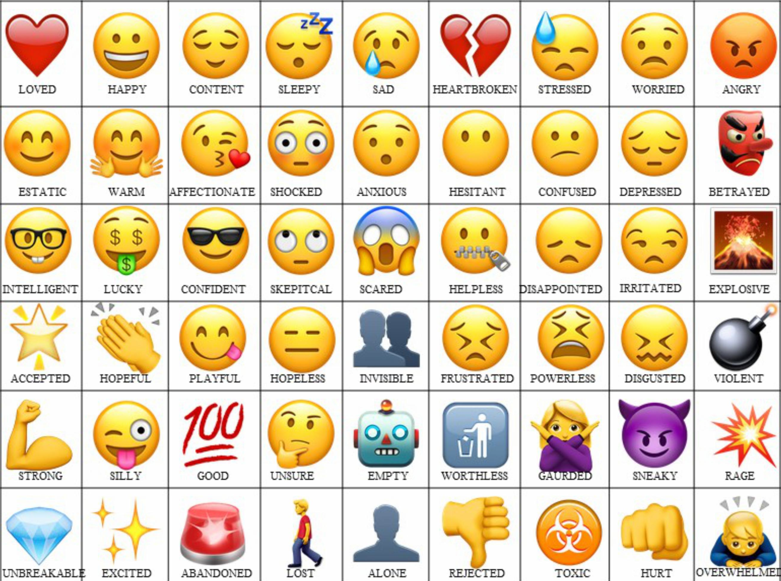
ICEBREAKER
How are you feeling? What emotion represents you and why?

Slide 3
Today’s Agenda
Interviews Pt. 2
Break
SMART Goals
Break
EA CAT Mentor Panel

Slide 4
Expectations
Notes:
Expectations (15-20 minutes) (9:35-9:50):
Re-enforcing communication expectation
Communication could be better
Lack of responses from my emails
I have no idea how to move forward with you all if I don’t have any sort of updates form you all
If you’re not getting my emails, you should be checking your spam just in case

Slide 5
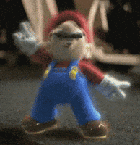
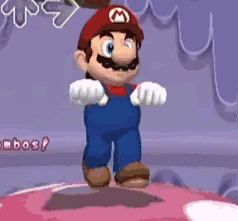
“To show me you have read this email, please send me your funniest meme picture or a general picture that describes how you feel currently! I will be showing these at the next Saturday program!”
-Manny
How many scholars?
How many did their first 1-on-1?
How many responded to my prompt?
27 Rhos!
20 Rhos!
5 Rhos.
Notes:
Bringing up the amount of responses I received from my big reminder e-mail

Slide 6
Download Microsoft Teams!
Go to your App Store
Search for “Microsoft Teams”
Look for the app that looks like this icon on the left
Download and login using your Elon account
Look for my message!
Notes:
To ensure our communication is much better, TEAMS
This will be the way I will be reaching out to you for now, make sure you download the app
Required
Will give time for everyone to download the app and login
Please keep checking your email and Teams for updates
Need to show me you’ve downloaded the app and are logged in before you leave today

Slide 7
Any Questions?

Slide 8
Interviews
Part 2

Slide 9
Tips and Suggestions
Greet with Confidence!
Listen Carefully, Pause Before Answering!
Positive Body Language!
Firm handshake
Greet the interviewer
Process each question
Ask for clarification
Eye contact
Sit up straight
Show Enthusiasm!
End on a Strong Note!
Speak Clearly and Keep Answers Concise!
Thank the interviewer
Ask thoughtful questions
Direct answers
STAR Method
Express passion
“I’m excited about…”, “I’m looking forward to…”
Notes:
Greet with confidence!
Always give a good firm handshake, should opportunity present itself
Don’t give a sad one ☹
Make sure to greet the interviewer
Listen Carefully
Allow yourself to process each question
Don’t just say something to say something
If you don’t understand a question, ask for clarification
Could use as an opportunity to get more time to think
Positive body language
Maintain good eye contact with your interviewer
Don’t wander off and look at other places
Maintain good posture, sit up straight
No slouching
Shows confidence as well
Speak Clearly
Make sure you answer the question
Don’t overexplain yourself but don’t undersell yourself either
Have a good balance
STAR Method
Situation:
Task:
Action:
Response:
Show enthusiasm
Express you passion in the opportunity
Show that you want to be there
Use statements such as “I’m excited about…” or “I’m looking forward to…”
End on a Strong Note
If the opportunity presents itself, thank your interviewer for their time
Leaves a good message and a good feeling for the interviewer
Always ask very thoughtful questions
Have a minimum of three prepared!

Slide 10
Example Interview

Slide 11
Your Turn!
Notes:
CAT Mentors will take their scholars anywhere they want around KOBC to practice interviews
Like last time, I will have a list of questions prepared for CAT mentors to ask scholars
Scholars and mentors will have the opportunity to ask questions to interviewee
If scholars ask what they are interviewing for, these are the options:
A scholarship aimed for low-income students
A scholarship aimed for first-generation students
A scholarship for a prestigious program at x university
A job of their choice?
Depending on time and scholars, allocate x minutes for each scholar and then x minutes for feedback for each scholar
Once completed, everyone return to room to go over some discussion questions about the experience

Slide 12
Discussion
Notes:
How was the experience?
What did you do well? What could you have done better?
What questions were difficult? Why?
How did you handle those difficult questions?
What is an area of focus that you should focus on to prepare for interviews?

Slide 13
Break Time
Login to a computer in Room 201 and then take a 10 minute break!

Slide 14
SMART Goals and Virtual Vision Board
Notes:
We’re going to talk about SMART goals and do a little activity!

Slide 15
What are SMART Goals?
Notes:
So what are SMART goals? Can anyone tell me?
Have a little discussion
Simply put, a SMART goal is a guided goal to your desired outcome, it helps you think of your goals at a deeper level!
Rather than your simple goals like “I want to get a scholarship” or “I want to get good grades,” SMART goals allow you to think about
Going through the process allows you to create a goal that you can EFFECTIVELY work towards!
SMART is an acronym for different aspects that create that SMART goal

Slide 16
SMART Goals
Specific
Achievable
Time-Based
Measurable
Relevant
Notes:
SMART Goals:
Specific:
What are you going to accomplish?
You want to go as defined as possible
Rather than making your goal surface level (I want to learn to swim or I want to learn how to drive), you go into the details as much as you possibly can
Is it vague? Make your goals as clear and concise as possible
Measurable:
How will you measuring your success? What does progress look like?
There has to be a way you’re keeping track of your success and improvements
Achievable:
Can you actually get it done?
How can your goal be accomplished? What steps will you be taking to get where you need to be?
You have set yourself very realistic expectations
Don’t set low expectations either, give yourself a challenge
Can you and will you finish?
Relevant:
Does the goal make sense to your current situation?
How does it help you in the long term?
Don’t make a goal just to make a goal, it should some logical sense
Is it the right time for your goal?
Time-based:
Give yourself a deadline to achieve this goal
When will you get this goal done?
It gives you a clear picture of when to get this goal done
Could also help with procrastination

Slide 17
Example
Goal: I want to do better in school.
Specific: I want to raise my math grade.
Measurable: I want to raise my math grade from a B to an A.
Achievable: I want to raise my math grade from a B to an A by studying 1 hour daily and seeking tutoring twice a week.
Relevant: I want to raise my math grade from a B to an A by studying 1 hour daily and seeking tutoring twice a week, since I need an A to move to the next math level.
Time-based: I want to raise my math grade from a B to an A by studying 1 hour daily for the next 6 weeks and seeking tutoring twice a week.
Goal:
I will raise my math grade from a B to an A by studying 1 hour daily for the next 6 weeks and seeking tutoring twice a week.
Notes:
Let’s make this goal more specific
Now how will we measure that, by showing that our grade has risen from a B to an A
How will we go about achieving that grade? We’ll study 1 hour daily and seek tutoring twice a week, this is how we’ll be going from the B to the A
Is it relevant to my situation? Well no, not really, I’m not in school right now, but lets assume that I need an A to move to that next math level, therefore it’s relevant to my work
How much time am I going to give myself? Let’s get this all done in say… 6 weeks, I think that’s reasonable
BAM, SMART goal
Does that make sense?

Slide 18
Virtual Vision Boards
Create two SMART goals, one short-term and one long-term using the template given
Using one of your SMART goals, create a vision board showing how you picture this goal
Use any resources you’d like, we will present at the end (time-pertmitting)!

Slide 19
Break Time
Take a 10 minute break and return to room 200!

Slide 20
Elon Academy CAT Mentor Panel
Notes:
Now we will do our Elon Academy CAT Mentor
Opportunity to learn about their college process and experiences
I will give guided questions to kind of start the conversation and at the end give you all time to ask questions as well!
Sounds good?

Slide 21
Introduce Yourself!
Name
Year
Major
A quick fun fact about yourself!

Slide 22
Why did you choose Elon?

Slide 23
How did you choose your major, and did your decision change over time?

Slide 24
What was the biggest adjustment you faced when starting college?

Slide 25
How did you find or build a sense of community on campus?

Slide 26
How do you balance coursework, extracurriculars, and social life?

Slide 27
Have you done internships, research, or study abroad? How did those experiences shape your goals?

Slide 28
Have you ever faced imposter syndrome or self-doubt? How did you work through it?

Slide 29
What role do support systems (friends, family, professors) play in your well-being?

Slide 30
What are some common mistakes students make in college, and how can they avoid them?

Slide 31
How do you define success in college beyond just grades and achievements?

Slide 32
How has networking and building connections helped you during college?

Slide 33
If you could go back and give your freshman self one piece of advice, what would it be?

Slide 34
OPEN Q&A!

