Slide 1
Elon Academy Morning Meeting
Saturday September 23, 2023
Notes:
John will start MM

Slide 2
Please park in the Innovation Quad Parking lot today

Slide 3
Future Saturday Programs
14 Oct.
scholars-only
4 Nov.
scholars & families
16 Dec.
scholars-only
20 Jan.
scholars-only
17 Feb.
all scholars & Rho/Sigma families
16 Mar.
all scholars & Pi families
13 Apr.
all scholars & Rho/Sigma families

Slide 4
CAT Mentors
CAT mentoring has started
Scholars required to meet with CAT mentors three times each semester.
Scholars should check their email every 2-3 days

Slide 5
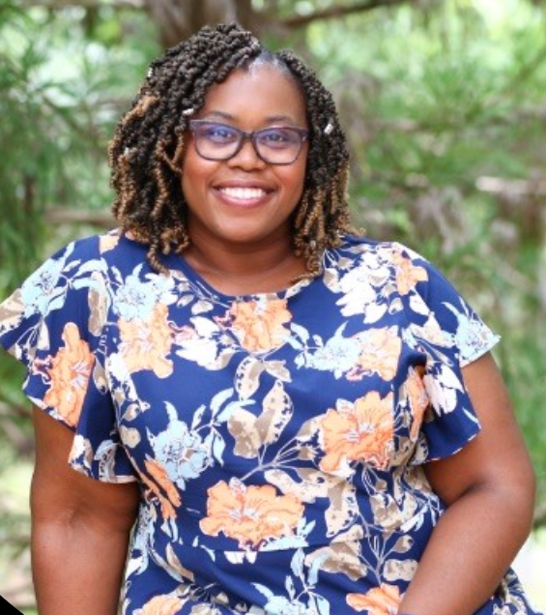
Mrs. Jenni Johnson

Slide 6
Academic Coaching and SAT Prep
Academic Coaching
Request an academic coach in any class that you’d like personalized practice in. To request, email Ms. W-K at ewinterichknox@elon.edu and include 1) what class you are requesting, 2) your teacher’s name, and 3) your general availability after school.
The deadline to request an Academic Coach is Monday, October 30th
SAT Prep
Reminder for SAT preppers! We will be doing a practice SAT test after next Saturday program, October 14th from 1-4pm with lunch before. Keep an eye on your email with more information coming from Ms. W-K before then.
Those signed up are: Ryan, Zainab, Alizah, Payton, Arasi, Kimberly, Camila, Anette, Mareli, Hector, Laney, Jacob, Berenice, Angela

Slide 7
Tau Class Recruitment
Would you be interested in sharing about your experience as an EA scholar to prospective 9th grade applicants? Email Ms. W-K at ewinterichknox@elon.edu if so!
Information Sessions:
Cummings – Thurs, Oct. 19 5pm-6pm
Dream Center (both English AND Spanish) – Nov 6, 6-7pm
Southern Alamance– Wed, Nov 15 7-8pm
Williams – Thurs, Nov 16, 6-7pm

Slide 8
Your Phoenix Card
Acts as your TICKET to student activities, concerts, athletic events, and cultural events on campus
Some events require advance ticketing
Use facilities at Campus Recreation
Access to Belk Library and ability check out books/media equipment
Phoenix Card is not a door key outside of the Summer Program
Turner Theater
Sunday, 3PM & 7PM, Paddington
Upcoming:
September 28th: 7pm, Woman at War
October 1st: Monster House 3pm, 7pm
www.turnertheatre.com/ for more listings

Slide 9
PSAT & PACT
All sophomores should take the PSAT & PACT
All juniors should re-take the PSAT
Please reach out to Mr. Pickett if you are not signed up

Slide 10
Important Dates! (will also be on our website)
President’s Reception for Pi Scholars
May 8th
2024 Summer Program
June 9th-28th
Transitions to College Retreat for Pi Scholars
July 26th-28th

Slide 11
Today
Pis will stay in 101
Rhos will meet in room 354
Sigmas will meet in Sankey 116
Pi Families stay in 101
Rho Families in 242
Sigma Families 310

Slide 12
REMIND text service
To join Remind as an:
EA Scholar: Text @elon2023 to 81010
English speaking parent: Text @ElonEng to 81010
Spanish speaking parent: Text @ElonEsp to 81010

Slide 13
Davidson College Scholarship
John M. Belk Scholarship
Elon Academy can nominate scholars for this!
Full scholarship at Davidson
Recognizes powerful students with demonstrated academic excellence, integrity, intellectual curiosity, willingness to take risks, and potential to be change agents in both their local and global communities
If interested in being a nominee please email Mr. Pickett by 10/15/23

Slide 14
College Acceptances! Nats- Campbell University

Slide 15
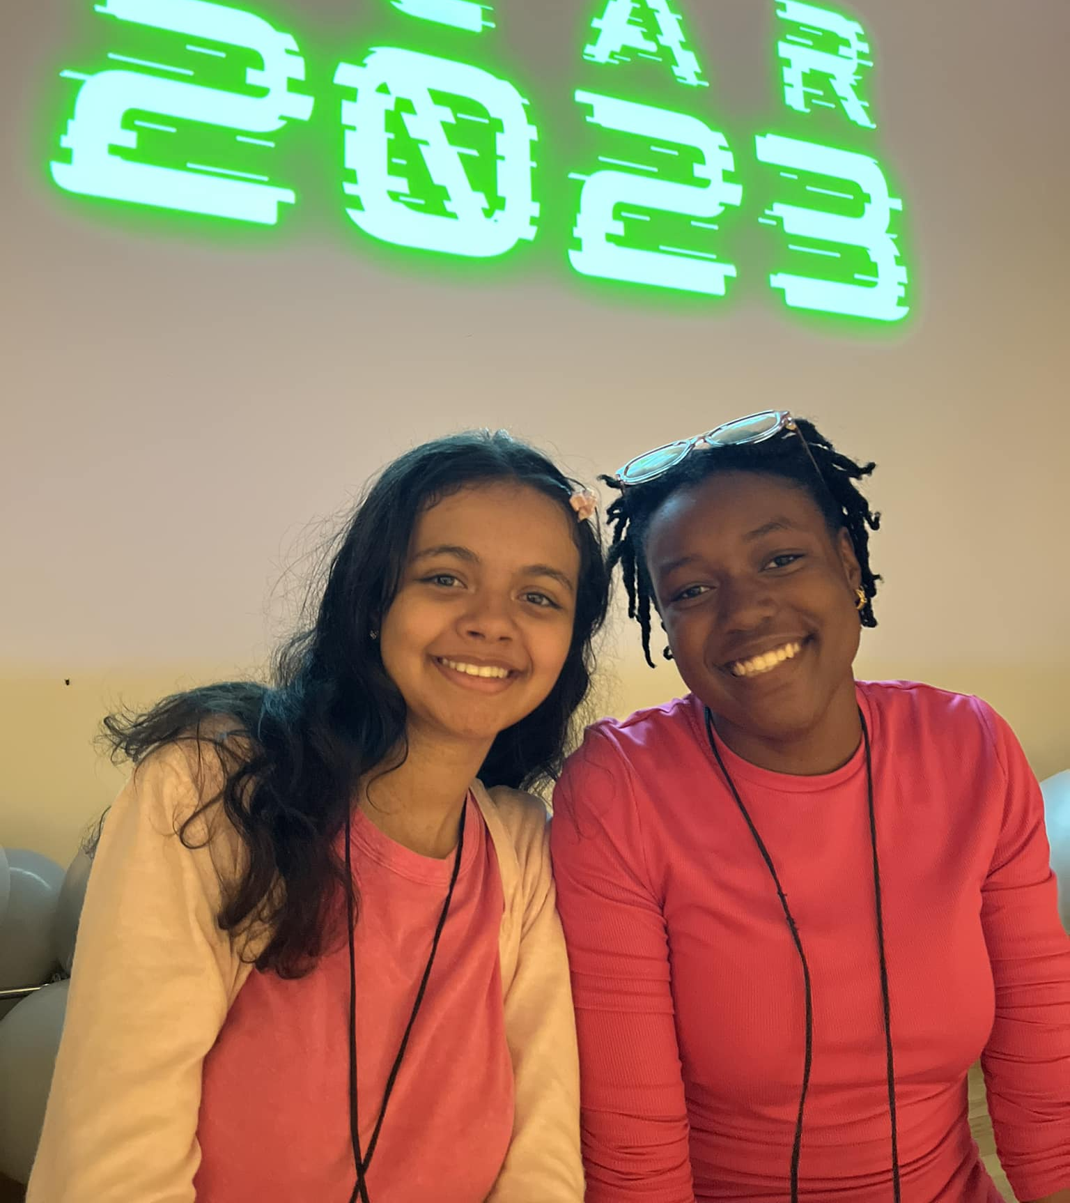
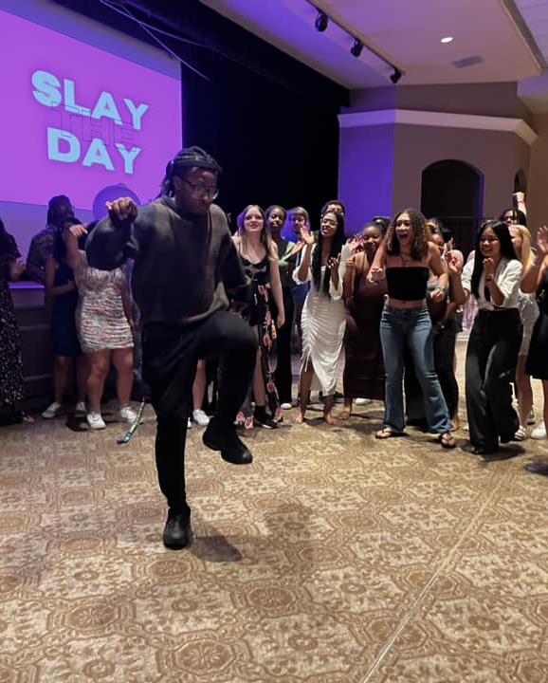
Have a GREAT day!!
Dismissal…
*Please return any headphones…
…unless you are a Pi family
Sigma CAT Mentors to 310
Rho CAT Mentors to 242
Senior CAT Mentors stay in 101
Rho (Junior) Families to 242
Sigma (Sophomore) Families to 310
Rho Scholars to 354
Sigma Scholars to Sankey 116
Pis & families stay in 101

