Slide 1
Navigating Financial Aid
September Saturday Program

Slide 2
Today’s Agenda
What is Financial Aid?
Types of Aid
How Do I Apply for Aid?
FAFSA
CSS/Financial Profile
Institutional Aid Forms

Slide 3
Financial Aid Quick Facts
Financial Aid- money to help pay for college
4 types of financial aid: Scholarships, Grants, Loans, Work-Study
4 sources for financial aid: Federal, State, Institutions, Private Sources
2 categories of aid: need-based vs. non-need based
Notes:
Eligibility for aid: be a US citizen or permanent resident
HS graduate or have earned GED
Be enrolled in a degree program
Valid SSN
Meet satisfactory academic progress once enrolled
Money has to be used for educational purposes

Slide 4
Types of Aid: SCHOLARSHIPS
Merit-based vs. need-based
Institutional Scholarships (ex: Odyssey Scholarship, Bonner Scholarship Program, Honors Program, etc.)
check prospective institutions' websites ASAP!
Private or Outside Scholarships
Notes:
Some scholarships needs to be repaid- refer to teach grant
Merit-based: need is not considered; talent-based, sports-based, academic-based
Private Scholarships: not associated with a university, but maybe with a private corporation: Gates, Coca-Cola Scholarship, Elks Foundation, etc.
Be sure to ask if any scholarship you receive is renewable!

Slide 5
Types of Aid: GRANTS
Grants don't need to be repaid.
4 important grants:
Pell Grant (up to $7,395/yr; eligible for up to12 semesters)
TEACH Grant (up to $4,000/yr; required to serve)
Iraq and Afghanistan Service Grant (up to $7,395)
Federal Supplemental Educational Opportunity Grant ($100-$4,000)
Notes:
Submit the FAFSA to “apply” for all of these grants!
Pell Grant- not first-come, first-serve
TEACH Grant- agree to teach in a high-need field at a low-income school; teach for 4 years
Iraq and Afghanistan Service Grant- only qualify if you’ve had a parent die or guardian die in Iraq or Afghanistan after 9/11
FSEOG- not offered at every school; awarded first-come first-serve, maximum amount varies by school

Slide 6
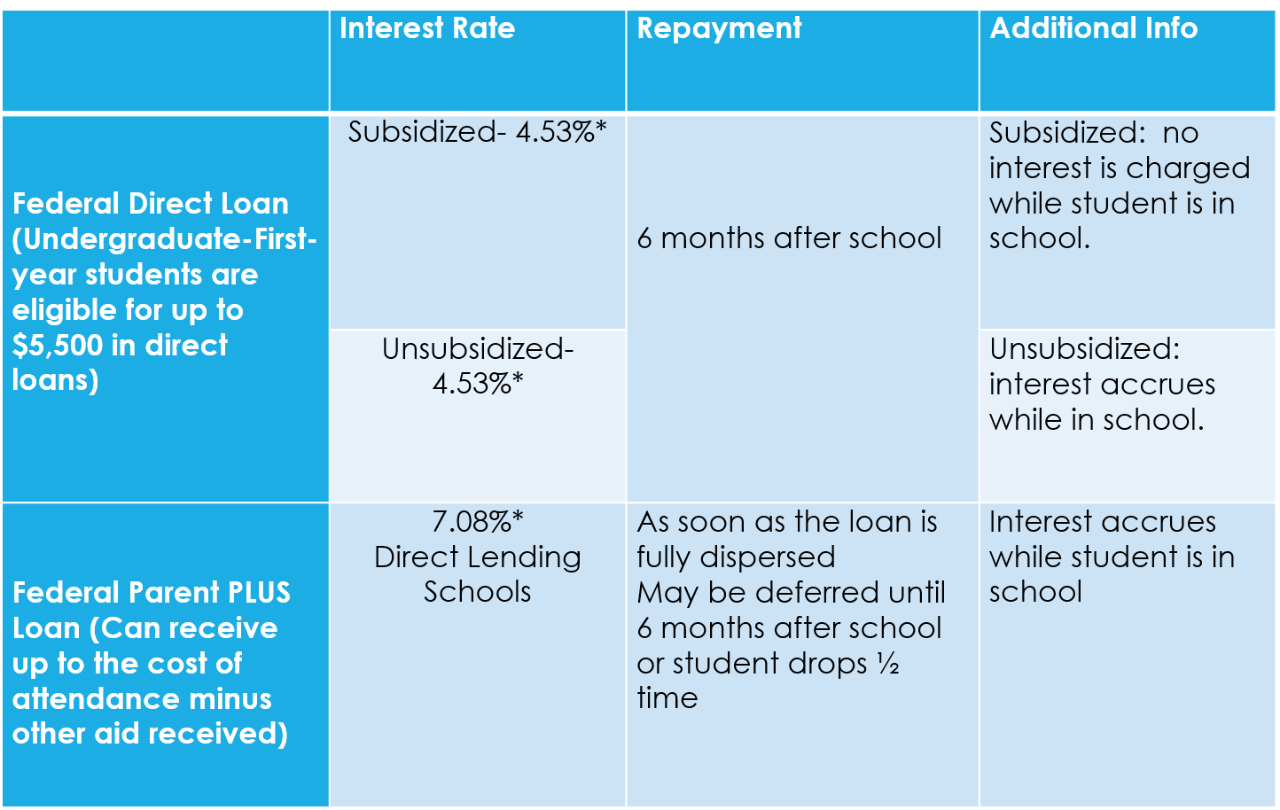
Types of Aid: LOANS You must repay loans
5.50%
5.50%
8.05%
*Interest rates are adjusted annually. Taken from studentaid.gov and NCAN
Notes:
Must complete the FAFSA to be eligible to receive any of these loans. We’re only talking about undergraduate first-year. Totals/availability are different for graduate school
Loans have to be repaid, but not until a student graduates or they drop below ½ time enrollment
Subsidized: based on need. Government pays interest while you’re in college; no more than $3,500 for first year dependent students
Unsubsidized: interest accrues as soon as the loan disburses to the school; $2000 for dependent students
Parent PLUS loans are credit-based and the parent applies. It is the parent’s loan to pay back, not the student’s. If the parent applies for the PLUS loan and is denied then the student is eligible for up to $4,000 more in unsubsidized loans
Private loans- your personal bank, discover, etc. LAST resort (or never resort)→terms aren’t as generous
Forgivable Education Loans for Service (FELS)

Slide 7
NC Assist Loan: New Alternative Loan!
CFNC offers to students and parents
Available AFTER you have maxed out on federal loans
Minimum: $1,000; Maximum: Cost of Attendance minus all other aid
Repayment
6-month grace period
Parents: no deferment option
Must be a US citizen or eligible non-citizen
Credit-based application
Co-signer?
https://ncassist.cfnc.org/ncassistInfo/infoHome
Notes:
NC Assist Loans-
new alternative loan (for students and parents) available to NC residents (can use at out-of-state schools) and out-of-state students attending NC schools
No application or origination fees
Borrow as little as $1,000 or as much as you need
Available if student has already maxed out on direct loans
Interest rates are lower than PLUS loans, but higher than direct loans
Parents immediately go into repayment (no deferment)

Slide 8
Types of Aid: WORK-STUDY
Part-time jobs for undergraduate students with financial need
On or off-campus jobs
Not all institutions participate in the Federal Work-Study Program
Is not usually applied directly to your bill!
Notes:
Money can be used to pay education expense
Employers like work-study students because they don’t have to pay the students out of their own pockets
Check with your institution to see if that money is applied to your bill

Slide 9
How Do I Apply for Aid
FAFSA
CSS Profile
Institutional Forms
Notes:
eligibility

Slide 10
FAFSA: FREE Application for Federal Student Aid
Used to get all sources of federal financial aid
Must be completed every year
Available this year in December
Information is used by universities to create a financial aid award
www.studentaid.gov or myStudentaid app on Google Play/App store

Slide 11
FAFSA- what documents are required to start the process?
Social Security Number (parents and student)(What if you don’t have a social security card?)
2022 W-2 Forms (parents and student)
2022 Federal Income Tax Returns (parents and students)
2022 Untaxed income records (veterans noneducation benefit records, child support, worker’s compensation)
Current bank statements (parents and students)
Any business and personal investments
Your alien registration or permanent resident card (if you are not a U.S. citizen)
Notes:
-all these forms (minus the bank statement) are the ones from the previous year
-untaxed income= do not include extended foster care benefits, student aid, earned income credit, additional child tax credit, welfare payments, untaxed Social Security benefits, Supplemental Security, Income,
-Your current business and investment mortgage information, business and farm records, stock, bond and other investment records (home mortgage doesn’t count)

Slide 12
FAFSA- Student Onboarding
When the student starts the 2024–25 FAFSA form for the first time, they are taken through the FAFSA onboarding process. The first onboarding page provides an overview of the FAFSA form and an accompanying video.
The second onboarding page explains Contributors to the FAFSA
The third onboarding page provides information about the types of questions the student can expect to see and how they can get additional help with filling out the FAFSA form.
The last onboarding page provides information about what to expect once the FAFSA form is completed and submitted.

Slide 13
FAFSA- How does the application work?
Both Students and Parents must have an FSA ID to login and sign the forms electronically
Responses are entered into a formula
Result is your Student Aid Index (SAI) sent in FAFSA Submission Summary (FSS)
You should receive a FSS three to five days after submitting the FAFSA
Financial need is determined by subtracting SAI from COA
You may be chosen for verification
You MUST provide consent on the FAFSA to be eligible for aid
Notes:
-you have the choice of where to send the FAFSA (up to 20 schools); send to all schools your son or daughter applied to (work up of the financial aid package)
Please create an FSA ID now!! (Definitely before meeting with me; if you CAN create an FSA ID if you don’t have an SSN)
-SAI will tell the college how much aid, Pell Grant status, college work study- IMP! Goes through the school not the Federal Government directly
We’ll talk more about what happens next, including interpreting award letters, at our November program.
-SAI is not what your parents are actually expected to contribute! Explain formula
FSS- contains SAI, any problems Dept. of Ed. Encountered while processing, next steps, if selected for verification, grad & transfer rates for each school on your list.
Made a mistake? No big deal. Make changes online!
IRS Direct Data Exchange- file electronically! If you are married and file separately both parents will need to log into FAFSA to complete their financial info. (can’t use if you don’t have a valid SSN)

Slide 14
FAFSA- Providing Consent
By providing consent, the student’s federal tax information is transferred directly into the FAFSA from the IRS to help complete the Student Financials section. The student selects "Approve" to provide consent
By providing consent, the parent’s federal tax information is transferred directly into the FAFSA from the IRS to help complete the Parent Financials section. The parent selects "Approve" to provide consent
If either student or parent refuses to provide consent the student will be ineligible for federal student aid

Slide 15
FAFSA- Dependent vs. Independent Status
As of today are you married?
When the 2024-25 school year begins, what will be your college grade level? (first year (freshman), second year, etc.)
Are you currently serving on active duty in the U.S. Armed Forces for purposes other than training?
Are you a veteran of the U.S. Armed Forces?
Do you have children or other people who will receive more than half of their support from you between July 1, 2022 and June 30, 2023?
At any time since you turned age 13, were you:
An orphan (both parents deceased)
A ward of the court
In foster care
Notes:
If you answer no to all of these questions then you are required to submit a parent’s financial information on the FAFSA. If you answer yes to any of these then generally you will be considered an independent student and will not need to submit parent information. Additional information may be requested to confirm your status as independent.

Slide 16
FAFSA- Dependent vs. Independent Status
As determined by a court in your state of legal residence, are you or were you an emancipated minor?
As determined by a court in your state of legal residence, are you or were you in legal guardianship?
At any time on or after July 1, 2023, were you unaccompanied and either homeless or self-supporting and at risk of being homeless?
Do unusual circumstances prevent the student from contacting their parents or would contacting their parents pose a risk to the student?
Notes:
If your parents are unmarried and live together then you would report both of their incomes.
If your parents are unmarried (whether never married or divorced) you report the income and information of the parent that will provide more than 50% of your financial support. If both parents contribute equally, pick one.

Slide 17
Whose Information Goes on the FAFSA??
If your parents (biological or adoptive) are married then information for both parents is reported
If your parents are unmarried and live together then information for both parents is reported
If your parents are unmarried and don’t live together (whether never married/divorced/separated) the information of the parent that will provide more than 50% of your financial support is reported regardless of which parent the student lives with.
If your parent is remarried you must include stepparent info!
Notes:
If your parents are unmarried and live together then you would report both of their incomes.
If your parents are unmarried (whether never married or divorced) you report the income and information of the parent that will provide more than 50% of your financial support. If both parents contribute equally, pick one.

Slide 18
Invite Parent to FAFSA Form
The student is asked to enter personal information about their parents in order to send them an invite to their FAFSA
Parent will receive an email invitation to log into the FAFSA and complete the parent section of the FAFSA
Parent must have an FSA ID
Parent must provide consent

Slide 19
FAFSA- Helpful Tips
File taxes on time and online so you can use the IRS Direct Data Exchange
ENTER ITEMS VERY CAREFULLY!
Apply for the correct FAFSA year (2024-2025).
Apply early (recommendation: CHECK THE DEADLINES FOR PROSPECTIVE SCHOOLS)
Verify that the FAFSA has been submitted
Do not disregard any emails or letters pertaining to the FAFSA
Contact the school in a letter or by phone about other family circumstances impacting your financial status
Keep track of your FSA ID! And keep it private!
Notes:
State and school deadlines vary; need time to allow for PIN (I have a list of priority dates that I will email to all scholars and any interested parents)
-filing taxes electronically saves time and some headaches
-call about things that might not appear in a SAI calculation (medical expenses etc)

Slide 20
CSS Profile
College Scholarship Service (CSS) Profile is administered by the College Board (Most schools require you to only complete it once, but there are a few schools who may require it each year ).
Why do colleges and universities use it?
Who uses the CSS Profile?
Costs associated with the CSS Profile
The process to complete the CSS Profile
Noncustodial Parent PROFILE
Notes:
NC institutions: Duke, Davidson, Wake, UNC-CH- Elon NO LONGER uses CSS Profile
Why they use it:
It goes into much more detail than the FAFSA- Previous year’s taxes, projection of next year’s information. Your current business and investment mortgage information, business and farm records, stock, bond and other investment records, home mortgage info
Who uses it:
Cost
$25 for the first school, $16 for each additional school
Fee waivers for up to 8 schools granted if you used an SAT waiver or income reported is $45,500 for a family of four
Completion process: registration, complete the application, submit the application
Noncustodial Parent PROFILE- req’d by duke, Davidson, and Wake Forest!

Slide 21
Institutional Aid Forms
Why do some colleges have their own forms?
How to locate them
Notes:
Many colleges have their own financial aid forms that applicants either must, or should, fill out.
Use it to determine who qualifies for special college scholarships.
For example, a college that requires all students to have a computer might use its own form to determine which students need assistance in funding the computer.
How to locate them
Contact your financial aid office to find out if there are institutional forms required or if you only have to submit the FAFSA (and CSS Profile)
Check the financial aid websites for instructions how to apply

Slide 22
Things to do for the Spring
Save money for college expenses
Deposits
College Needs
Apply for more scholarships
Scholarship Websites
Scholarship Scams
Pay attention to all emails and mail from prospective colleges and universities (check your spam folder!)
Visit top prospective colleges and universities
Select the school you will attend by May 1st and give a deposit
Housing, Classes, Orientation
Notes:
Verification for December! Non-Negotiable: Complete the FAFSA and other required financial aid documents and forward me the confirmation by March 1!
Deposits- sometimes they will add your deposit to your fall bill.

Slide 23
Helpful Resources
http://studentaid.ed.gov/
http://www.finaid.org/
http://www.cfnc.org
Federal Student Aid Info Center: 1-800-433-3243
M-F, 8am-11pm; Sat/Sun, 11am-5pm
CSS Profile: 844-202-0524
M-F, 9am-6pm

