Slide 1
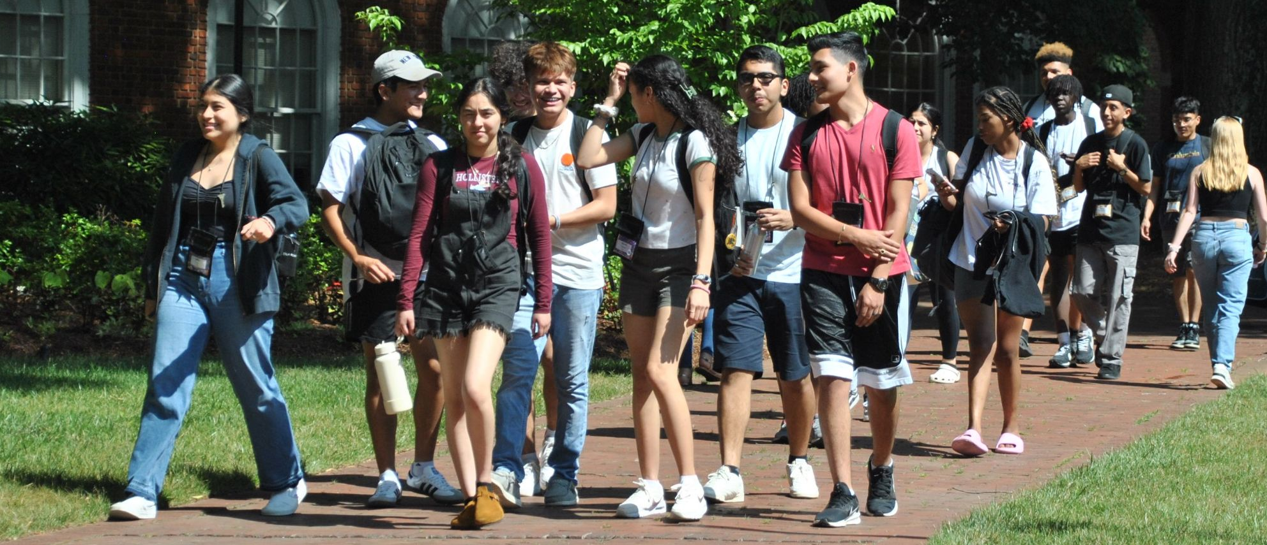
ELON ACADEMY
Morning Meeting
Saturday, February 17, 2024!

Slide 2
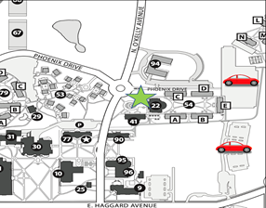
REMEMBER:
Please
park in the Innovation Quad Parking lot

Slide 3
Future Saturday Programs!
16 Mar.
all scholars
& Rho/Sigma families
all scholars
& Pi families
13 Apr.

Slide 4
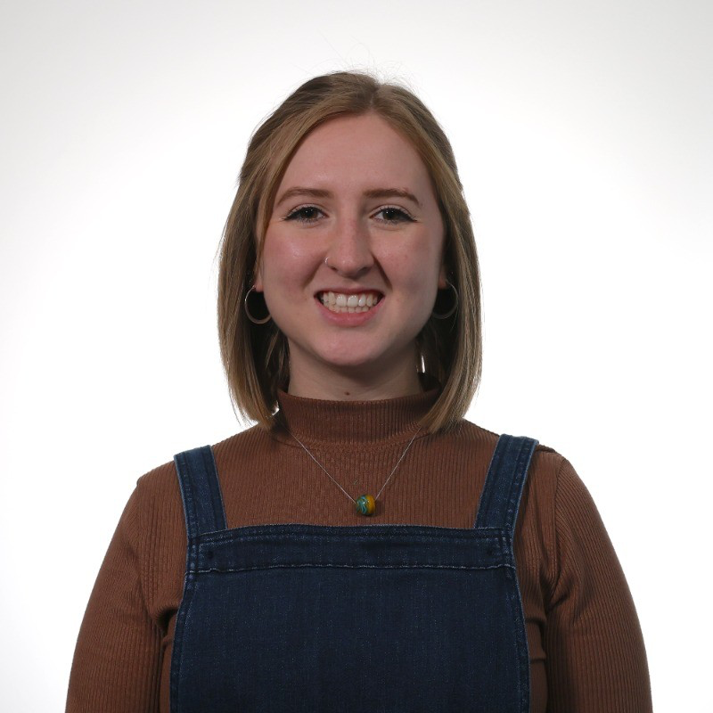
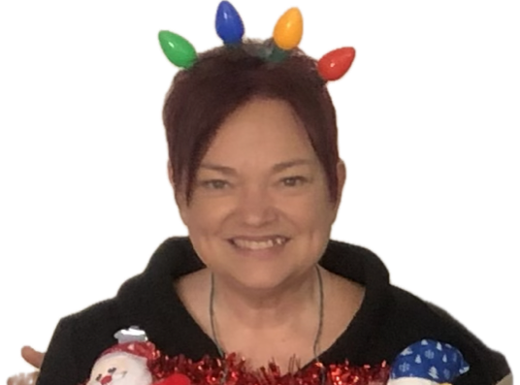
Introducing Ms. Grush
New Program Assistant!

Slide 5
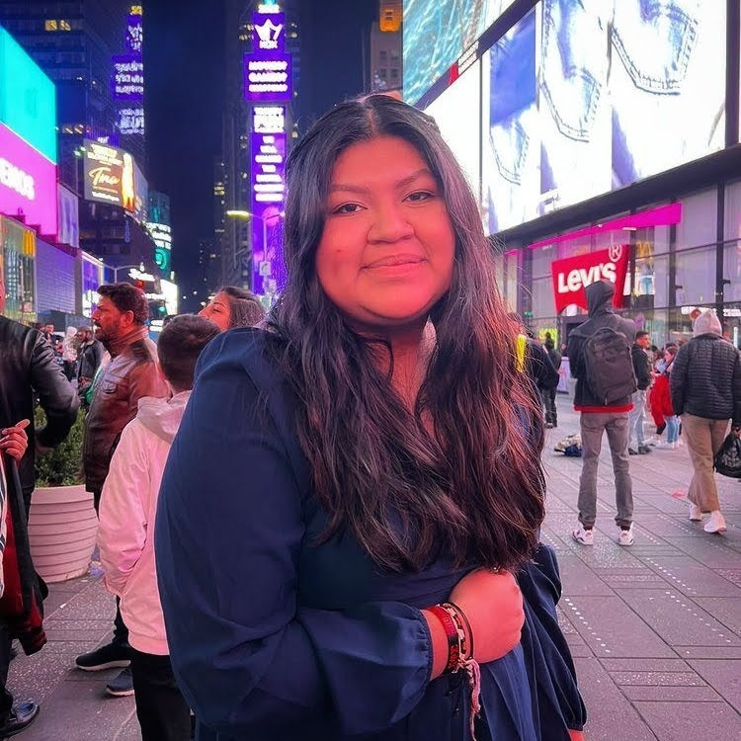
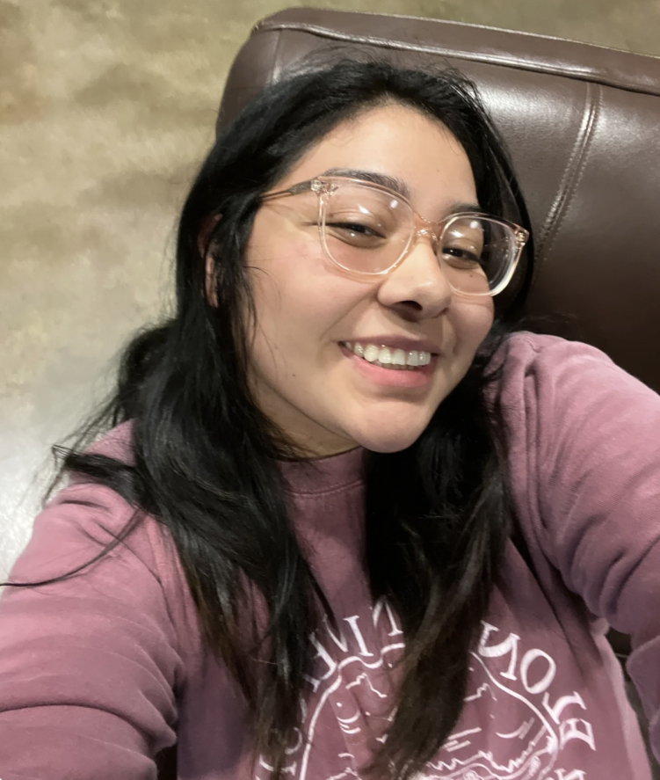
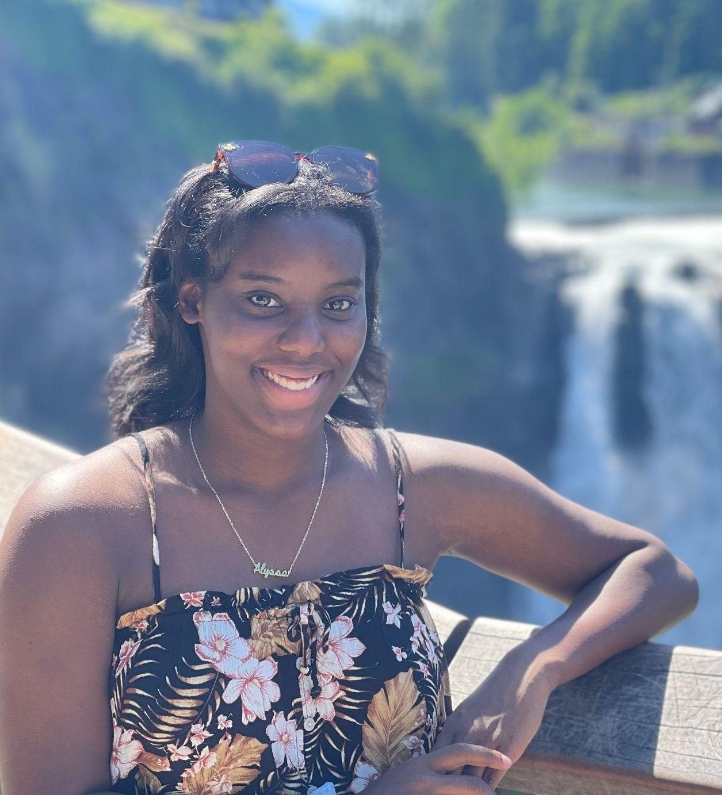
CAT Mentoring!
Have you scheduled your Feb. face-to-face?
Joining the team:
Gisselle Garcia-Jose
Eva Real Roman
Alyssa Wise

Slide 6
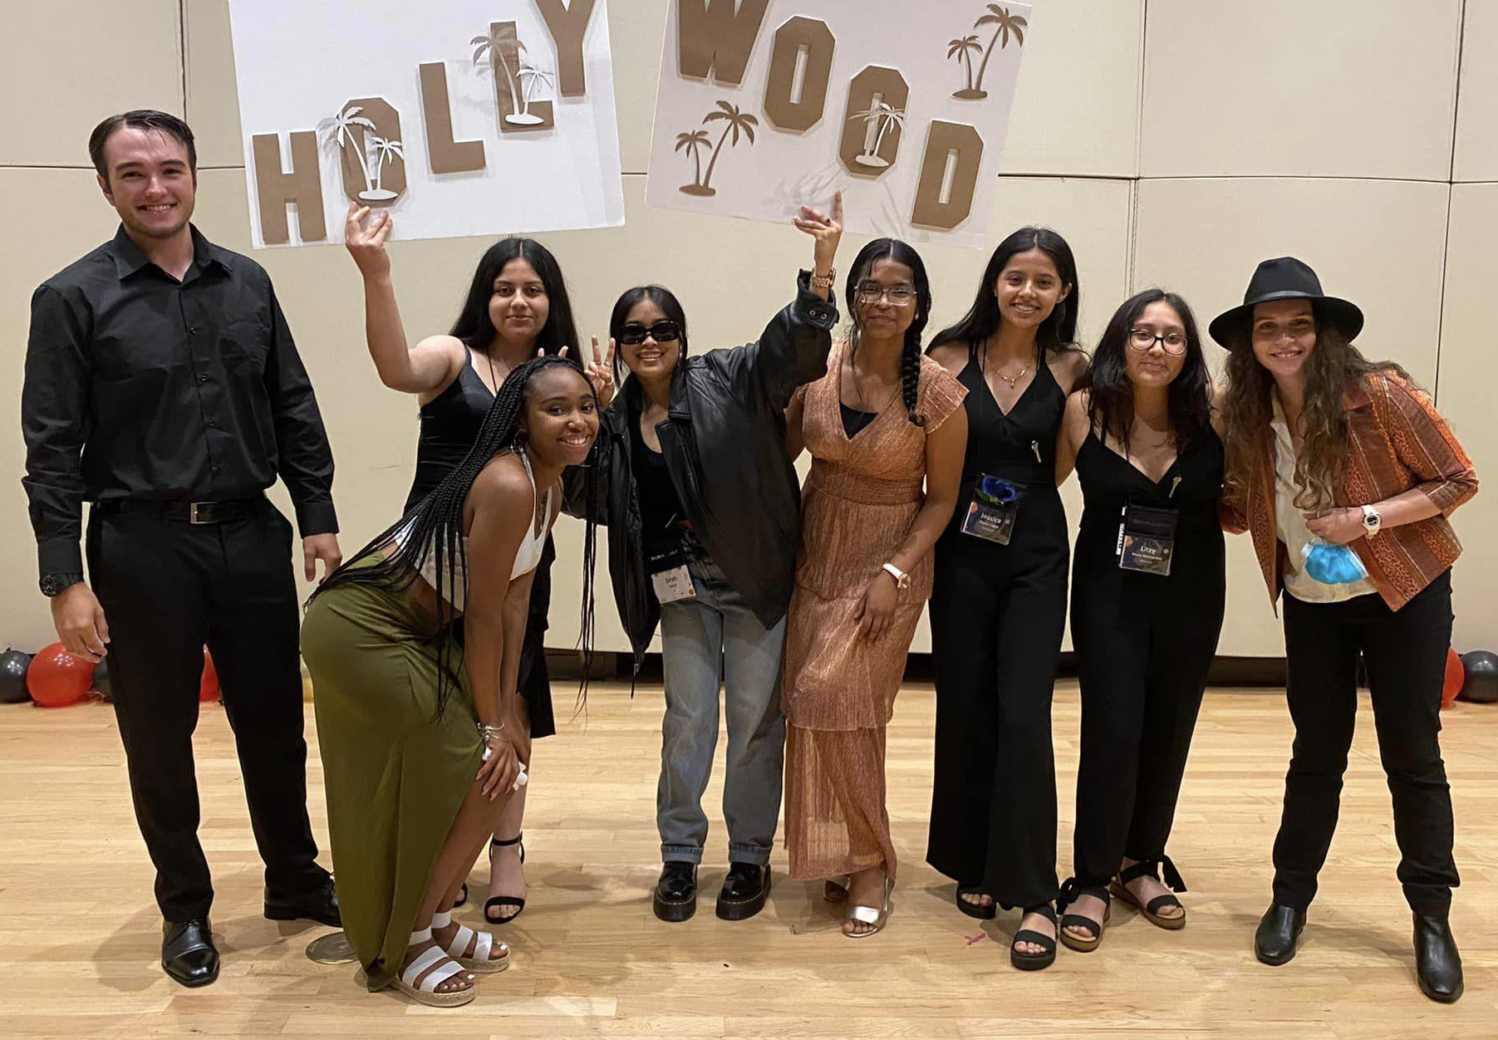
EA 2024 Summer Leadership Team!
Looking for a leadership role in the EA Summer program? This may be for you:
Serve as a voice for fellow scholars
Help with select events (Talent Show, Summer Celebration)
Movie Night ideas/suggestions (voting will include all scholars)
Take lead re-organizing spaces used after activities & meals
Develop your own leadership skills
Submit your speech → Friday, Mar. 8
Speeches/vote by scholars → Sat. March 16
Hold the Date! For Team training → after the April Saturday program (lunch provided)
Questions? Email Mr. B at tbishop4@elon.edu

Slide 7
ACADEMIC COACHING
Be proactive.
Request a spring academic coach!
Email Ms. W-K at ewinterichknox@elon.edu
and include:
the class you are requesting,
your teacher’s name, and
your general availability after school.
Many Elon students are still off campus in January, so coaches don’t officially begin until February.
Deadline to request: March 29th

Slide 8
PSAT & PreACT
PSAT scores
have been released
Check for an email & log into College Board account
PRE-ACT scores
available to schools within 5-10 days of testing
See your school’s testing coordinator for results
Until CAT Mentoring resumes in February, share your scores with Ms. W-K and add to your college list spreadsheet.

Slide 9
IMPORTANT
DATES!
(also can be found
on our website)
also
President’s Reception
for Pi Scholars (Required)
May 8th
2024 Summer Program!
for Rhos, Sigmas & Taus!
June 9th-28th
Transitions to College Retreat
for Pi Scholars
July 26th-28th

Slide 10
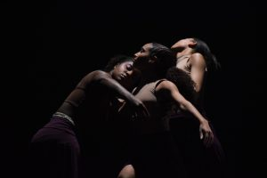
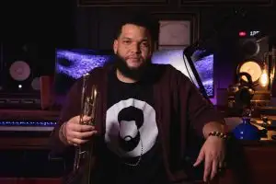
Upcoming Elon events
(Free with your Phoenix card!)
Today
Abusua, Black History Month Dance Concert
McCrary Theatre, Center for the Arts, 2 pm
Sunday, February 18th (tomorrow)
Enchanted
Turner Theatre @ 3 pm and 7 pm
Saturday, February 24th
Elon Jazz Festival Concert w/ special guest Kris J.
McCrary Theatre, Center for the Arts @ 7:30 pm
Sunday, February 25th
Elon Women’s Basketball vs. NC A&T
Schar Center @ 2

Slide 11
Amani
Fayetteville State University,
Wingate, NC-Central,
UNC-Greensboro, NC A&T Chloé
UNC-Greensboro, Duke University
George
East Carolina, UNC-Charlotte, UNC-Asheville, Rutgers, Penn. State, University of Oklahoma, University at Albany, NC State Ja’Sāi
Guilford College, Winston-Salem State, UNC-Greensboro, Elon, UNC-Charlotte
Jaylon
East Carolina, UNC-Greensboro,
Winston-Salem State,
NC-Central, Western Carolina, Guilford College, NC Wesleyan, UNC-Pembroke, UNC-Asheville
College Acceptances!

Slide 12
Jimmy
NC A&T, Elon, ECSU, UNC-Pembroke
Jonathan
UNC-Greensboro, High Point,
Arizona State, University of Arizona,
East Carolina, App State, NC A&T, University of Alabama
Marco
Guilford College, East Carolina, Winston Salem State, UNC-Greensboro
Nats
Campbell University, Meredith College, Hollins College, UNC-Greensboro, UNC-Charlotte, Fayetteville State University, Elon, UNC-Pembroke, Charleston Southern University
Noel
Winston-Salem State
Sirah
UNC-Greensboro, North Carolina Central,
UNC-Chapel Hill, Appalachian State
College Acceptances!

Slide 13
Vanessa
UNC-Chapel Hill, Elon, UNC-Greensboro, UNC-Charlotte
Venus
North Carolina Central, UNC-Greensboro, Appalachian State, NC A&T, UNC-Pembroke, Guilford College, Elon
William
North Carolina Central,
UNC-Greensboro
Zora
North Carolina Central,UNC-Greensboro,
Clark Atlanta University,Guilford College,
Temple University, East Carolina,
UNC-Charlotte, Western Carolina,
Winston-Salem State, Campbell, Hawaii Pacific, Louisiana State, NC A&T, University of South Florida
College Acceptances!

Slide 14
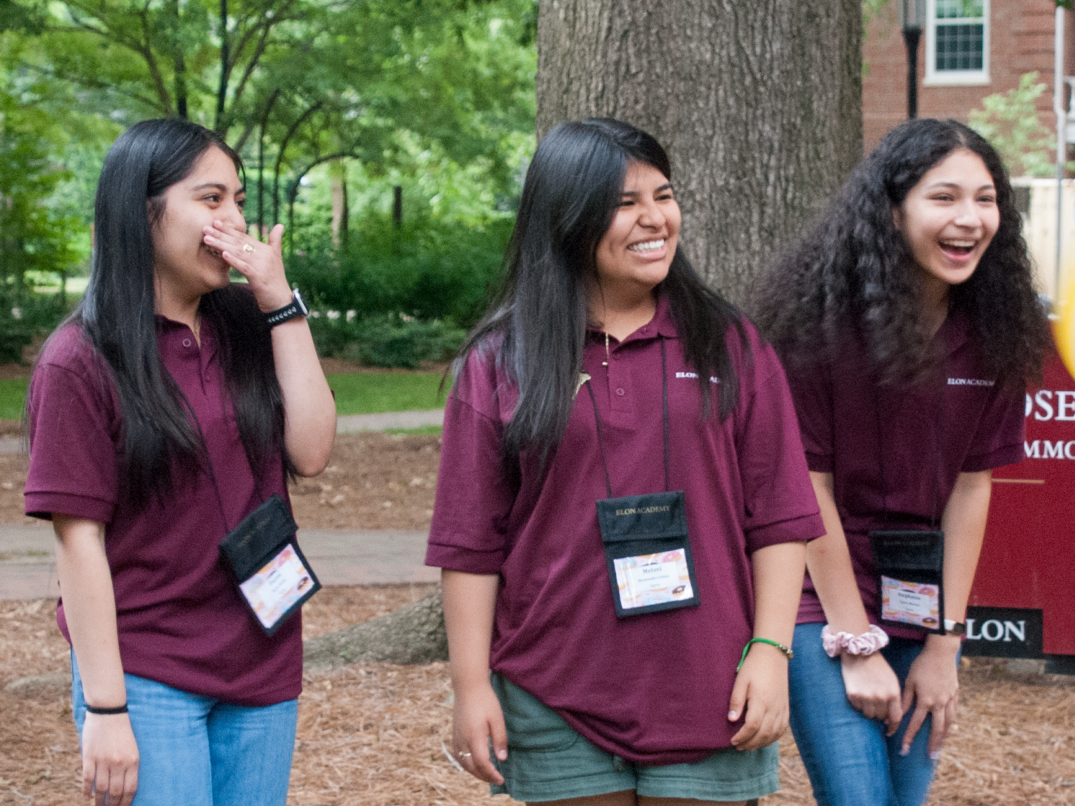
SCHOLARS
FAMILIES
TODAY
Pis: room 313
Rhos: room 354
Sigmas: Sankey 106
Rho Fams: room 242
Sigma Fams:
Spanish workshop in room 145
English workshop in room 112

