Slide 1
ELON Academy
Saturday, September 23rd, 2023

Slide 2
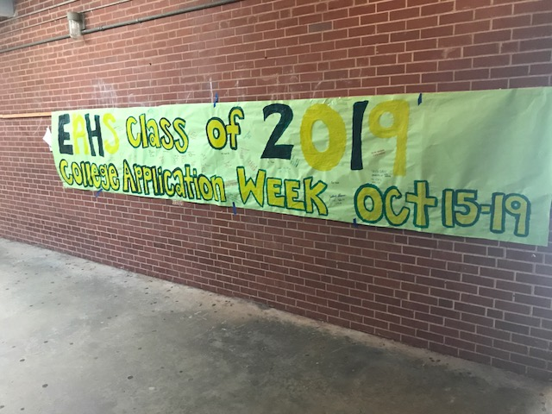
INTRODUCTIONS
Kate Cushman
Eastern Alamance High School Lead Counselor
27 years as a high school educator

Slide 3
AGENDA
Role of your school counselor
Graduation requirements review
PSAT/Pre ACT overview
Fee Waivers
College planning

Slide 4
School Counselor
Counselor can help you with academic, personal/social concerns and career planning
Talk to your counselor about your future plans- work together on course selections
Counselor is usually who you can talk to about fee waivers/application waivers
Counselor can connect you to other school personnel according to your needs
CDC
Social Worker
Nurse

Slide 5
Graduation Requirements
4 English
1,2,3,4
4 Math
Math 1, Math 2, Math 3 and one additional math (AP Stats, AP PreCalculus, Math 4, Math 4 Honors)

Slide 6
Graduation Requirements
4 Social Studies
World History, Founding Principles-Civic Literacy, American History , Economics and Personal Finance
Civic Literacy, AP World History, AP US History, Economics and Personal Finance

Slide 7
Graduation Requirements
3 Sciences
Earth/Environmental Science, Biology, Physical Science or Chemistry

Slide 8
Graduation Requirements
12 elective credits
For more competitive schools electives should focus on higher level academic courses
AP courses
PLTW courses at CTEC
Dual-Enrollment courses at ACC/ Elon
Upper level foreign language classes

Slide 9
UNC System Schools
Minimum requirements
2.5 weighted GPA
The testing requirement has been waived
2 credits in foreign language no longer required BUT still recommended

Slide 10
PSAT and PRE-ACT
Pre ACT given to ALL 10th graders
4 sections
English, Math, Reading and Science
PSAT - Elon academy students would all be taking this test
DIGITAL this Fall (2023)
2 sections
Math, Reading and Writing

Slide 11
PSAT VS PreACT Scoring
PSAT scores
Total can range from 320 to 1520
Benchmark scores are 410 for Reading and Writing and 450 for Math
Elon Academy students should the PSAT 11th grade year also in order to be eligible to qualify for PSAT/NMSQT scholarships

Slide 12
PreACT Scoring
Score is given in ranges
Range from 1- 35
Test is specific to 10th grade so readiness benchmarks are specific to 10th grade

Slide 13
ACT
ALL juniors in NC take this exam during a school day in early Spring
Must register for ACT exams on Saturdays
4 parts
English
Math
Reading
Science

Slide 14
ACT vs SAT Scoring
Scoring is very different:
ACT- 36 Perfect Score- 36 on each section
SAT – 1600- Perfect Score- 800 on each section

Slide 15
SAT
Will be all digital by Spring 2024
Digital SAT only has 2 sections- English and Math
Much shorter- entire test lasts around 2 hours
Must register to take on Saturday

Slide 16
Fee Waivers!
Fee Waivers allow you to take the ACT and SAT for free
Fee Waivers also allow you to apply to college for free at most schools
How do you get one?
At most schools, just ask your counselor
ANY student who QUALIFIES for free or reduced lunch is eligible for waivers
Elon Academy students AUTOMATICALLY QUALIFY

Slide 17
Fee Waivers!
For college applications, counselors can send either a paper copy of a waiver or the college will accept the Fee Waiver # as proof of eligibility
How many can you get?
2 FOR THE ACT (use in junior and senior year ONLY)
2 FOR THE SAT (use in junior and senior year ONLY)
UP TO 10 College Application Waivers

Slide 18
College Planning
10th grade year
Continue to take rigorous courses
Practice for the SAT and ACT with their practice tests: PSAT and Pre-ACT
Remember that there are always free practice examples available on act.org and collegeboard.org
Start working on your list of possible colleges- use CFNC or BIg Future or other sites to start – and remember that it’s ok to change your mind….lots.

Slide 19
Thanks!
I appreciate your attention and time this morning!

