Slide 1

Exploring Leadership with Experiential Learning
Mustafa Akben
Assistant Professor of Management

Slide 2

Course Overview:
Principles of Management

Slide 3

MGT-3230 – Principles of Management
MGT3230 is a required course for the majors in the Love School of Business.
It doesn't merely focus on imparting fundamental concepts of organizational behavior and management, but also on nurturing critical thinking skills and enabling the practical application of theoretical concepts in real-world scenarios.
Management has four functions
  Planning
  Organizing
  Leading
  Control
Notes:
The MGT3230: Principles of Organizational Behavior and Management course is meticulously designed to ensure a holistic development of the students. It doesn't merely focus on imparting fundamental concepts of organizational behavior and management, but also on nurturing critical thinking skills and enabling the practical application of theoretical concepts in real-world scenarios. A crucial aspect of this development is leadership pedagogy, which is deeply embedded into the course structure and objectives, underscoring the development of essential leadership skills required for effective management of organizational behavior.

Slide 4
Fostering Relational Leadership
Relational leadership involves a focus on five primary components:
  Purpose: Having a common set of values and vision to move an initiative forward
  Inclusivity: Welcoming and open to diverse points of view and diverse identities
  Empowerment: Sharing power with others to embrace what they have to offer
  Ethics: Upholds values and standards of morality
  Process-Orientation: The focus is on the group and how the group works together
Notes:
The Relational Leadership Model, which we leverage in this course, forms the backbone of our approach. This model is grounded in the belief that leadership effectiveness is intrinsically linked to the ability to cultivate positive relationships within an organization. It is structured around five key components: purposefulness, inclusivity, empowerment, ethics, and process orientation. Each of these components is intricately woven into the fabric of the course, thereby ensuring that students not only assimilate the theories of organizational behavior and management but also develop the requisite skills to emerge as socially responsible leaders capable of effecting positive change within their organizations (Please see the students feedback on this matter in Answer 5).

Slide 5

Relational Leadership: Purposefulness
Semester-Long Group Project (Shark Tank Activity)
  Collective Vision
  Purpose to help their community and others
  Find the intrinsic joys and passion to explore
Each students take a role of leadership
  Strategy Leader, HR Leader, Culture Leader, Operation Leader etc.
Do research, work collectively, challenge their assumptions, learn from their interactions, manage their roles
Notes:
Purpose: Having a common set of values and vision to move an initiative forward
For instance, at the onset of the course, we establish semester-long teams wherein team members share their collective vision and set the tone for the semester, thereby instilling a sense of purposefulness right from the start. This is just one example of how we (my students and I) integrate the component of 'purposefulness' into the course.

Slide 6
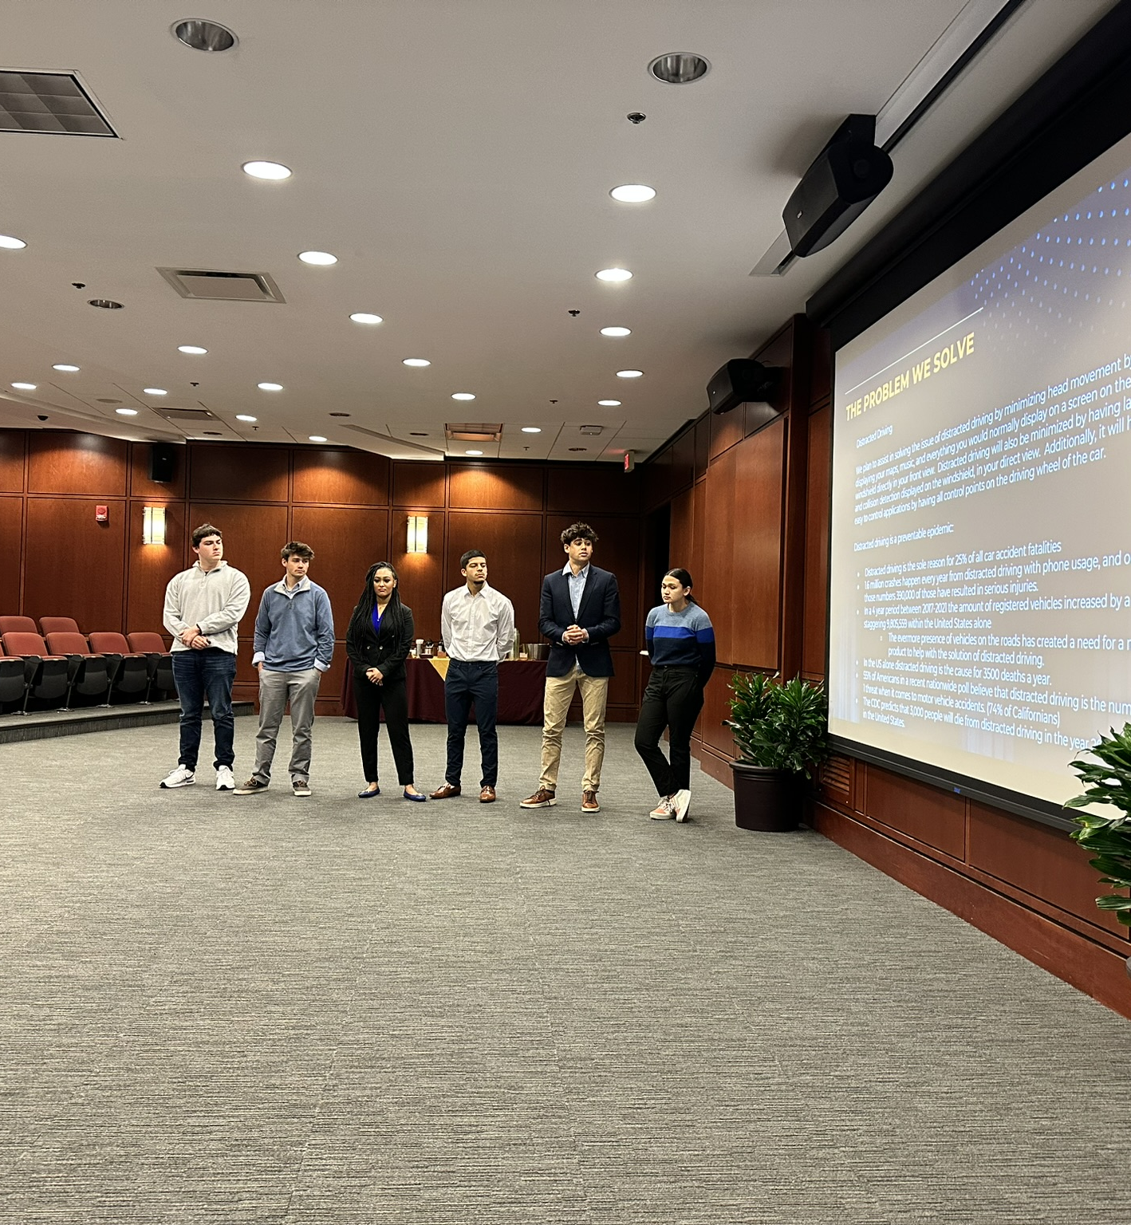
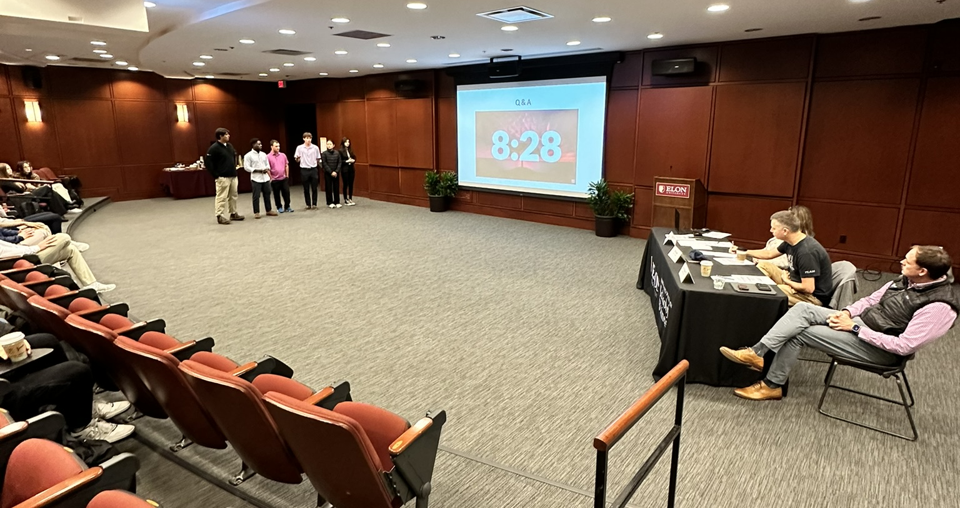
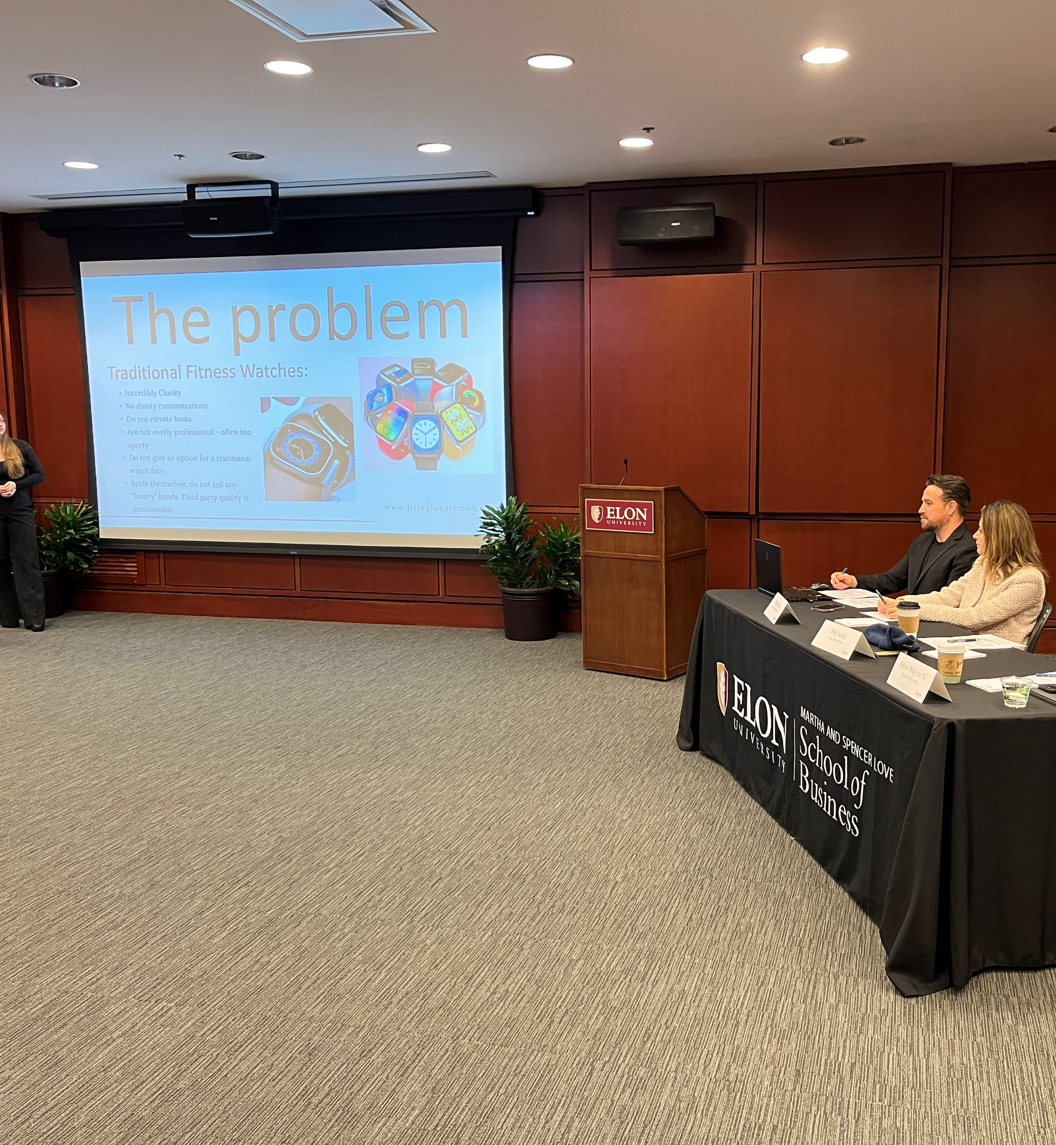
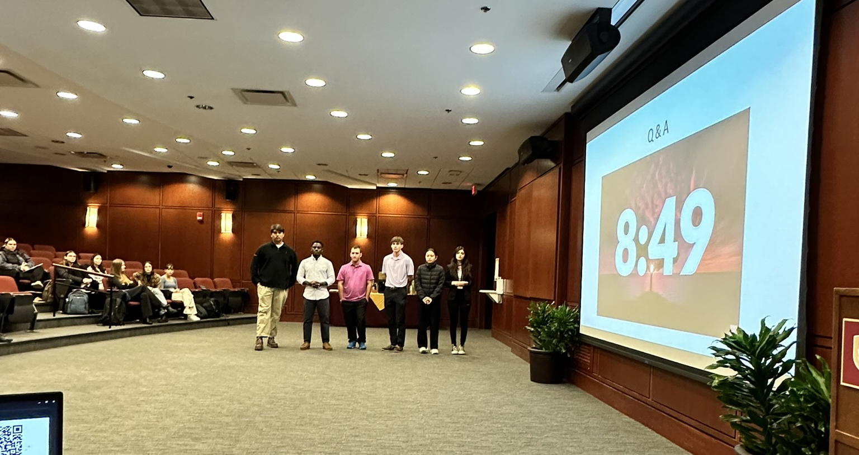
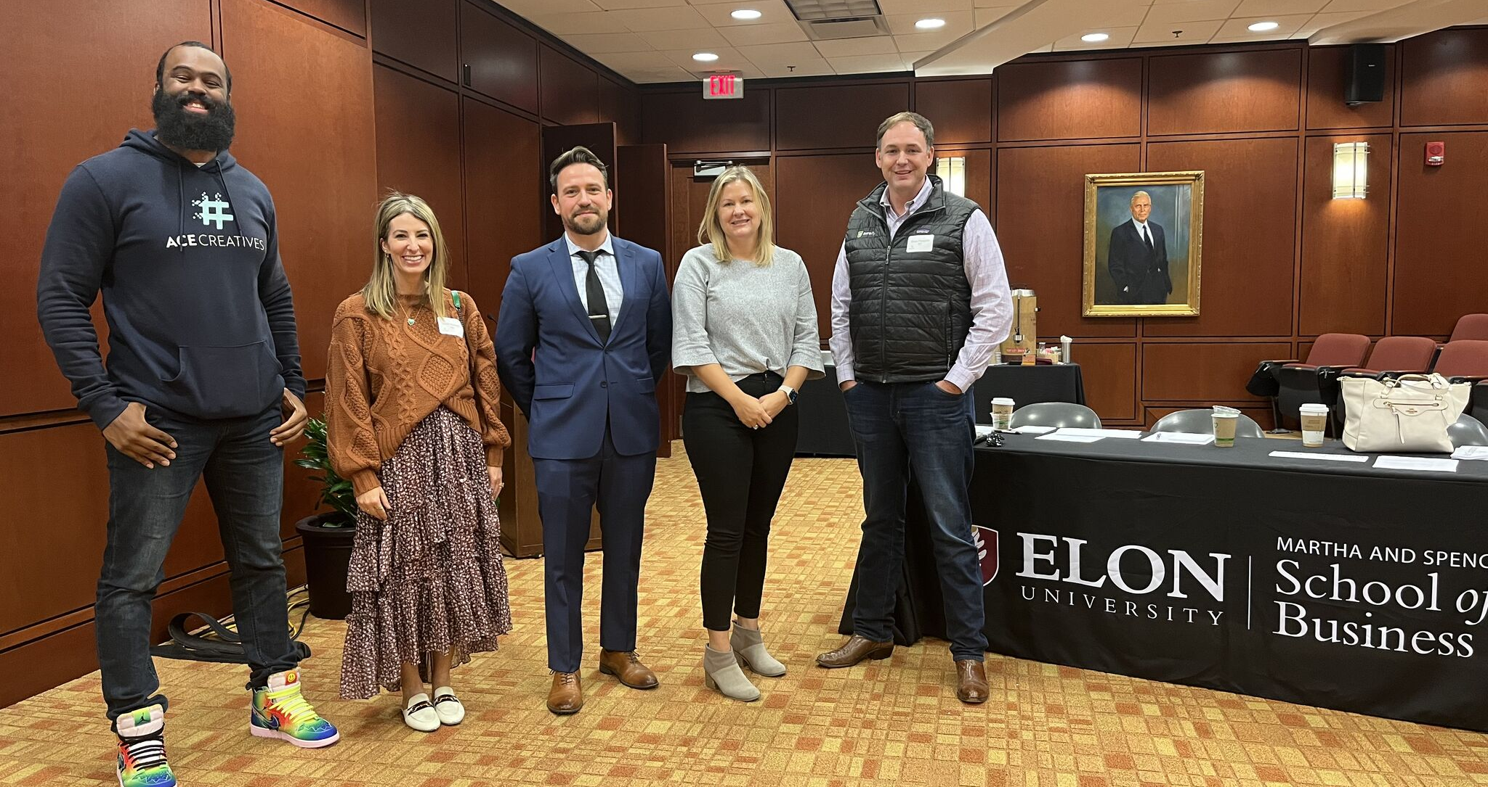
Shark Tank Activity

Slide 7

Example Projects
Magic Gloves – An automated medical glove dispenser that reduces the operational mistakes during medical procedures.
On the Run – A peer-to-peer chores service that allows college students to outsource tasks such as grocery shopping, laundry, and errand running, among others.
GrowBaby – An adjustable baby clothes with advanced biometrics to protect your newborns unexpected sudden infant death.
SmartShelf – AI enhanced food preservation systems, reducing the food waste for all.
DriveHeart – AI based health detection systems during a drive, preventing the death on wheels.

Slide 8



Relational Leadership : Inclusivity
Unpacking the implicit biases
Demystify the idea of leadership
Understanding the gender differences
Mini-class experiments
Notes:
Inclusivity: Welcoming and open to diverse points of view and diverse identities
'inclusivity' is addressed by engaging students in exercises that reveal their implicit biases and then facilitating discussions on creating a more inclusive future of work. This not only sensitizes students to their biases but also encourages them to actively work towards fostering inclusivity.

Slide 9
Do you think physical attributes affect leadership?

Slide 10




Slide 11


Name: Mary Taylor
Age: 42
Height: 5 Feet ( 155 cm)
Hobbies: Reading, cycling

Slide 12

Name: Mary Taylor
Age: 42
Height: 6 Feet (185 cm)
Hobbies: Reading, cycling

Slide 13
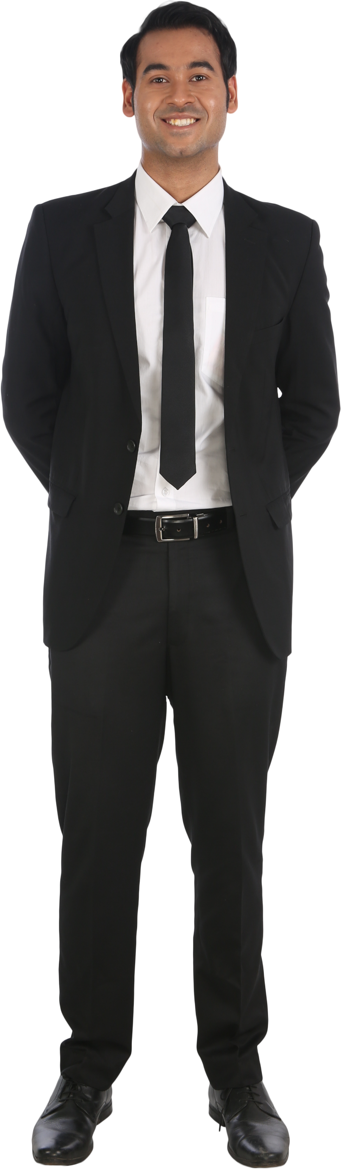
Name: John Lewis
Age: 39
Height: 5.4 Feet (165 cm)
Hobbies: Swimming, painting

Slide 14
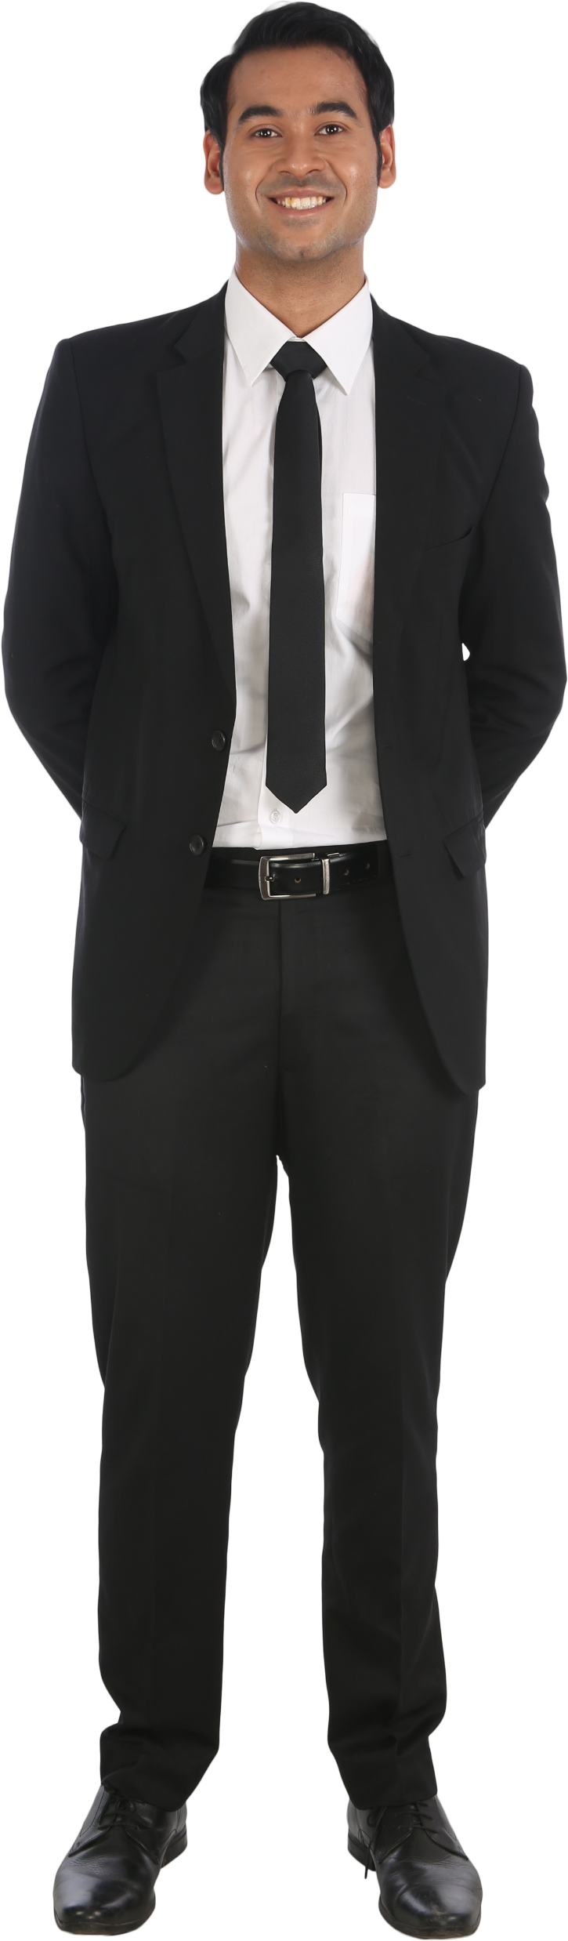
Name: John Lewis
Age: 39
Height: 6.4 Feet (195 cm)
Hobbies: Swimming, painting

Slide 16

Extended discussions on how we come to see the leadership

Slide 17
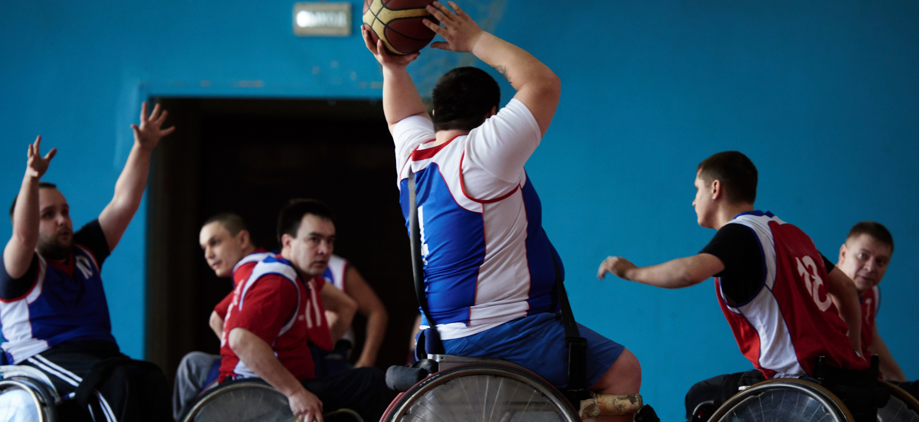

Relational Leadership : Empowerment
Give voice the students
Make their own decisions to practice leadership
Activities
  Pick which written assignment they will submit
  Pick your own group
  Escape Room
  Leadership Arena
Notes:
Empowerment: Sharing power with others to embrace what they have to offer
Empowerment is another key component that is actively promoted throughout the course. Students participate in activities such as the Escape Room, which requires them to share responsibilities, coordinate efforts, and solve puzzles collaboratively. This activity, among others, instills a sense of empowerment as students take on responsibilities, work together, and overcome challenges.

Slide 18
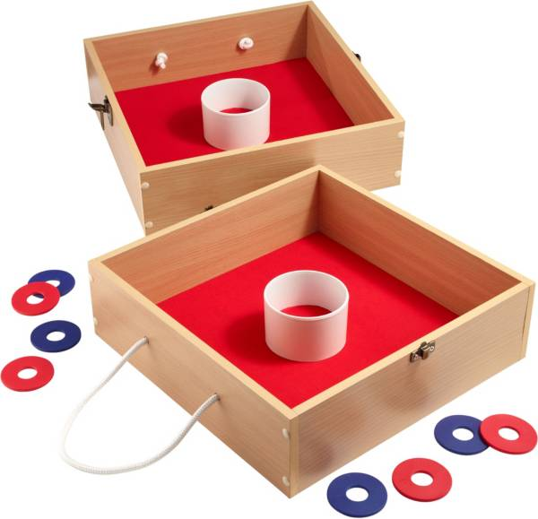
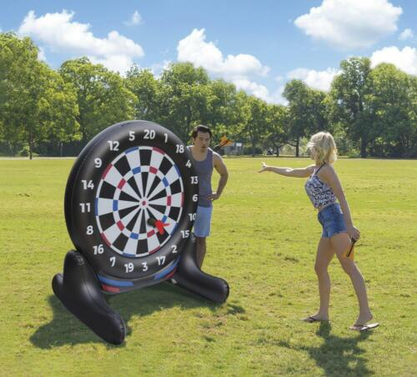
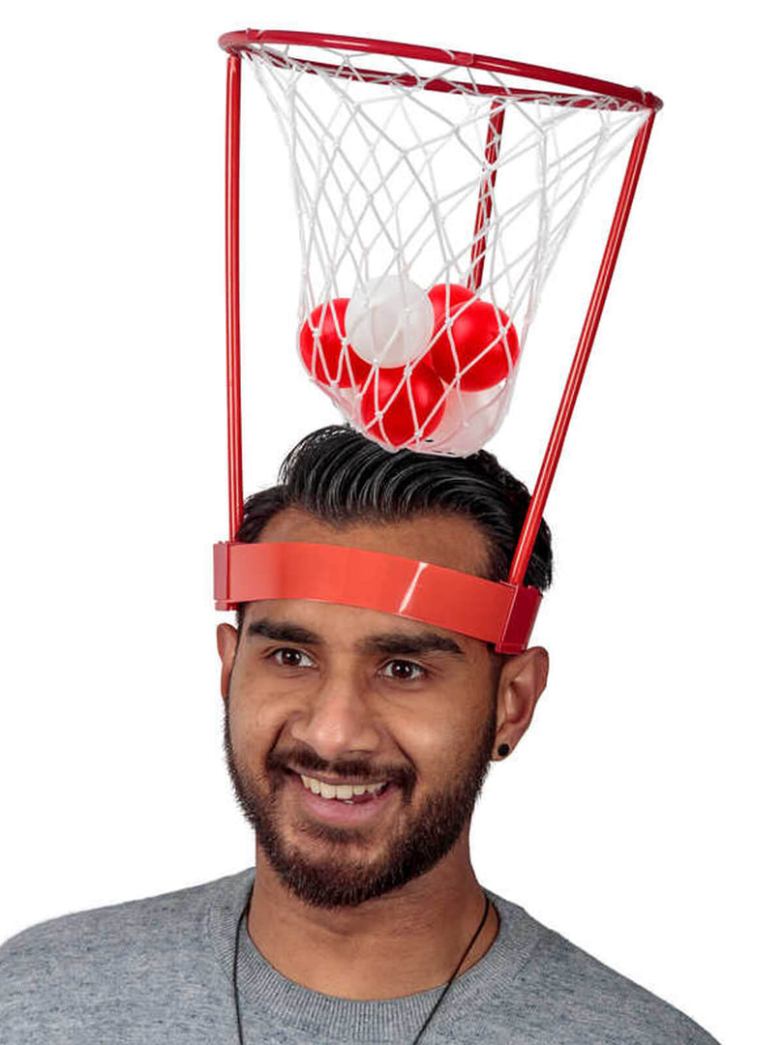


Slide 19
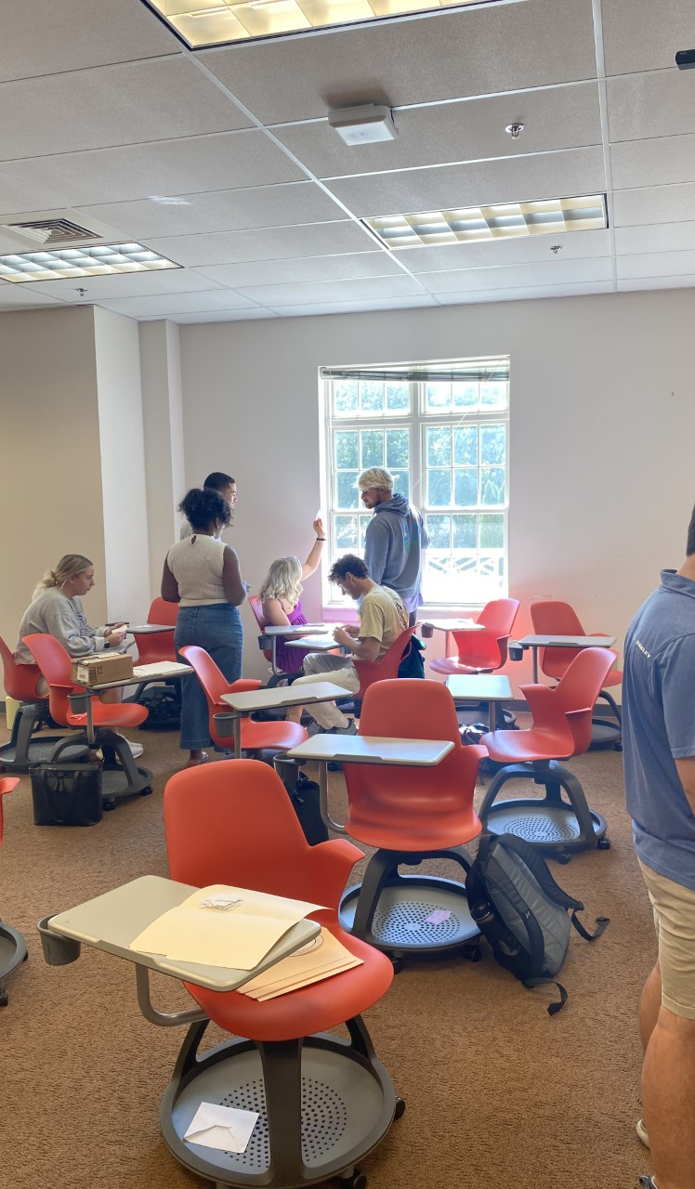
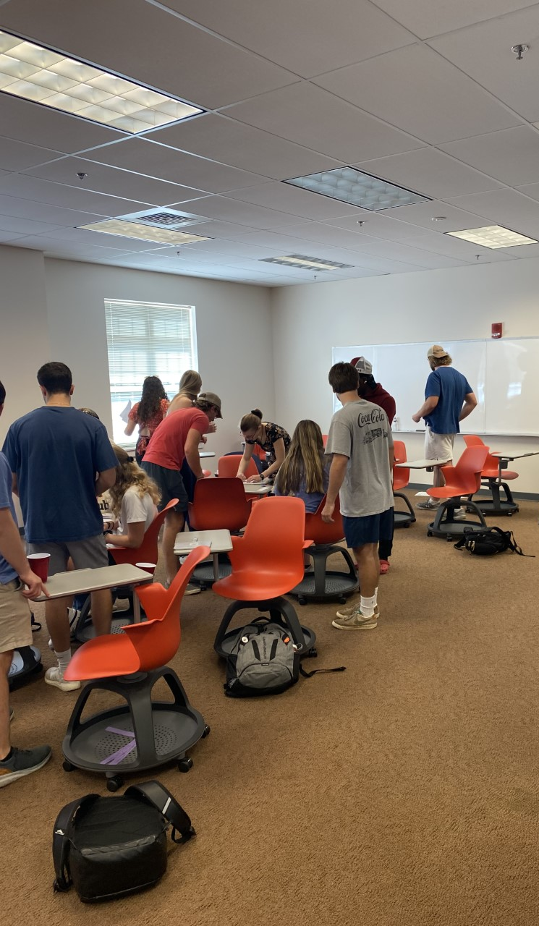
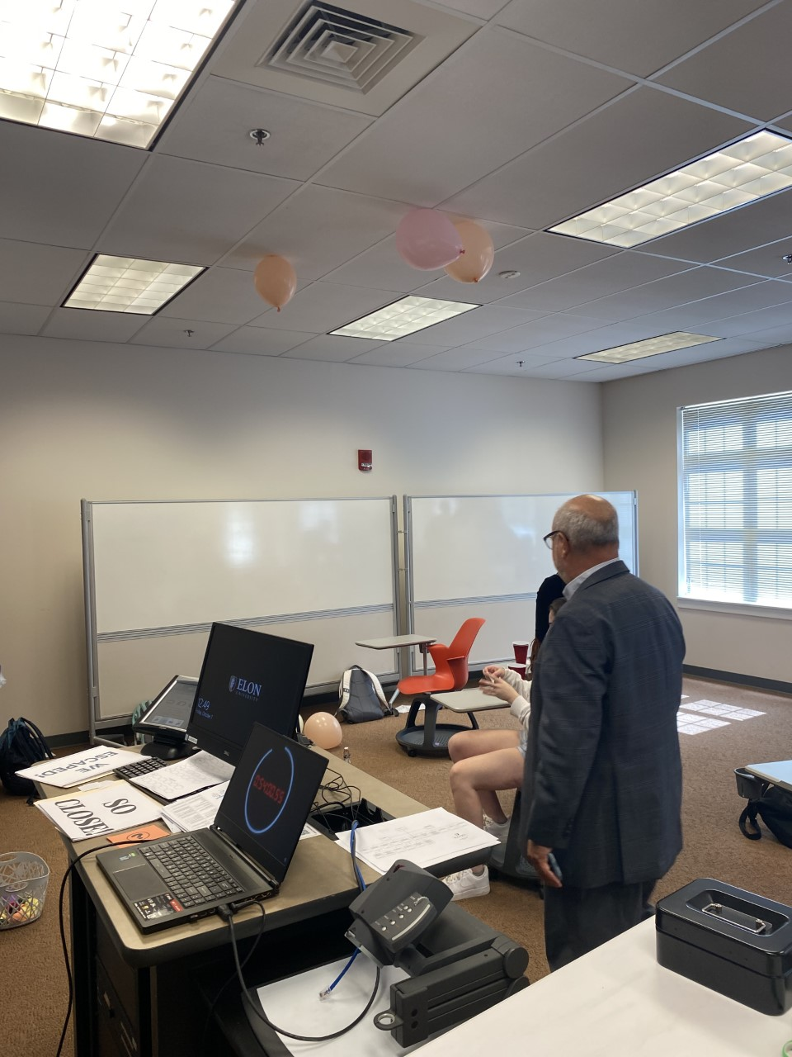
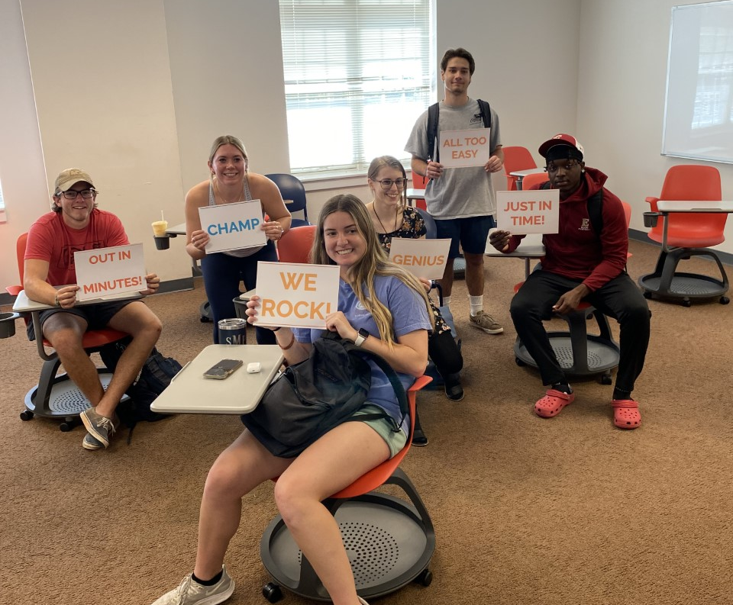

Slide 20

Relational Leadership: Ethics
Ethical Leadership
Case studies
Gamification
1Huddle Platform for Human Trafficking
Notes:
Ethics: Upholds values and standards of morality
Furthermore, the course delves deeply into 'ethics' by engaging students in activities like case studies and gamification with the 1hurdle platform. These activities are designed to stimulate critical thinking about the ethical implications of their decisions in practical scenarios.
Lastly, the course promotes a 'process-oriented' learning approach, emphasizing that every occurrence in the class is a learning and growth opportunity. This approach fosters a growth mindset and a process-oriented attitude among the students.

Slide 21
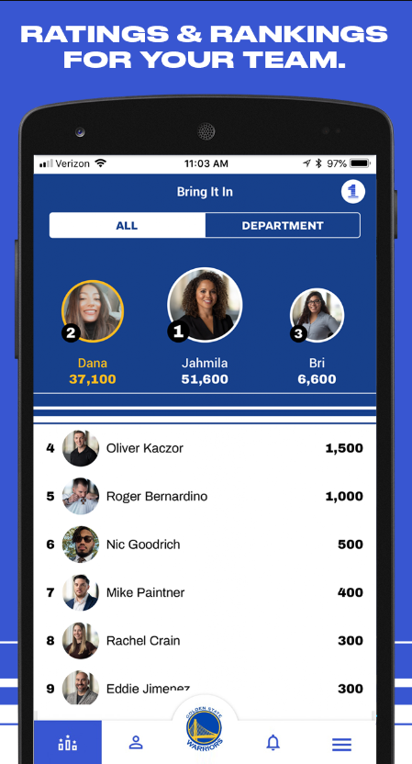
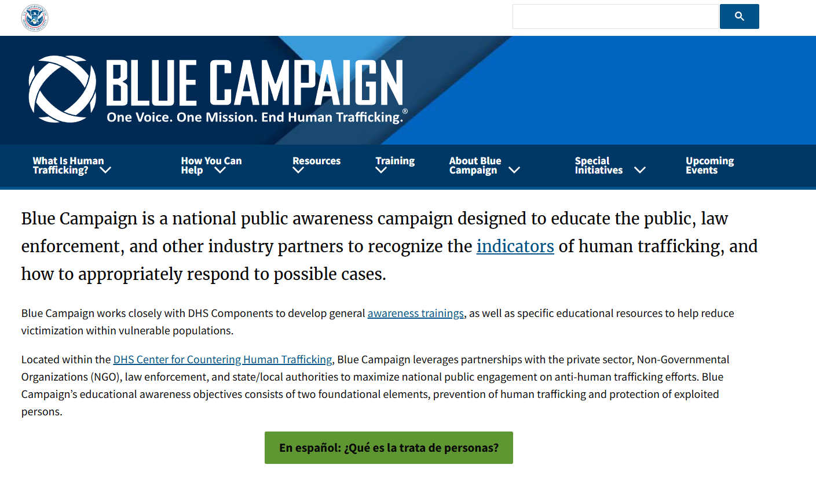

Slide 22
A Reflection from A Student
Leaving class this week, the lecture about ethical behavior is what stuck with me the most. I was touched by how we were urged to seek a life that revolves around us being socially responsible leaders, rather than seeking out profit and money. It is often something educators do not emphasize - how our classroom learning with relate to the real world. I believe this week was truly eye-opening, and I will go about my classes differently. I will no longer dial in on the importance of regurgitating information back, rather also keep an open mind on how what I am learning will shape me as a leader in the future. I was also heartbroken by the modern slavery video we watched. Human trafficking is something I knew, but not the full depths as I did after these learning activities. In my daily life I seek to educate people on the broad spectrum of modern slavery and hopefully can help make a change, one person at a time.

Slide 23


Relational Leadership : Process-Orientation
Imparting “growth mindset” | Giving room for growth and learning from mistakes
Growth oriented feedback
Self-reflection essays every week
Self-discovery surveys
  Emotional Intelligence Test
  Personality Test
Class Survey Discrepancy and Development Plans
  How do you see yourself as a leader?
  How do your peers see you as a leader?
Notes:
Process-Orientation: The focus is on the group and how the group works together, how do you learn from your mistakes – not only end but the process itself is full of joy and learning opportunities.
Lastly, the course promotes a 'process-oriented' learning approach, emphasizing that every occurrence in the class is a learning and growth opportunity. This approach fosters a growth mindset and a process-oriented attitude among the students.

Slide 24
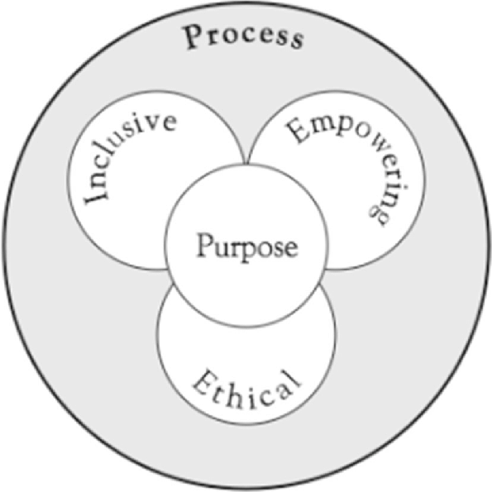

Slide 25

Thank you! Feedback & Questions
Mustafa Akben

