Slide 1

Questioning (as) Leadership
Group Discussion as Leadership Pedagogy
Ben Murphy (bmurphy24@elon.edu)
English Department
Notes:
Talk about the students i teach, general ed/non-majors; what can i give to the broadest range of students?

Slide 2
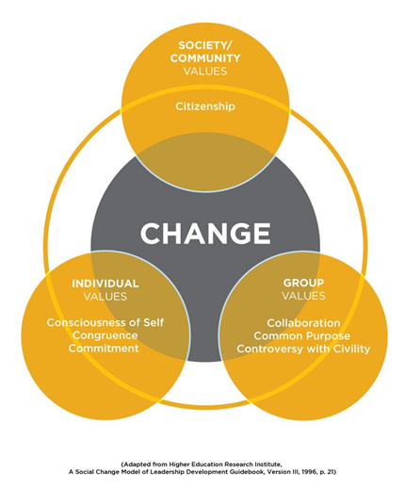
Questioning Prior Leadership Models
Prior leadership models stress top-down decisions & Great Man charisma
Newer leadership models stress collaboration and feedback loops of self-reflection and collective inquiry.
For example, the Social Change Model of Leadership (SCML) models how individuals, groups, and communities interact to promote change across scaling levels of introspection & teamwork.
As Wendy Wagner puts it in Leadership for a Better World (2016):
This model “expects all group members to engage in the leadership process. This requires that everyone develop that capability and efficacy. The leader’s role is not to provide solu­tions but to help the group become capable of working collaboratively to create their own solutions, taking advantage of the variety of perspectives and wisdom available in the group.” (Wagner, “Change.” Leadership for a better world (John Wiley & Sons, 2016, pg. 227)
Notes:
A really good problem is one we don’t solve; it solves us. (219)
The implication for leaders then is to develop the capacity of individuals, groups, and communities to think and lead together by ex­ panding their collective ability to think with more complexity and empathy and to act with more intentionality.

Slide 3
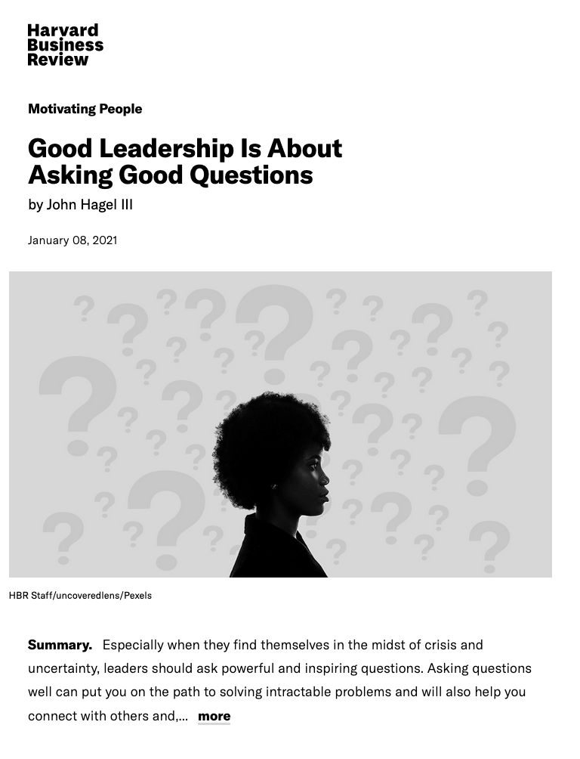
Good Leadership means
Asking Good Questions
Current models (like SCML) require all members (as leaders) to ask questions: questions of themselves and of others.
Likewise, Hagel III, a corporate executive & advisor in Silicon Valley, writes:
“Leaders should ask powerful and inspiring questions, convey that they don’t have the answers, and solicit others’ help to find them.”
Notes:
A really good problem is one we don’t solve; it solves us. (219)
The implication for leaders then is to develop the capacity of individuals, groups, and communities to think and lead together by ex­ panding their collective ability to think with more complexity and empathy and to act with more intentionality.

Slide 4

Learning to Ask Good Questions
in the English Classroom
In the classroom, students can practice good leadership by learning how to craft and ask good questions.
“Reading, study, and discussion of the “Great Texts” of literature, philosophy, and politics offer an important complement to contemporary leadership education literature and are arguably essential reading for the liberally educated student.” (72)
“The benefits accrued from a leadership education based in Greats are manifold; students benefit both from the content learned and from the manner of study required.” (72)
Journal of Leadership Studies 3.4 (2010)
Notes:
A really good problem is one we don’t solve; it solves us. (219)
The implication for leaders then is to develop the capacity of individuals, groups, and communities to think and lead together by ex­ panding their collective ability to think with more complexity and empathy and to act with more intentionality.

Slide 5





ENG 1718: “Black Speculative Fiction”
Leadership Pedagogy Assignment:
“Team Discussion Leading”
Assignment Overview:
In teams of 3 or 4, students will work together to write 5 “good discussion questions” based on the assigned texts for their team’s designated class day. Then, during class, each team member will lead a small group (between 8-11 students) in a 20-minute discussion of the pre-prepared questions. So, before class, students prepare questions together as a team; during class, each student leads a small group on their own.

Slide 6
ENG 1718: “Black Speculative Fiction”
Leadership Pedagogy Assignment:
“Team Discussion Leading”
Assignment Learning Outcomes: By the end of this assignment, students will…
1) Sharpen evidence-based critical thinking skills.
2) Work collaboratively with peers in a team environment.
3) Learn to craft a ‘good discussion question’ (based on criteria we will discuss).
4) Build leadership skills & confidence to lead peers in focused & inclusive conversation.
5) Appreciate and engage a diverse array of perspectives and identities.
6) Deepen self-knowledge through reflection on strengths & areas for improvement.

Slide 7

Best Practices & Learning
Outcomes for Discussion Pedagogy
In 31-page guide, Sibold (2017) discusses critical thinking & leadership learning outcomes that flow from discussion pedagogy.
Also provides research-based ‘best practices’ for mitigating the challenges of discussion pedagogy.
Also provides rubric templates for different ways to assess this discussion pedagogy.
Notes:
A really good problem is one we don’t solve; it solves us. (219)
The implication for leaders then is to develop the capacity of individuals, groups, and communities to think and lead together by ex­ panding their collective ability to think with more complexity and empathy and to act with more intentionality.

Slide 8
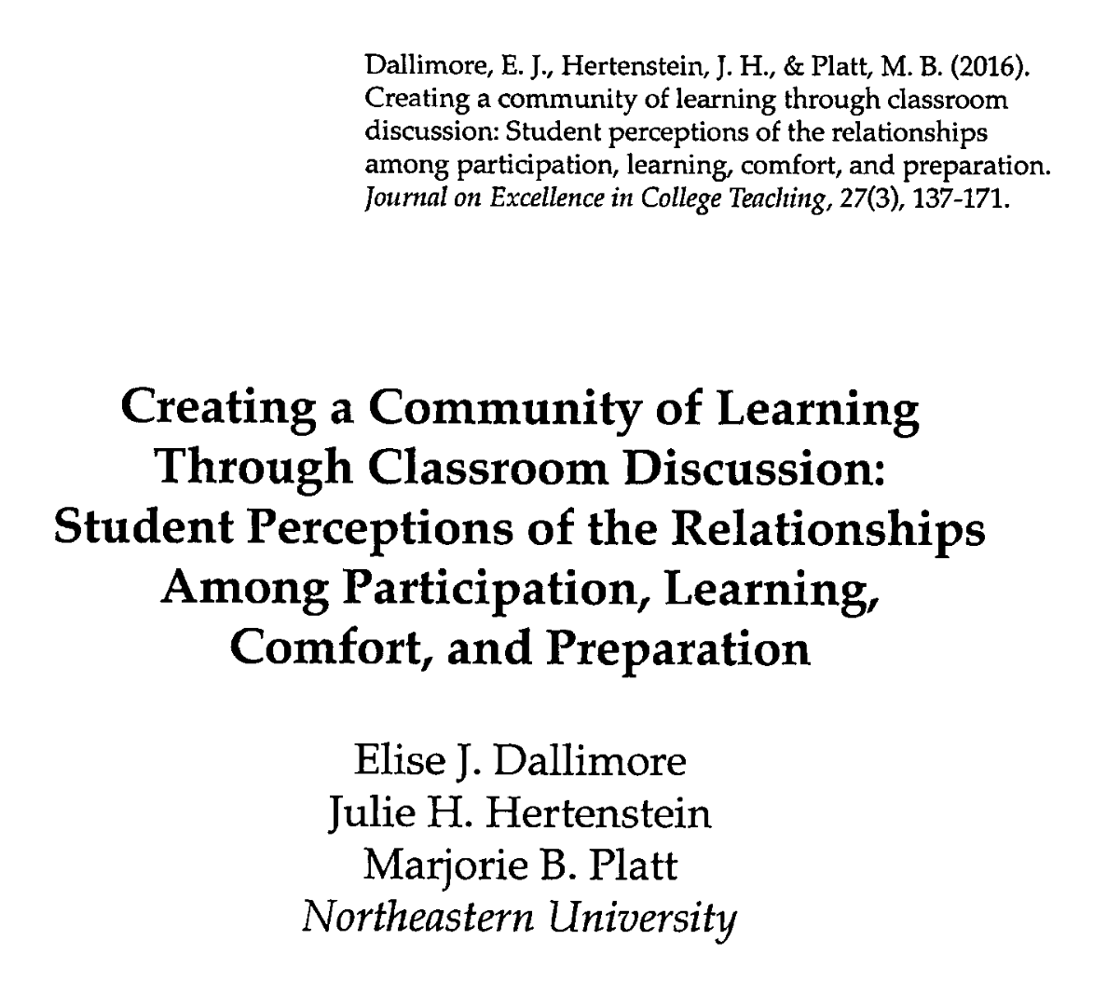
Best Practices & Learning
Outcomes for Discussion Pedagogy
Dallimore, Hertenstein & Platt (2016) back-up learning outcomes linked to discussion pedagogy.
Also stress power of student self-awareness & self-appreciation of this type of learning:
“Students identify five ways that discussion participation enhances learning, in­cluding:
1) increasing engagement,
2) remembering and retaining information,
3) confirming learning,
4) clarifying, and
5) deepening understanding. [...]
That students perceive and can so clearly articulate these relationships is an important finding… ” (166)
Notes:
A really good problem is one we don’t solve; it solves us. (219)
The implication for leaders then is to develop the capacity of individuals, groups, and communities to think and lead together by ex­ panding their collective ability to think with more complexity and empathy and to act with more intentionality.

Slide 9

Discussion Groups &
Inclusive Pedagogy (& AER)
“... it is clear that participation alone cannot act as the sign of inclusion. Silent listening, resistance towards class discussions, and refusals to engage with gendered, racialised, and classed expectations within the seminar space also appear as actions that might radically challenge understandings of participation as
they are currently framed in good practice models” (700)
“While teaching methods and activities that encourage participation certainly have their place in fostering inclusion, they should not be considered an exhaustive strategy for achieving inclusive classrooms, nor should they be seen as necessarily dealing equally well with all kinds of difference.” (708)
Notes:
A really good problem is one we don’t solve; it solves us. (219)
The implication for leaders then is to develop the capacity of individuals, groups, and communities to think and lead together by ex­ panding their collective ability to think with more complexity and empathy and to act with more intentionality.

Slide 10
ENG 1718: “Black Speculative Fiction”
Leadership Pedagogy Assignment:
“Team Discussion Leading”
“A really good problem is one we don’t solve; it solves us.” (Wagner 219)
Assignment Sheet - Linked here
Thank you!

Slide 11
Works Referenced
Dallimore, E. J., Hertenstein, J. H., & Platt, M. B. (2016). Creating a Community of Learning Through Classroom Discussion: Student Perceptions of the Relationships Among Participation, Learning, Comfort, and Preparation. Journal on Excellence in College Teaching, 27(3), 137–171.
Frank, S., & Moore, S. H. (2010). Reading, study, and discussion of the “great texts” of literature, philosophy, and politics as a complement to contemporary leadership education literature. Journal of Leadership Studies, 3(4), 71–80. https://doi.org/10.1002/jls.20141
Gibbs, J., Hartviksen, J., Lehtonen, A., & Spruce, E. (2021). Pedagogies of inclusion: A critical exploration of small-group teaching practice in higher education. Teaching in Higher Education, 26(5), 696–711. https://doi.org/10.1080/13562517.2019.1674276
Northouse, P. G. (2015). Leadership: Theory and Practice (Seventh Edition). SAGE Publications, Inc.
Odom. (2015). Undergraduate Student Perceptions of the Pedagogy Used in a Leadership Course: A Qualitative Examination. Journal of Leadership Education, 14(2). https://doi.org/10.12806/V14/I2/R2
Sibold, W. (2017). Enhancing Critical Thinking through Class Discussion: Taylor Institue Guide Series. Calgary University Taylor Institute for Teaching and Learning.
Wagner, W. (2016). Change. In S. Komives & Wagner, W. (Eds.), Leadership for a Better World: Understanding the Social Change Model of Leadership Development. John Wiley & Sons, Incorporated.

Slide 12
ENG 1718: “Black Speculative Fiction”
Leadership Pedagogy Assignment:
“Team Discussion Leading”
Assignment Learning Outcomes: By the end of this assignment, students will…
1) Sharpen evidence-based critical thinking skills.
2) Work collaboratively with peers in a team environment.
3) Learn to craft a ‘good discussion question’ (based on criteria we will discuss).
4) Build leadership skills & confidence to lead peers in focused & inclusive conversation.
5) Appreciate and engage a diverse array of perspectives and identities.
6) Deepen self-knowledge through reflection on strengths & areas for improvement.

Slide 13
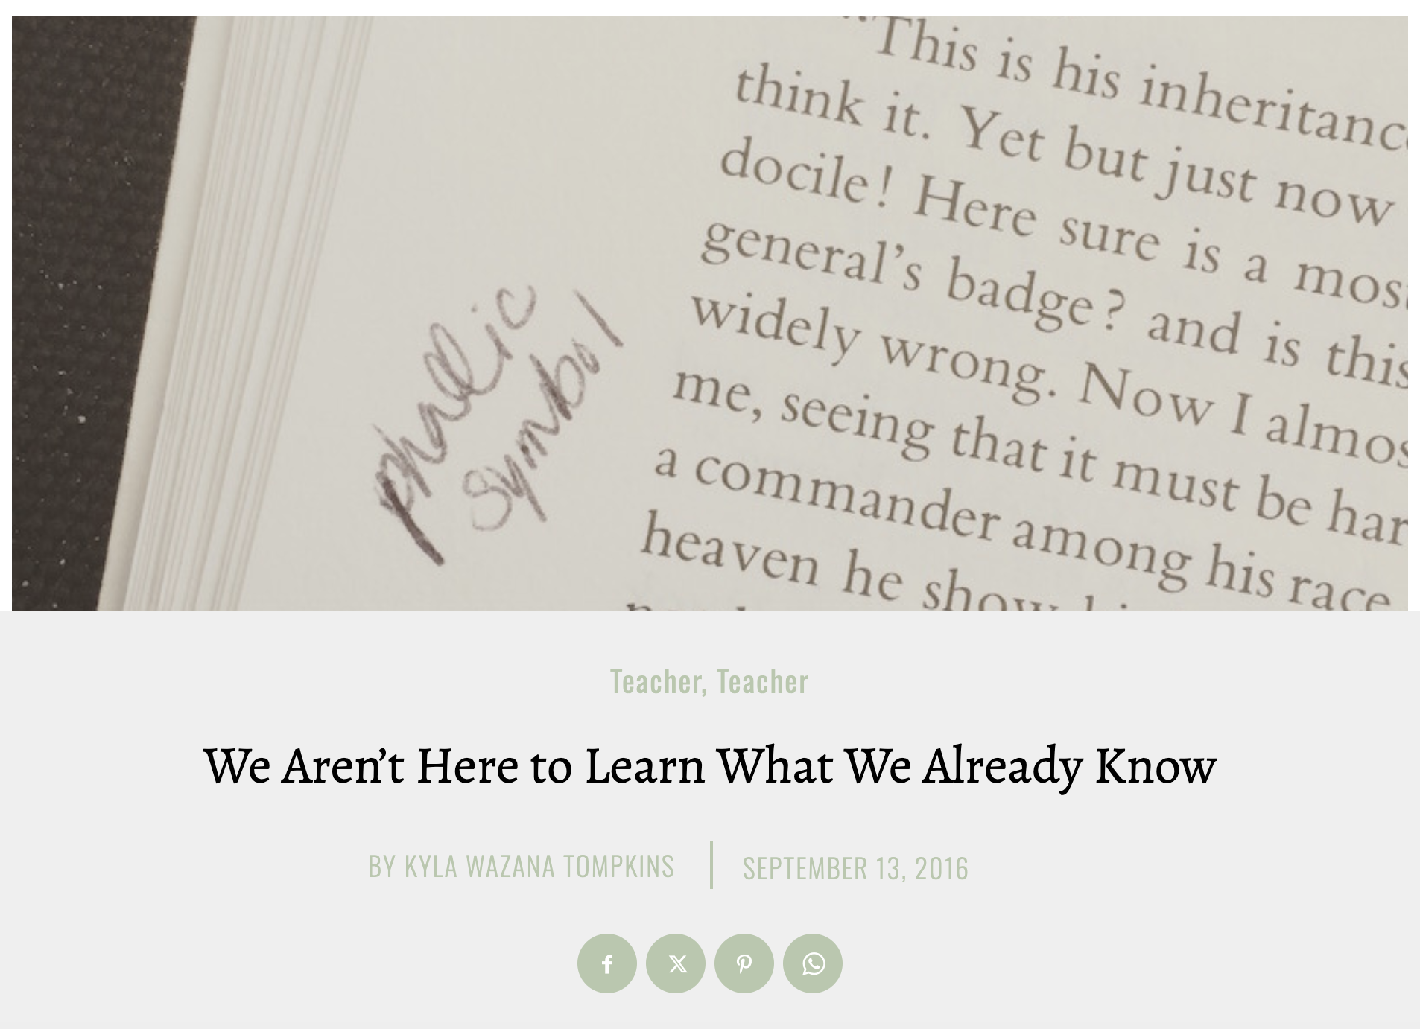
What is a “good discussion question”?

