Slide 1

Infusing Leadership Education into the Elon music theatre BFA
Courtney Liu
Leadership Education Faculty Fellow
Assistant Professor of performing Arts

Slide 2
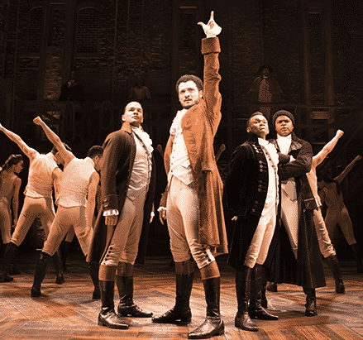
Music Theatre BFA Requirements
History of Music Theatre & Music Theatre Literature
Music Series: Materials of Music, Aural Skills, Piano, voice lessons for six semesters
Dance Series: four courses in Dance for the Musical Stage + 6 dance technique courses
Acting Series: Acting I, II, & III
Courses that combine all three skills: Performance in Music Theatre, Senior Seminar I & II, MTE 2700, & mainstage performances
Professional Practices

Slide 3
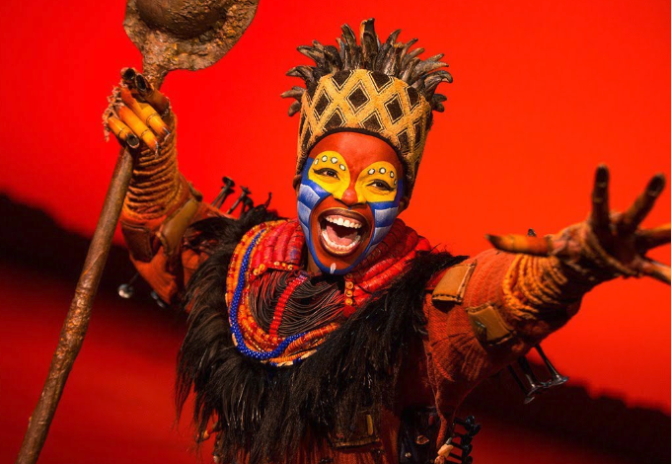
MTE 1000
Professional Practices
required weekly course
professional development opportunities, share creative work, engage in production critique and analysis
3-part Leadership Series

Slide 4
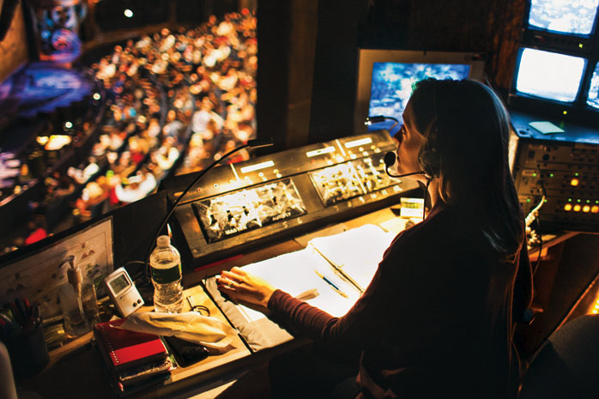
MTE 2700 Grand Night & Collage
Grand Night
  Student directed, choreographed, music directed, and arranged
  Class and identity numbers
  Large-scale numbers
  Goodbye to seniors
  Welcome for accepted students
Collage
  Family weekend
  Cabaret-style performance
  Adapt previous numbers
  Workshop new numbers
  Welcome first-year students

Slide 5
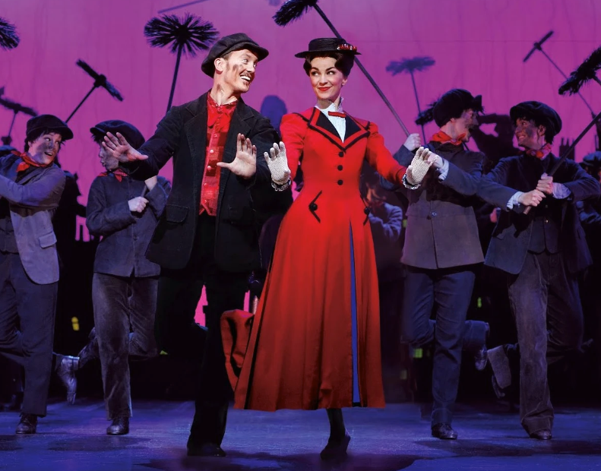
Part 1: Leadership series, MTE 1000
INTRODUCTION TO LEADERSHIP, Power, & Influence
What is leadership? What is power? Where does leadership occur in music theatre? What does it look like? Who are the leaders in music theatre?
Share definitions of leadership
  “A process whereby an individual influences a group of individuals to achieve a common goal” (Northouse 2016)
  “The process of people together attempting to accomplish change or make a difference to benefit the common good” (Komives 2009)
  “Influential increment over and above the mechanical compliance with the routine directives of the organization” (Katz & Kahn 1978)

Slide 6
Part 1: Leadership series, MTE 1000
INTRODUCTION TO LEADERSHIP, Power, & Influence
Power/influence and leadership
  Power = how you get someone to do something or “why would someone listen to you?”
  French & Raven Bases of Power
    Reward, coercive, expert, legitimate, referent
    Possible outcomes: resistance, compliance commitment
Discussions will center around how this applies directly to MTE 2700

Slide 7
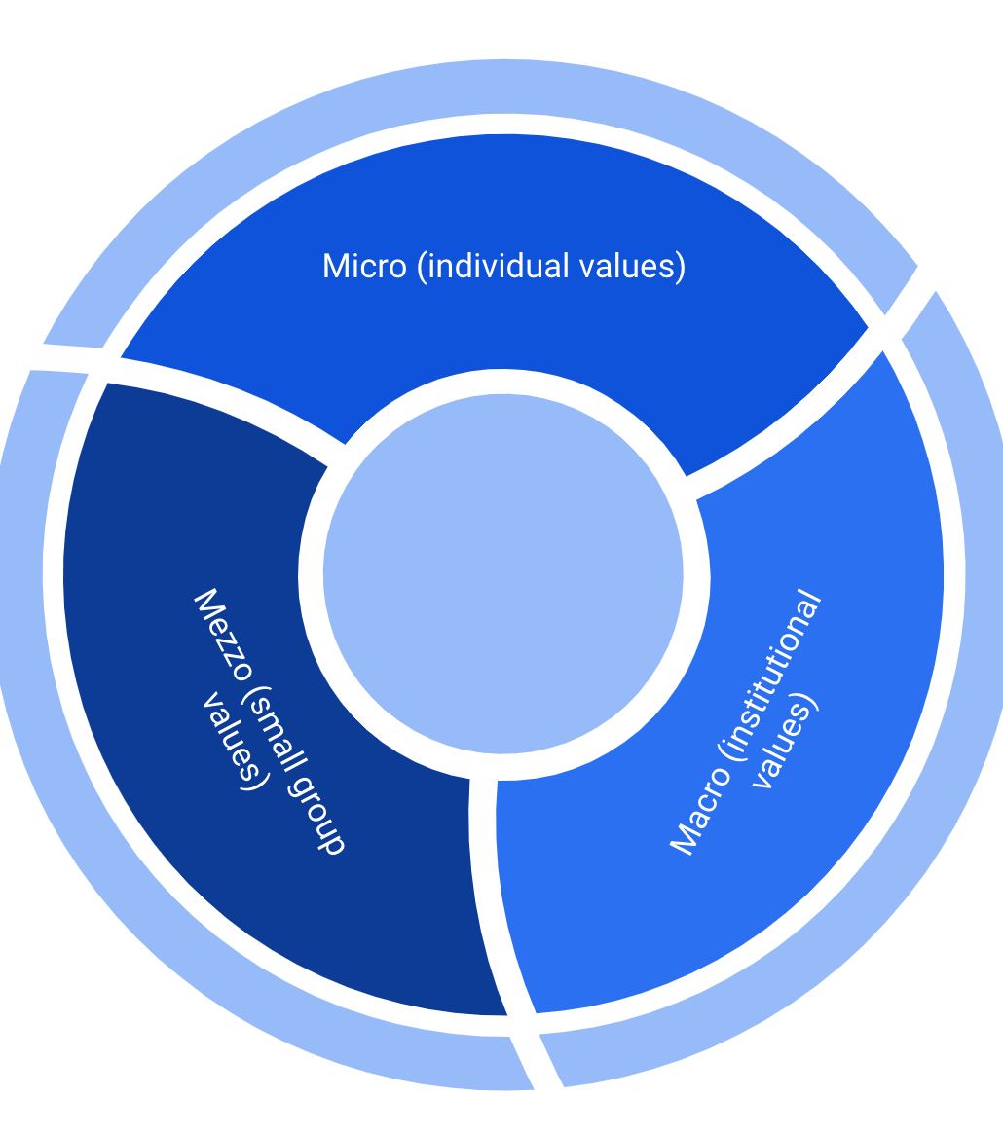
Part II: Leadership series, MTE 1000
ALIGNMENT of visions & Values Across leadership LEVELS
Definitions of micro, mezzo, & macro levels of leadership
Articulation of personal values
  Choose three from the list and define via demonstration
  i.e. A value I appreciate is communication. I know I see communication when a communicator chooses their words (either speaker or writing) with the receiver in mind.

Slide 8
Part II: Leadership series, MTE 1000
ALIGNMENT of visions & Values Across leadership LEVELS
Understanding mezzo interactions on creative teams
  Possible roots of conflict
    Clash of values on a spectrum
    Individual and cultural differences/ways of communicating
    Previous experience
Explore macro values of Elon, Elon Performing Arts, & Elon Music Theatre through Boldly Elon & mission statements
Locating the overlap of shared values
  i.e. Reflect on how our personal values affect the creative process and interact with the greater mission of Grand Night & Collage

Slide 9
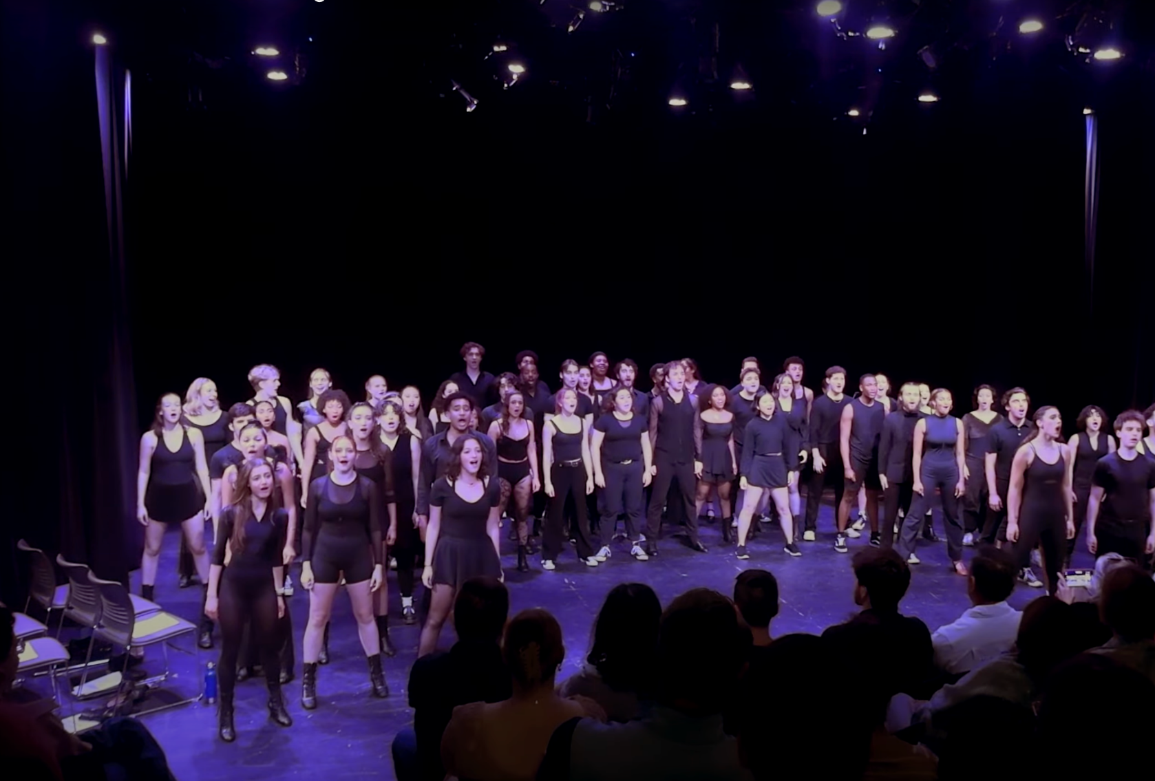
Part III: Leadership series, MTE 1000
APPLICATION TO MTE 2700 AND THE PROFESSIONAL INDUSTRY
Theatre Industry Leadership Tree
  Local/state/federal government, nature, limited resources, human limits → + Elon
  Producing team, Artistic Director, Board → Faculty Co-Directors
  Creative & Design Team → Elon MT BFAs
  Performers & Crew→ Elon MT BFAs
  Discussion about real world challenges and MTE 2700

Slide 10
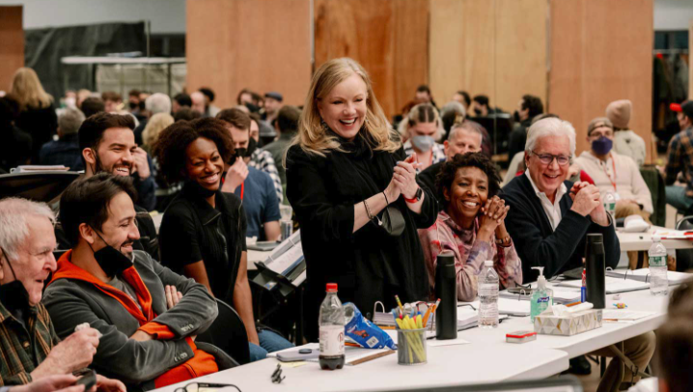
Part III: Leadership series, MTE 1000
APPLICATION TO MTE 2700 AND THE PROFESSIONAL INDUSTRY
Application Questions for MTE 2700
  Reflect on the definitions of leadership that were covered in Session 1. Based on what you have learned, create your own definition of leadership as it would apply to the process (i.e. how folks show up and interact) and product (i.e. making a smash pre-bway hit!) of your Grand Night number?
  Describe how you will go about referent power. What other types of power do you see as important and appropriate for your Grand Night number?

Slide 11
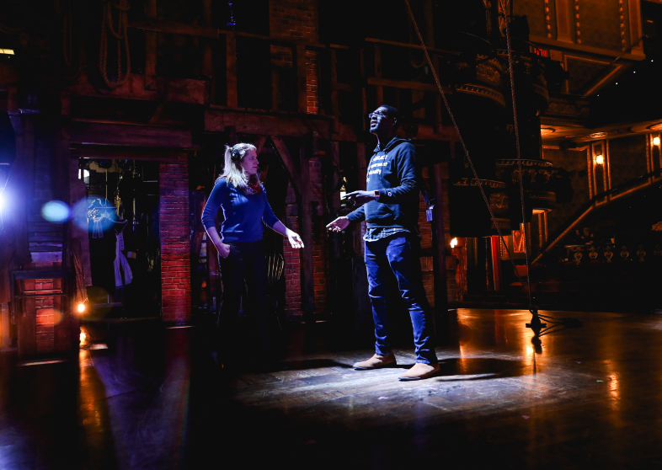
References
Northouse, P.G. (2016). Leadership: Theory and practice (7th ed.). Thousand Oaks, CA: Sage Publishers, Inc.
Komives, Susan R., Nance Lucas, and Timothy R. McMahon. Exploring leadership: For college students who want to make a difference. John Wiley & Sons, 2009.
Katz, D., & Kahn, R. L. (1978). Social psychology of organizations (2nd ed.). New York: John Wiley.
Special thanks to Raj Ghoshal, Chris Leupold, Keshia Wall, & the 23-24 Cohort of Leadership Education Faculty Scholars
Courtney Liu
Leadership Education Faculty Scholar
Assistant Professor of performing Arts

