Slide 1
Cross-cultural Leadership Development Through Collaborative Online International Learning (COIL)
Sandy Marshall
Leadership Faculty Fellow, 2023-24
DRAFT – March 13, 2024

Slide 2
OUTLINE
Define key concepts related to Cross-Cultural Leadership (CCL)
Identifying best practices and benefits of COIL
Examine how COIL can promote CCL
Outline of COIL leadership project
Questions/Suggestions?

Slide 3
Cross-Cultural Leadership
Culture = values, beliefs, and implicit assumptions about the world
Cross-cultural leadership has moved away from the pursuit of universal leadership principles to a focus on the impact of cultural dimensions on leadership styles and practices (Leithwood, 1998; Dickson, 2003; Hanges 2016).
Increasing demand for and complexity of leadership is cross-cultural settings requires cultural awareness and adaptability (Shankar Dobey 2018; Kumar, 2011)
Need to lead and motivate teams with different cultural backgrounds and values (Frost, 2007) which can moderate the outcomes of different leadership styles (Hanges, 2016).

Slide 4

COIL
Partnerships between instructors and students in different countries collaborating on jointly-constructed learning experiences
Promotes:
  Intercultural understanding
  Global perspective taking
  Interdisciplinary learning
  Organization
  Communication
  Time management
  (Harris 2021, Drobotun, 2023; Bauk, 2019

Slide 5

COIL
Working in diverse Teams
Virtual Collaboration
Cultural Awareness Training
Interdisciplinary Problem-Solving
Intercultural Communication
Global Perspective
Reflection and Feedback
& Cross-Cultural Leadership

Slide 6

COIL Project
Collaboration between IGS 2500 at Elon and High-Intermediate English class at an-Najah University (Palestine)
LEARNING GOALS:
Think critically and engage in meaningful cross-cultural dialogue on issues related to democracy, justice, human rights, and equality n ways that challenge Western-centric perspectives.
Identify and compare examples of youth leadership and political/civic engagement in different cultural settings.
Be able to advocate for practices or policies that support justice, inclusion, and democratic engagement by and for young people in multiple modalities, verbally and in writing.
“Young People’s Leadership & Political Engagement in the US & Palestine”

Slide 7
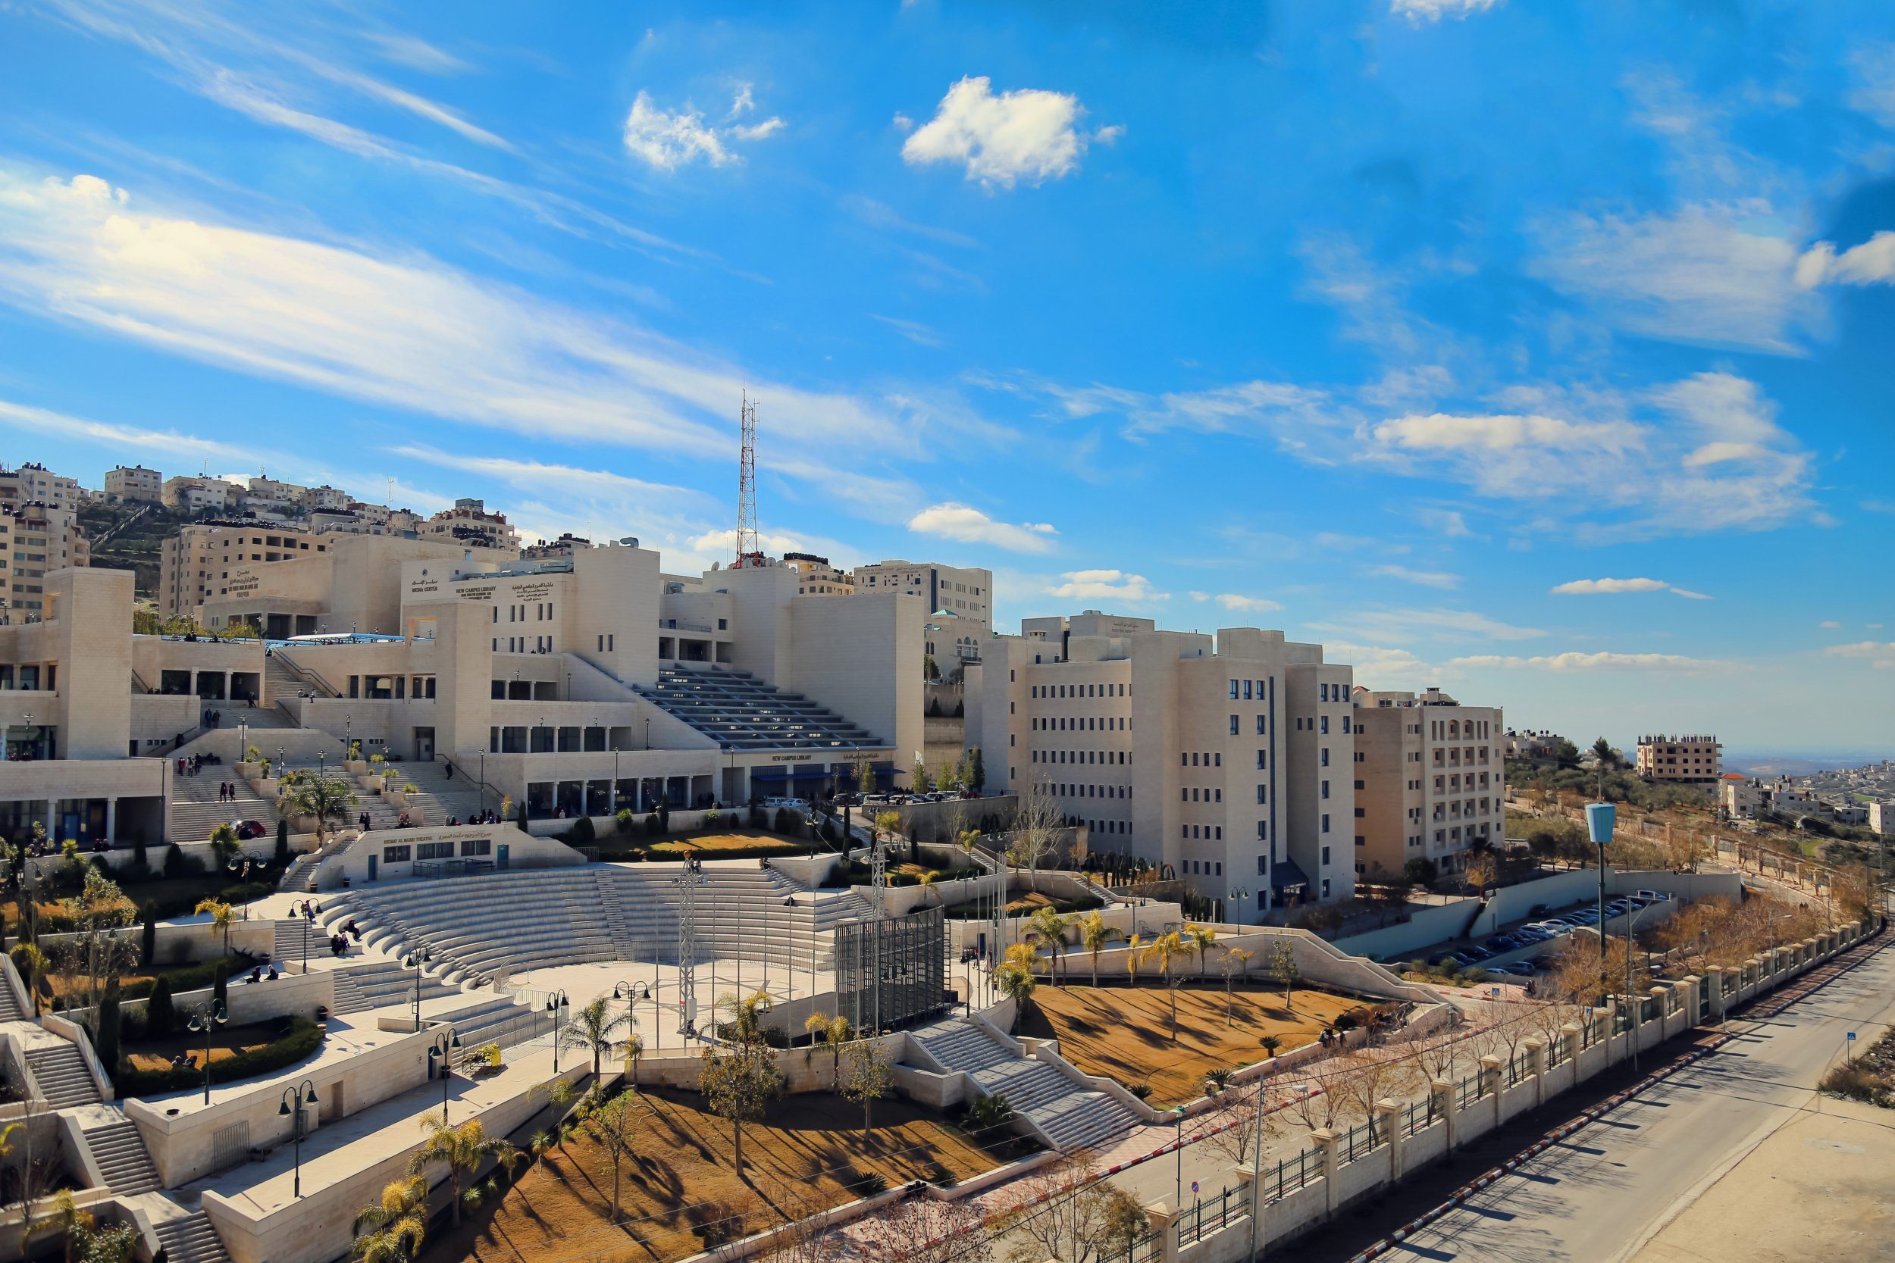
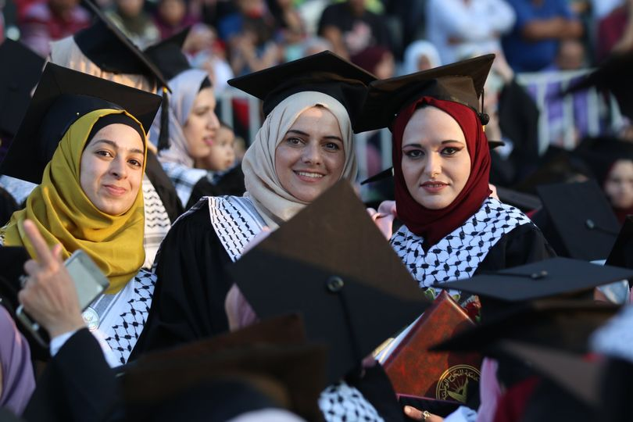
COIL
WEEKLY LEARNING ACTIVITIES
Week 1 - Introductions (asynchronous
Week 2 - Day-in-the-life
Week 3 - Mapping Your Cultural Orientation
Week 4 - Home Town Tour
Week 5 - Visualizing Democracy
Learning Activities

Slide 8
COIL
Weekly written reflections
Expectations: What are you hoping and expecting to get out of this collaboration? What are you excited about? What are you nervous about?
First Impressions: What are your first impressions so far? How have your assumptions been challenged?
Messy Reality: Glow & Grow/Roses-Buds-Thorns
Summative reflection: What have you learned, how have you changed, how have you grown, and where do you go from here?
Weekly Reflections & Learning Assessment

Slide 9
COIL
Create a deliberative dialogue guide for a global issue (e.g. does social promote civic engagement or disinformation? )
Engage in an in-class deliberative dialogue on this topic.
Student groups then create a strategy for sharing what they learned publicly. Options include creating an InstaGram story, TikTok videos, sharing with audiences in their own contexts.
Final Project

Slide 10
Thank YOU!
QUESTIONS?

