Slide 1
Fostering Interfaith Leadership
REL 3110: Interreligious Encounters and Social Change
Brian K. Pennington

Slide 2

Interreligious Studies as an Emerging Field
Critical Theory strand
  Focused on understanding the dynamics of interreligious encounter in the context of colonialism, global capitalism, etc.
Normative strand
  Focused on training of leaders to promote interreligious cooperation for social change

Slide 3



Interreligious Studies as an Emerging Field

Slide 4


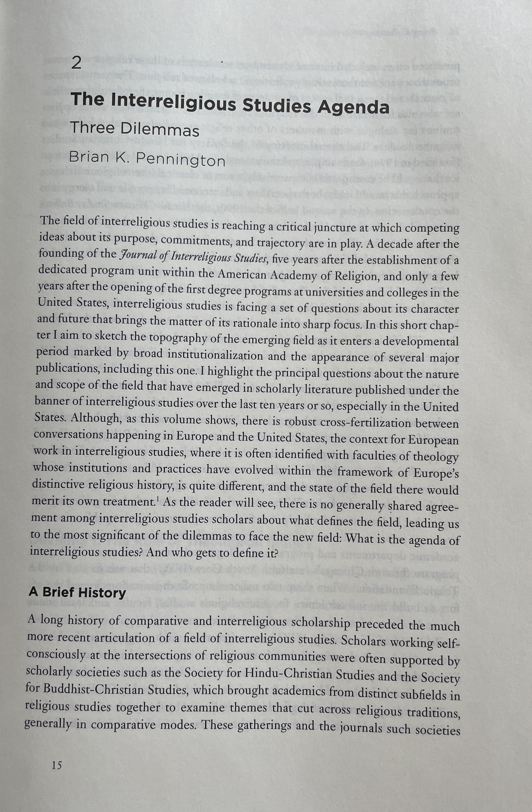
Interreligious Studies as an Emerging Field

Slide 5
Interreligious Studies at Elon
Interdisciplinary minor that includes courses in ARH, HIS, GEO, ENG, PLS, SPN, and more
One of the country’s first academic programs in the field
Capstone: REL 3110 Interreligious Encounters and Social Change (Instructors: Brian Pennington and Helen Orr)

Slide 6
REL 3110: Interreligious Encounters and Social Change
Course Description (revised)
This course draws from the emerging field of interfaith studies and aims to bring theoretical models for understanding the nature and consequences of interreligious encounter into dialogue with a) data from historical and contemporary instances of encounter, and b) major frameworks for understanding leadership. It will provide students a historical scaffolding for examining the encounter of religious traditions over time, familiarize them with typologies of encounter, and help them think critically about the nature of pluralism, tolerance, and interfaith leadership.

Slide 7
Course Objectives
Students will produce nuanced reflections on ways that religious traditions and religious communities have interacted with other religious traditions and communities throughout history.
Students will critique existing models for understanding and facilitating interreligious engagement and offer constructive suggestions for improving these models.

Slide 8


Slide 9
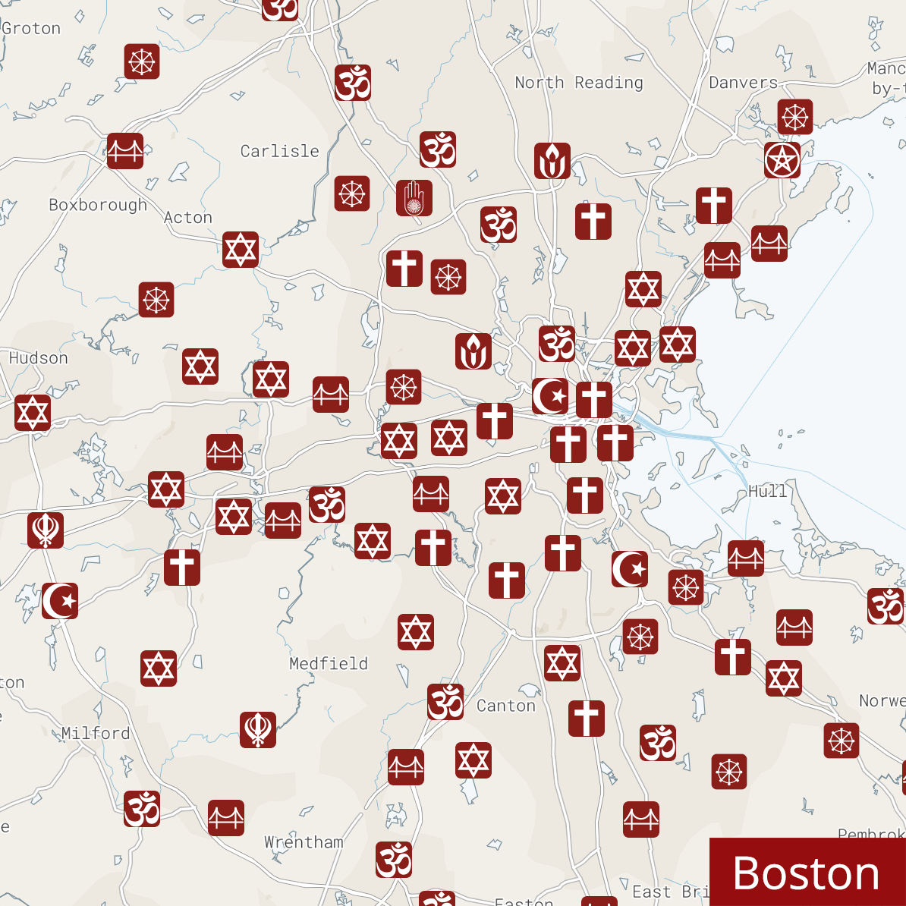
Religious Diversity in Greater Boston

Slide 10
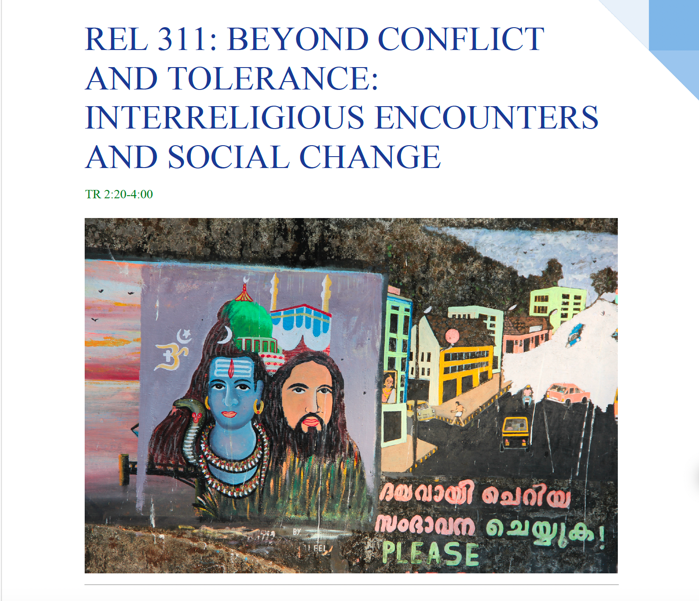
Leadership Faculty Scholars Project
Revise REL 3110 for inclusion in the Leadership Studies minor
  Course objectives
  Unit on leadership models
  Strengths finder/team building
  Capstone project

Slide 11
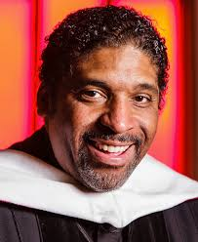
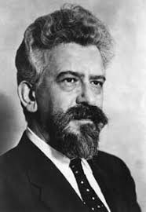
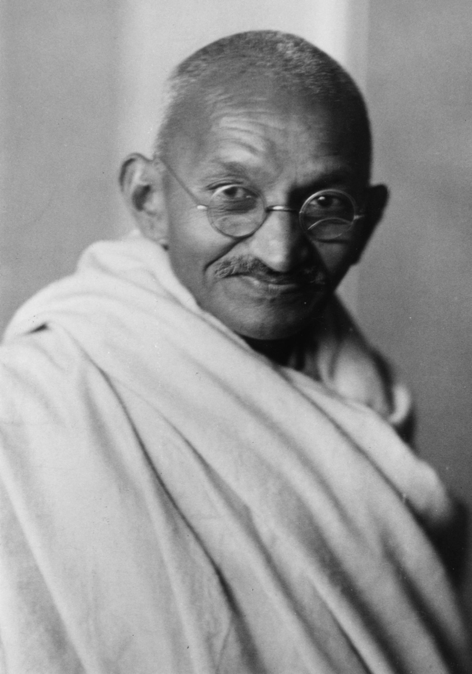

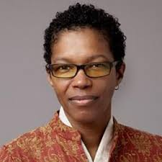
Assignment: Profile of an Interfaith Leader

Slide 12
Assignment: Profile of an Interfaith Leader
History of the organization/biography of the leader
Focus on change or development over time
Impact assessment
Leadership Analysis using Social Change or Interfaith Leadership framework
Analysis oriented around the values the organization/leader espouses or exhibits and the processes by which they advance their objectives.

Slide 13
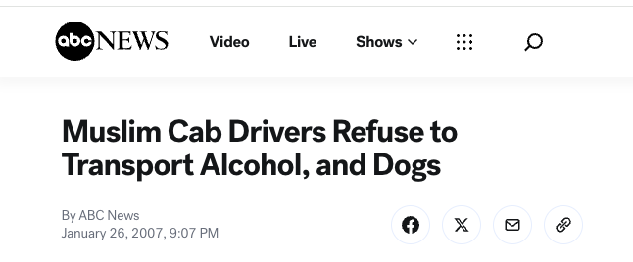
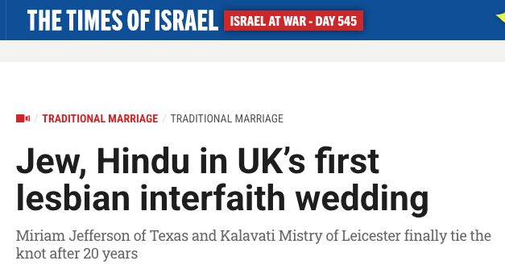
Assignment: Development of a Pluralism Case Study

Slide 14
Assignment: Development of a Pluralism Case Study
Students produce a Pluralism Project-style case study
Material drawn from news sources, films, personal experience, family history, etc.
Case study examines the issues related to interreligious encounter that it highlights
A Leadership Analysis examines themes and questions related to leadership studies:
  What leadership qualities and characteristics are displayed in this case?
  Where are leadership deficits?
  What values or commitments derived from the Social Change or Interfaith Leadership model would promote resolution of this conflict?

