Slide 1


Leadership in Engineering Design
Will Pluer
4/3/2025

Slide 2
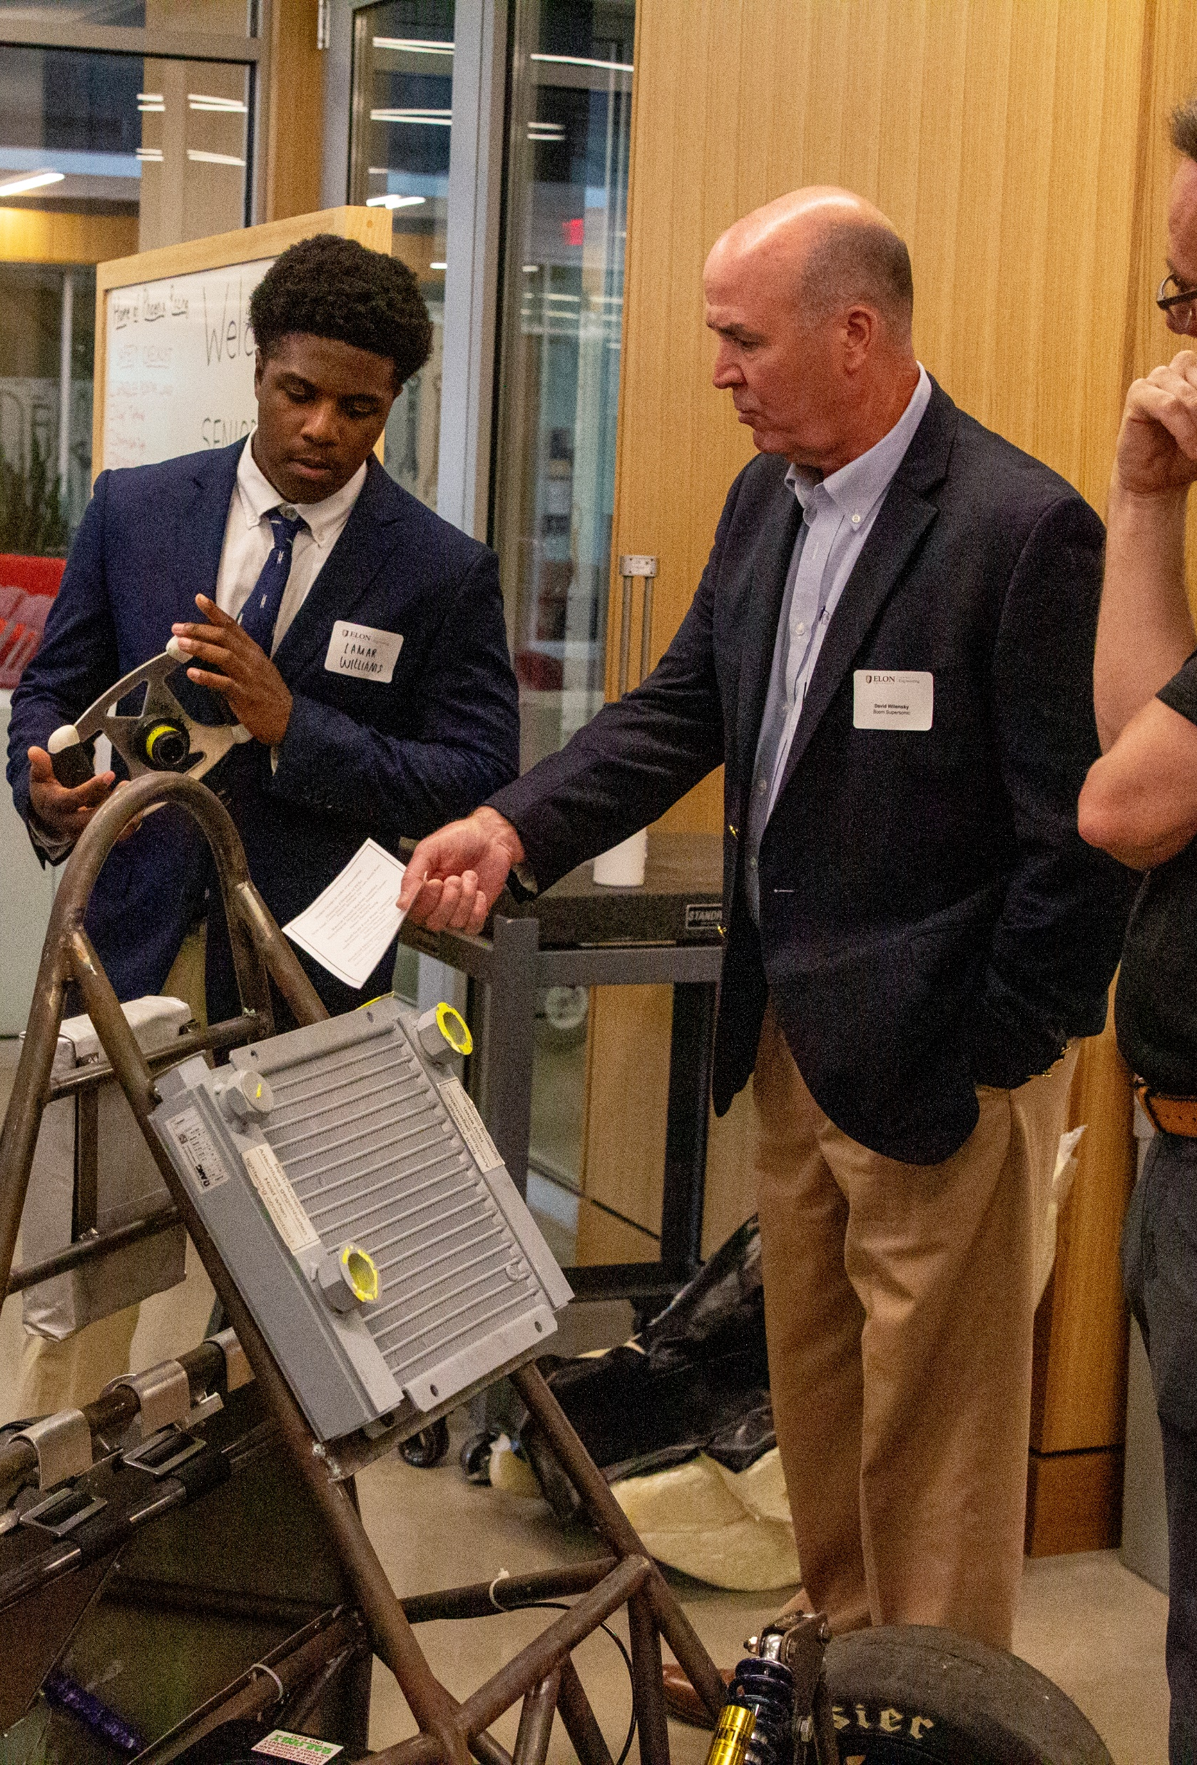
What is SPEED
Senior Projects in Elon Engineering Design
Small teams of senior engineers
Problem-solving
Yearlong
Real-world
Technical
Collaboration with external organization
Notes:
Interesting projects
Experiential learning
Professionalism
Networks

Slide 3














Partners

Slide 4
Groups to Teams
Group: individuals completing tasks that add up to a single outcome
Team: individuals working collaboratively toward a common purpose while supporting each other with leadership, accountability, and inclusivity
Moving from group to team requires thoughtful reflection
  Who students are as individuals
  What they value
  How they work
  How they interact with and
  impact others
Social Change Model

Slide 5
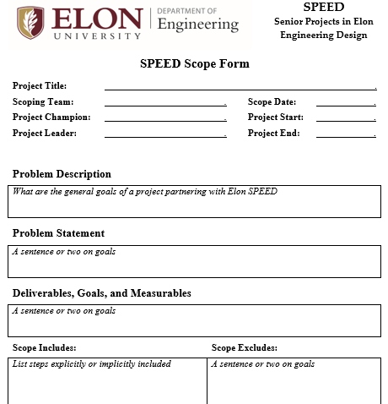
Team Support
Scope: detailed expectations for project
Champion: partner role and is a person in a decision-making capacity
Leader: partner role and is the person that commits time to work with the team
Subject Matter Expert: faculty or partner member with technical knowledge
Stakeholder: a person that influences inputs or is impacted by outcomes

Slide 6
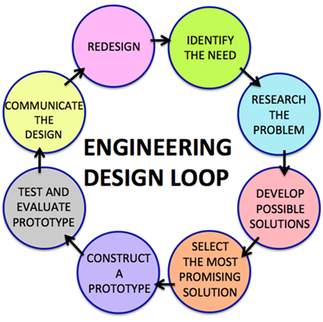
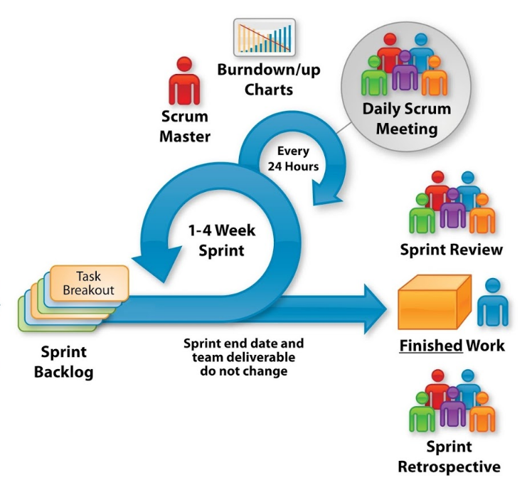
Course Milestones
Stakeholder engagement
Ideation review
Detailed design packet
Functional mockup & design
Functional prototype
Testing results
Final design report
2-3
per week

Slide 7
Leadership Competencies
Ensures accountability
Action oriented
Collaborates
Communicates effectively
Manages conflict
Decision quality
Values differences
Demonstrates self-awareness
Nimble learning
Plans and aligns
Resilient
Self-development
Instills trust
Drives:
  Engagement
  Vision and purpose
  Results

Slide 8
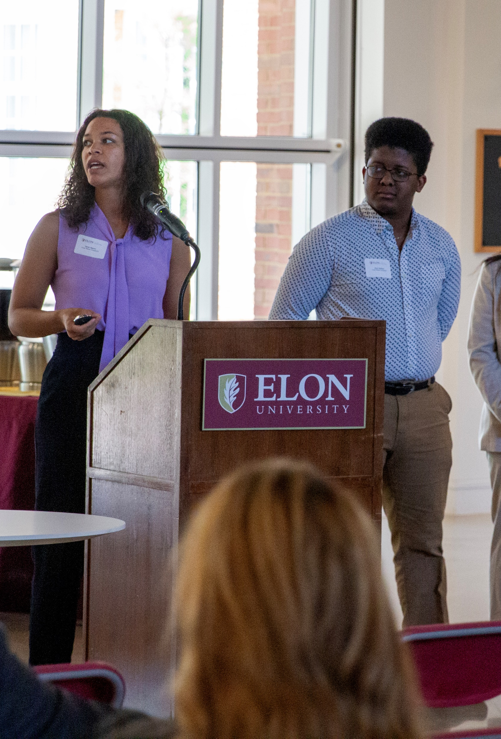
Portfolio Objectives
Explore your personality, strengths, and default ways of interacting with others
Learn about characteristics and values of effective teamwork and leadership
Reflect on who you are within a team and organization and how you impact others
Set goals for how you can strengthen your teamwork and leadership

Slide 9
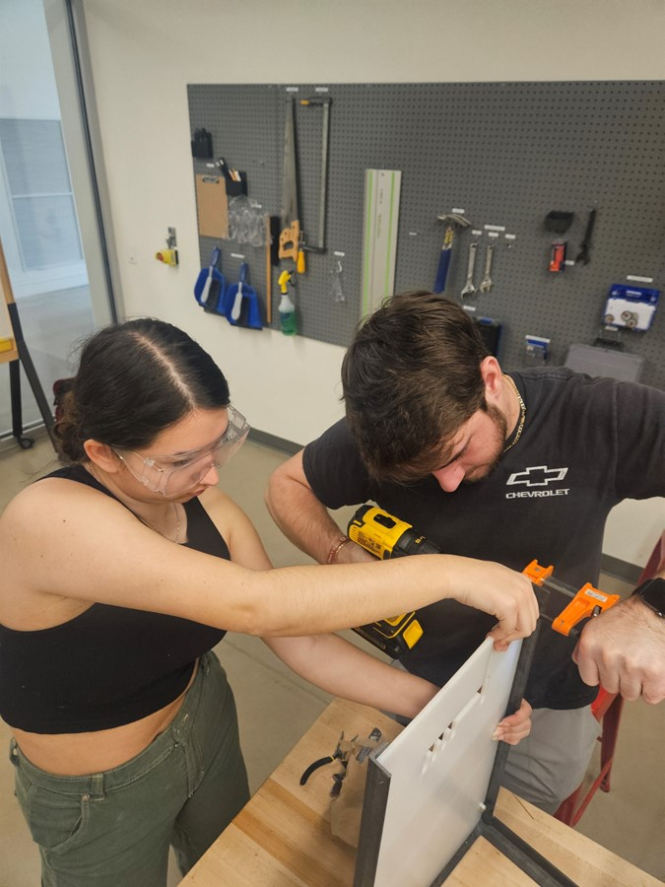
Portfolio Assignment
Read
Reflect
Respond
Compile

Slide 10
Leadership Readings
What Makes a Leader (Goleman)
Secrets of Great Teamwork (Haas & Mortensen)
Zombie Leadership (Haslam, Alvesson & Reicher)
A New Prescription for Power (Lingo & McGinn)
Courage to Take Moral Action (Chaleff)
Getting Serious About Diversity (Ely & Thomas)
How to Become a Better Ally (Warren & Sekhon)
Change (Wagner)
The Now, New, and Next of Digital Leadership (Quaquebeke & Gerpott)

Slide 11
Leadership Assessments
Gallup Strengths
Workplace communication styles
Goleman’s Leadership styles
Values mapping
5 factor assessment
MBTI
Enneagram test
Daring leadership assessment

Slide 12
Rubric
Summarize
Provides comprehensive description of resource or assessment results
Reflect
Demonstrates critical thinking and insightful analysis
Connect personal reactions, theoretical knowledge, and professional implications
Apply
Articulates specific, actionable, and innovative strategies for personal growth

Slide 13
Performance Reviews
Knowledge Competencies
Job knowledge
Technical knowledge
Knowledge acquisition
Work Competencies
Quality of work
Dependability
Initiative
Decision-making
Safety
Interpersonal Competencies
Communication
Working relationships
Broader impact
Overall
Strengths
Weaknesses
Reflection
Personal goals

Slide 14

Extension of Portfolio
Strengths interview language
Career development
Exit interview

Slide 15
Thanks

