Slide 1

Leadership in Nursing: Creating Future Nurse Leaders
Dr. Stacey Thomas
Assistant Professor of Nursing
Leadership Faculty Scholars 2024-2025 Cohort

Slide 2

Leadership in Nursing: Creating Future Nurse Leaders
Elective Nursing course
Designed for Nursing Fellows
  Instructor permission for others with strong leadership interests
Senior year course

Slide 3

Leadership Frameworks
Relational Leadership
  Build trust
  Foster inclusivity
  Prioritize relationships
Servant Leadership
  Service to others
  Ethical-decision making
  Empowering team members

Slide 4
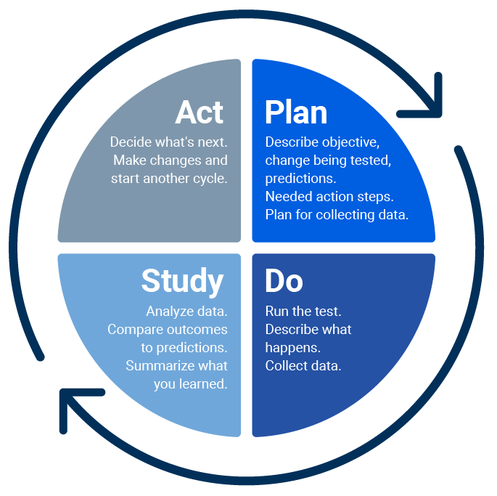
Disciplinary Focused Work
Complete a minimum of 40 hours of service with the following
  Assist with open-lab hours
  Peer tutoring sessions
  Participate in underclass student clinical as Care Coordinator/Charge Nurse
Group project that identifies and problem solves a potential leadership related issue in a clinical setting
  Project will utilize the Plan-Do-Study-Act (PDSA) model of Quality Improvement

Slide 5

Student Deliverables
Weekly reflective journal entries
  Using “What? So What? Now What?” framework to discuss weekly experiences
Interactive class discussions based on weekly readings about leadership and how readings support both the relational and servant leadership models
Periodic exams based on content readings
Group project with presentation

