Slide 1


YOUR COURSE IS IN
Beginning with the Fall 2026 semester, Elon is using Canvas instead of Moodle.
To get started: Log in at
IMPORTANT
www.elon.edu/canvas
After logging in for the first time, verify your Elon email address in Canvas as part of setting up your account.
using your Elon account.
For this course, you'll use Canvas to:
  Access course materials
  View Grades
  Submit assignments
  Receive course announcements
Find all student resources and support on the Canvas Transition Hub.

Slide 2
QUESTIONS? START HERE!
Learning how to use Canvas?
Have a question while using Canvas?
Explore “Passport to Canvas” for a self-paced introduction.
Use 24/7 Canvas Support from the Help menu for questions about assignments, grades, navigation and other features.
Can't find one of your courses?
Having trouble logging in or accessing your account?
Courses may become available at different times. If a course should be available but you don't see it, contact your instructor first.
Contact the Technology Service Desk.
Find all student resources and support on the Canvas Transition Hub.

Slide 3
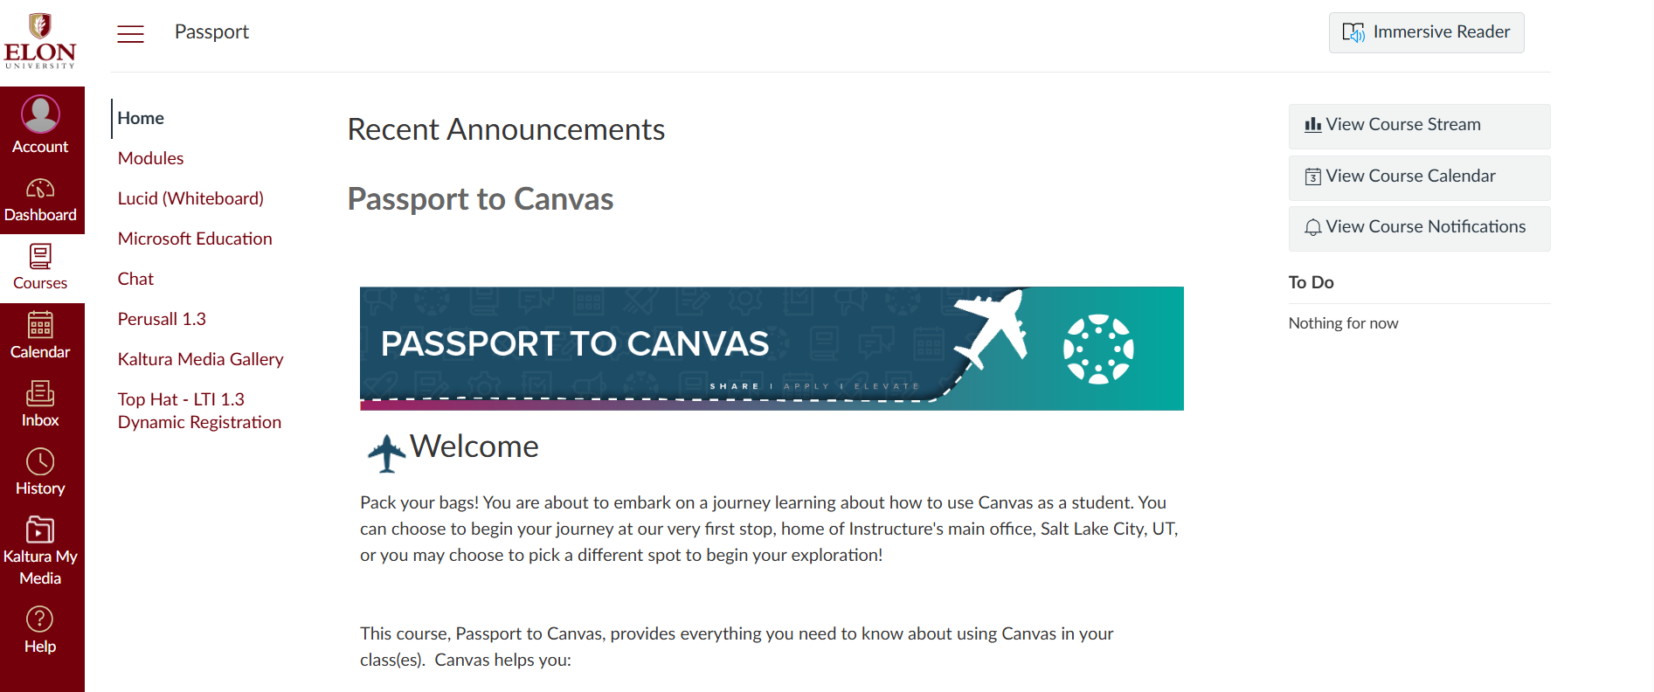
FINDING YOUR WAY AROUND THIS COURSE
In this course:
  Start with Modules to find weekly/course content.
  Check Announcements for course updates.
  Review Assignments for upcoming work.
  Use Grades to view feedback and grades.
Your instructor may organize Canvas a little differently from your other courses.

