Slide 1
Presented by Elon University Police Department
RAVE GUARDIAN & E-ALERTS

Slide 2
E-ALERTS
Alerts come through RAVE
All students, staff, and faculty are automatically enrolled
Elon University email account
Cell phone provided in Ontrack

Slide 3
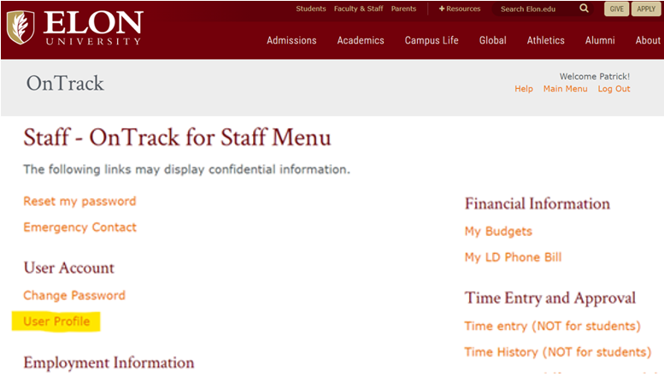
ACCESS YOUR ACCOUNT IN ONTRACK
Log in to Ontrack at https://www.elon.edu/ontrack
Under User Account, Click User Profile
This will load your User Information page

Slide 4
UPDATE/ADD YOUR CELL PHONE
Scroll to the “Phone Numbers” section and add or update your cell phone number
Updates will sync with E-Alert at 6:30 AM every morning

Slide 5
RAVE GUARDIAN

Slide 6
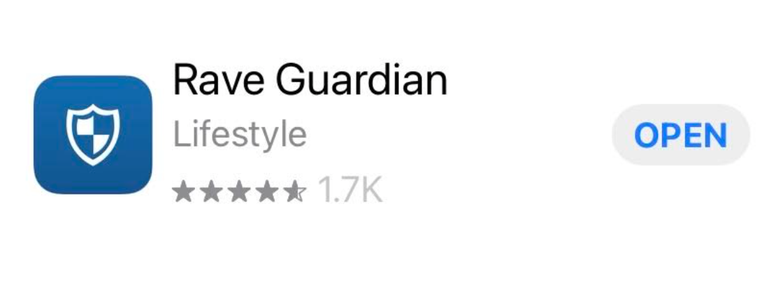
RAVE
PLATFORM
An easy to use powerful platform for
critical communication and collaboration

Slide 7
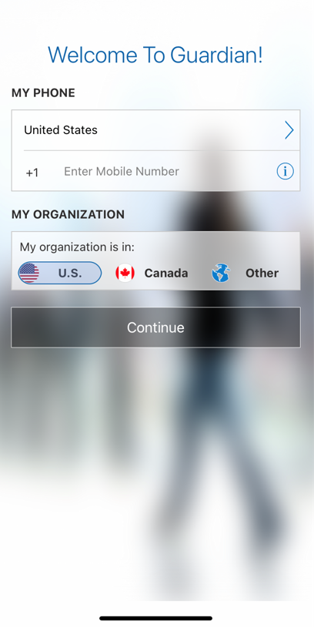
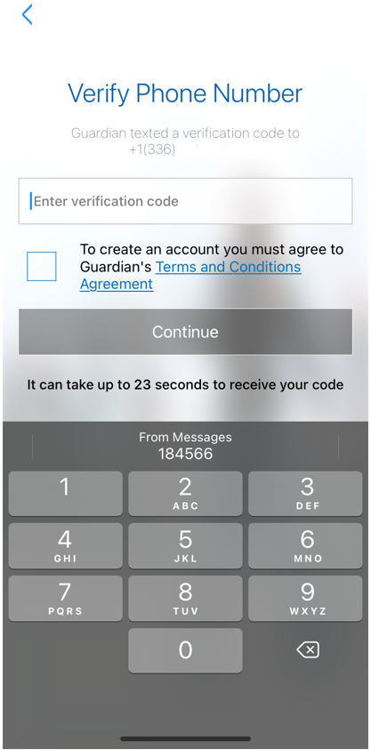
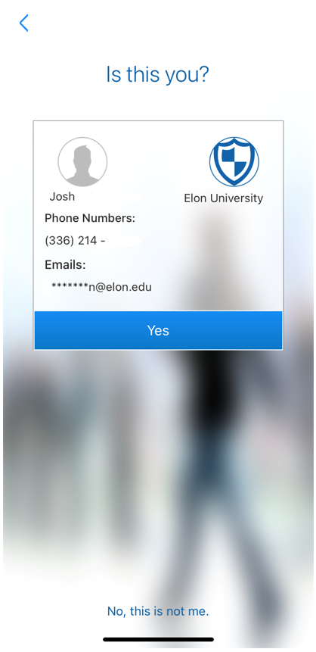
SAFETY IS A COLLABORATIVE RESPONSIBILITY

Slide 8
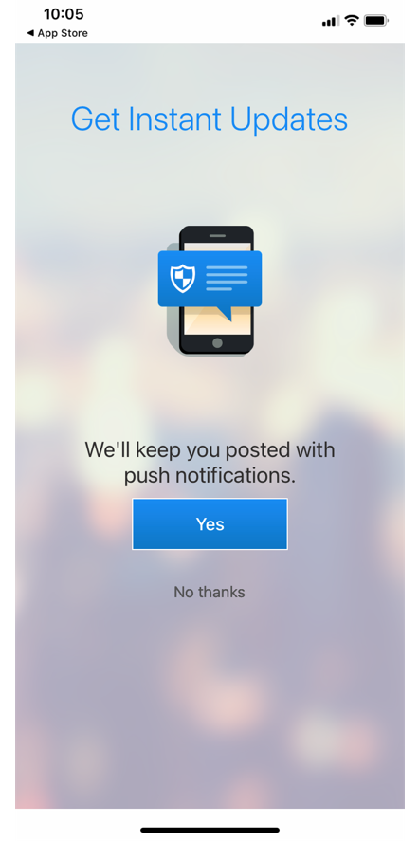
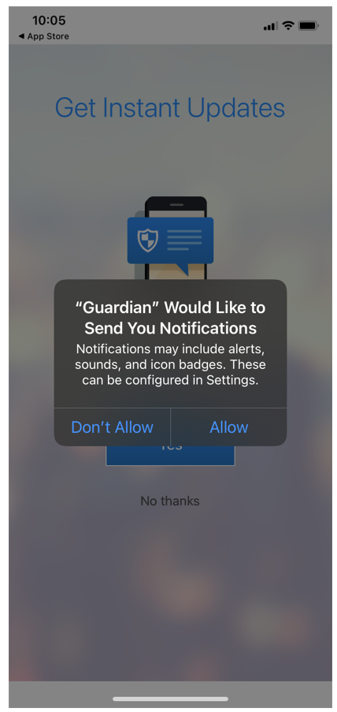
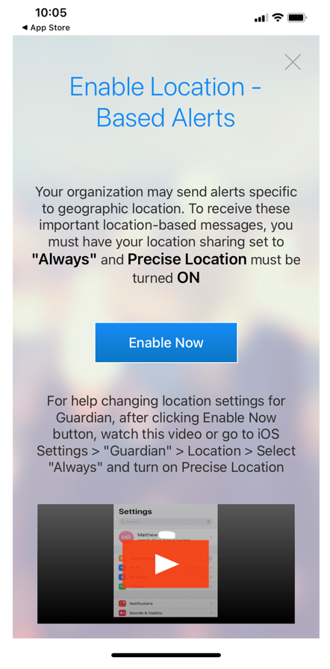
STAY UPDATED

Slide 9
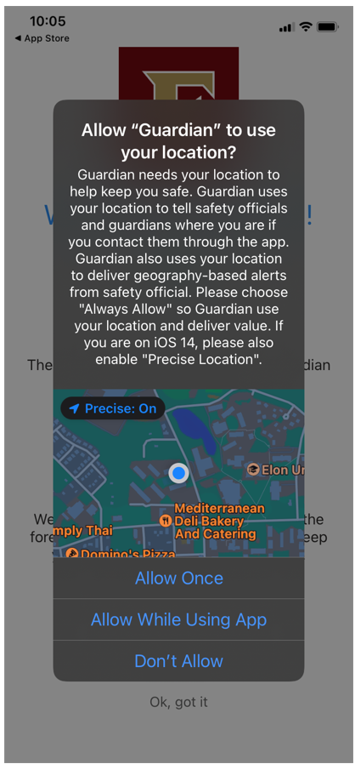
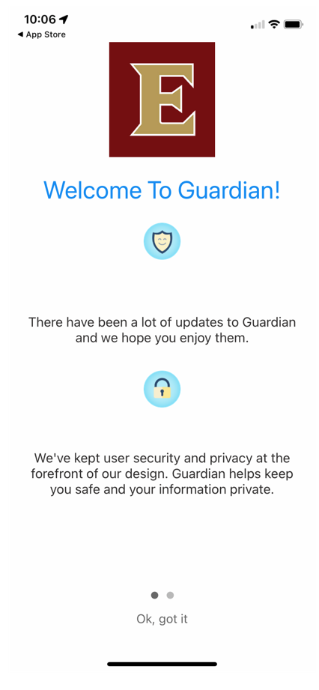
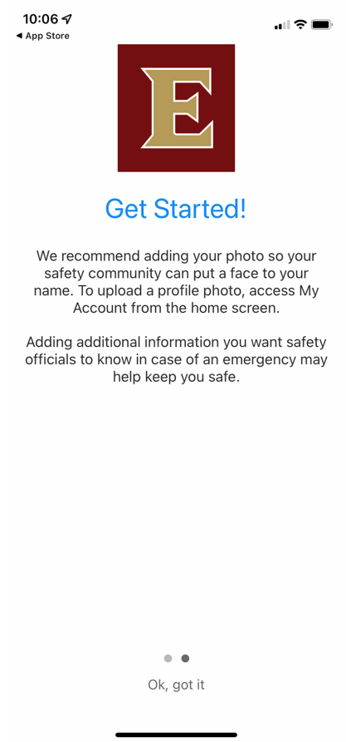
Guardian helps keep you safe and your information private.

Slide 10
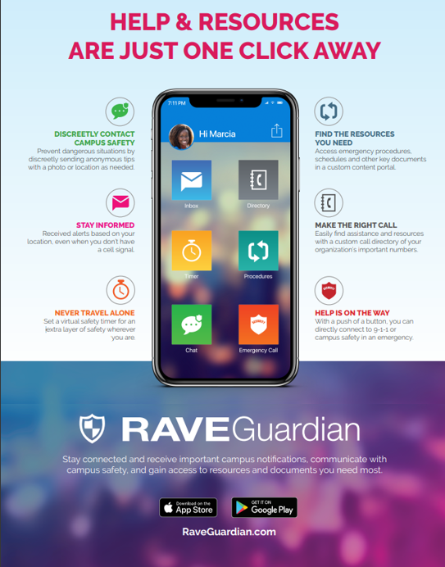
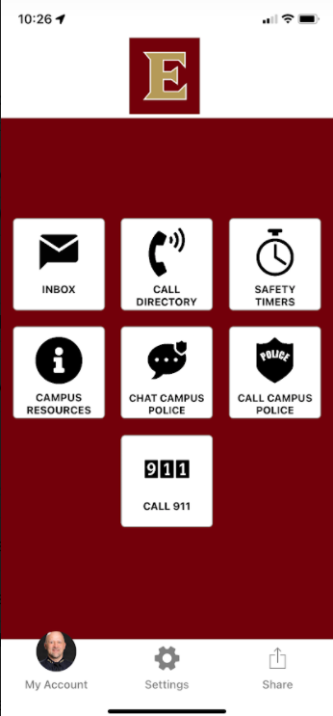
DISCREETLY CONTACT CAMPUS SAFETY
FIND THE RESOURCES YOU NEED
STAY INFORMED
MAKE THE RIGHT CALL
NEVER TRAVEL ALONE
HELP IS ON THE WAY

Slide 11
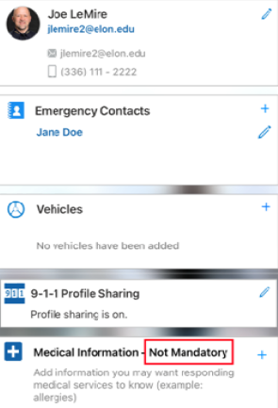
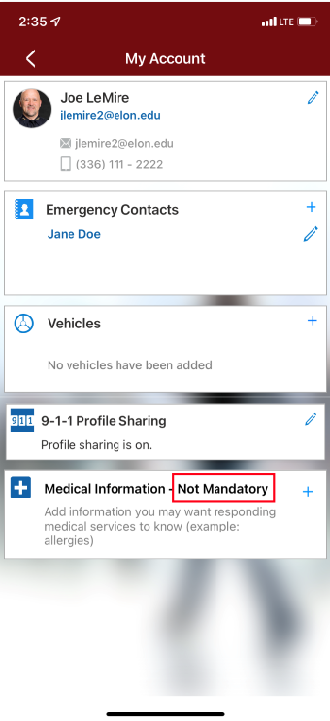

Slide 12
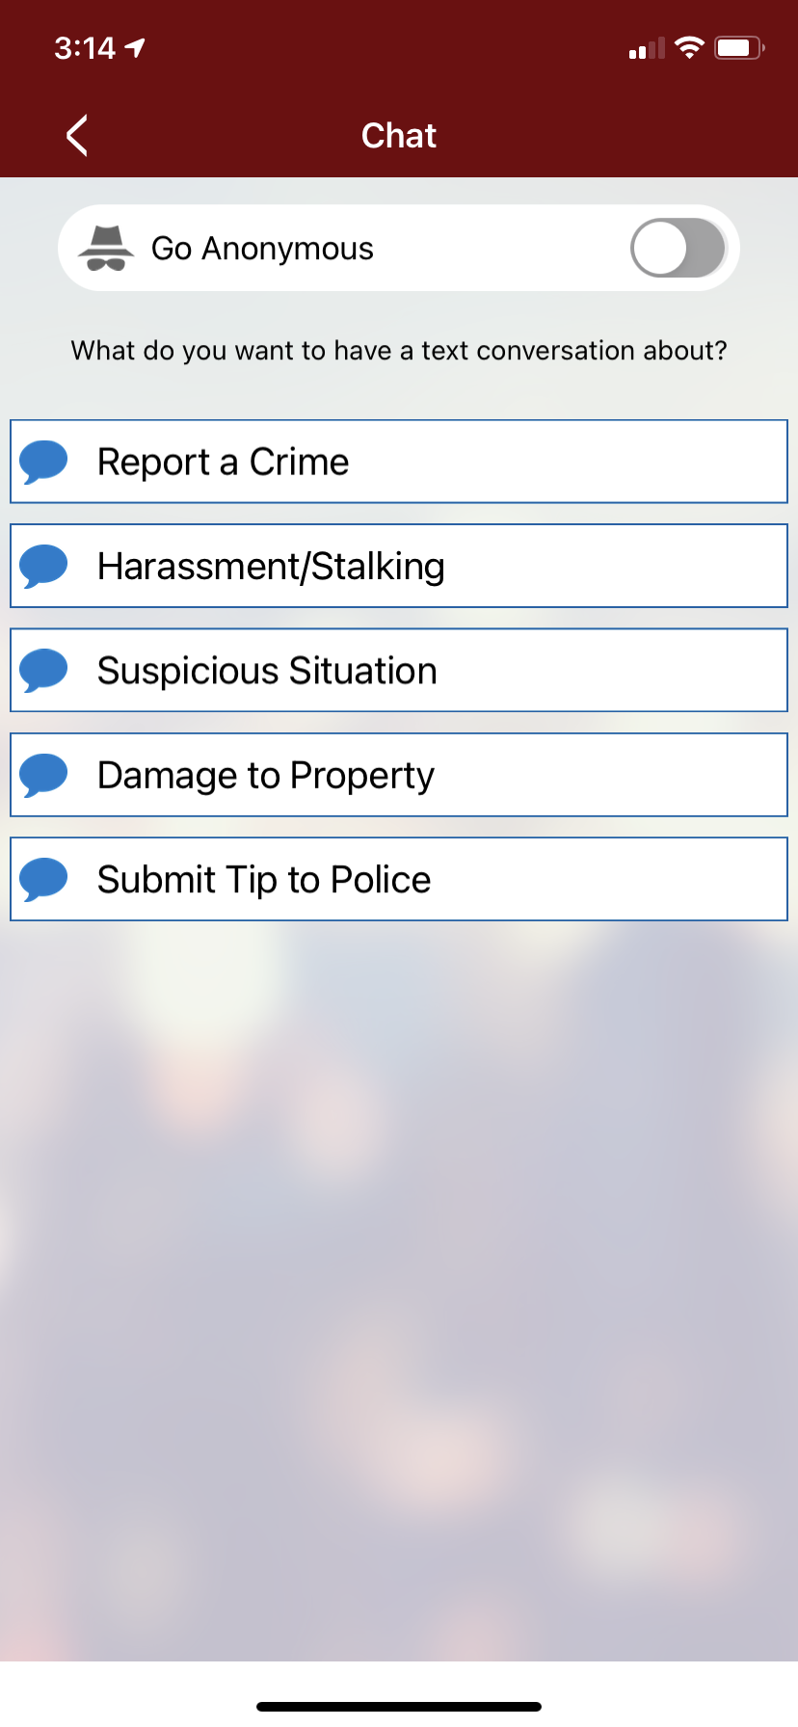
DISCREETLY CONTACT CAMPUS SAFETY
Prevent dangerous situations by discreetly sending anonymous tips with a photo or location as needed.

Slide 13
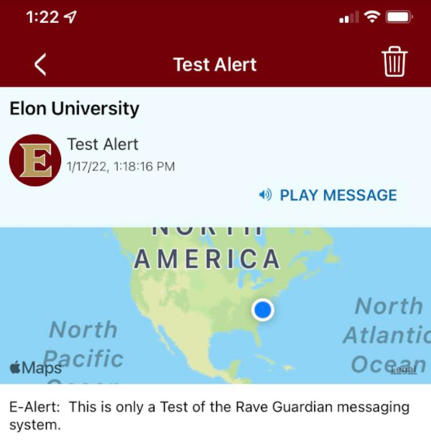
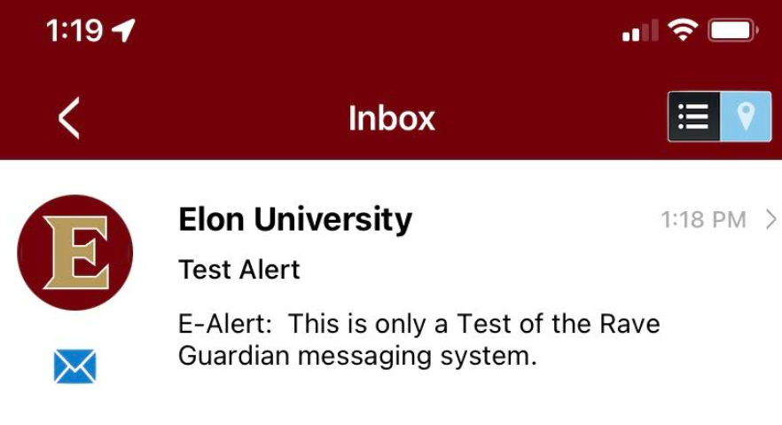
STAY INFORMED
Receive alerts based on your location, even when you don’t have a cell signal.

Slide 14
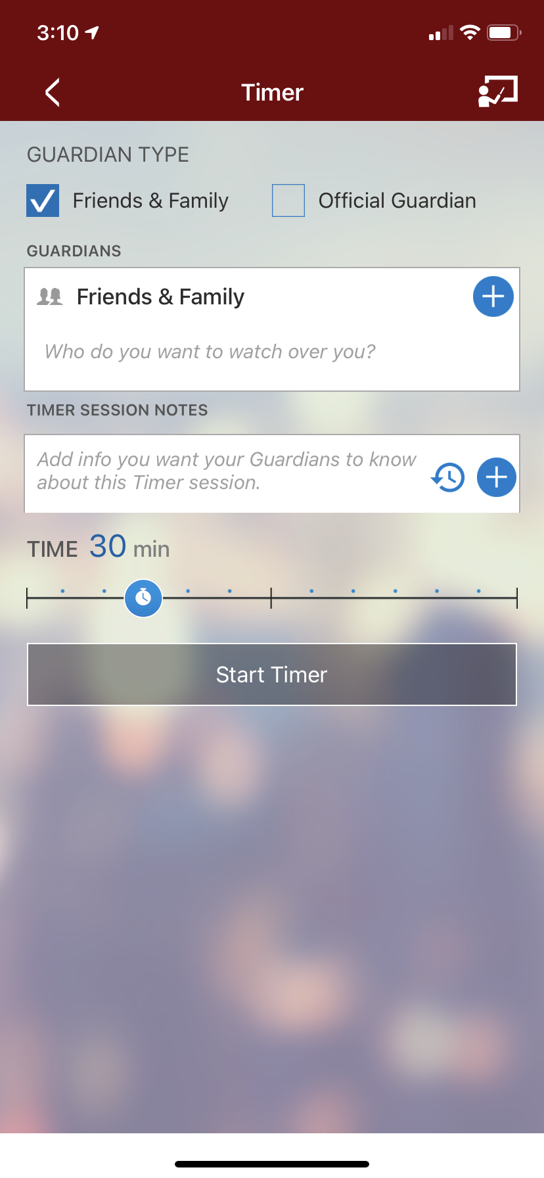
NEVER TRAVEL ALONE
Set a virtual safety timer for an extra layer of safety wherever you are.
? ? ? ? ? ? ?
who
what
where
when
? ? ? ? ? ? ?

Slide 15
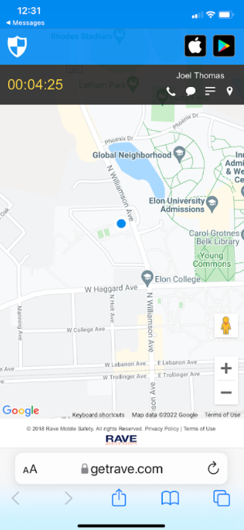
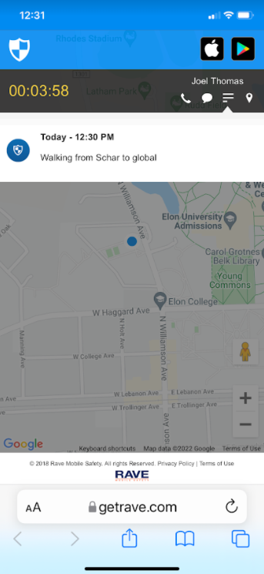
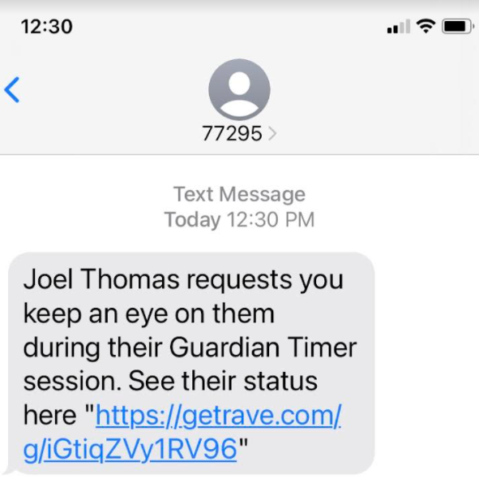
WHAT DOES YOUR GUARDIAN SEE?

Slide 16
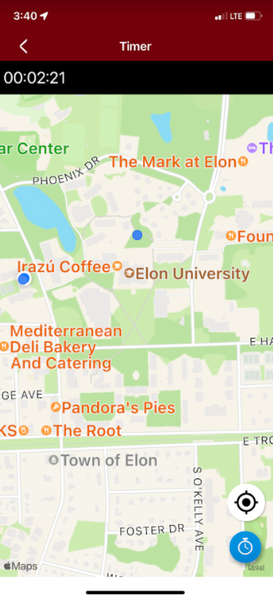
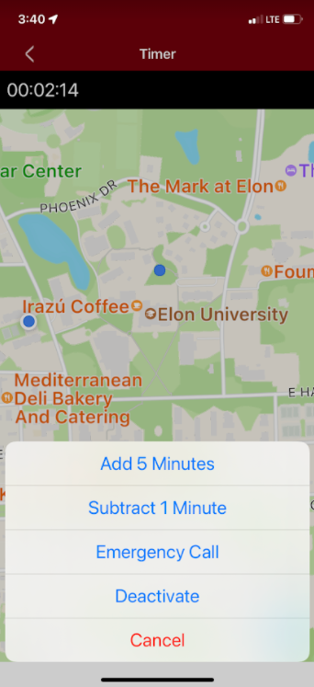

Slide 17
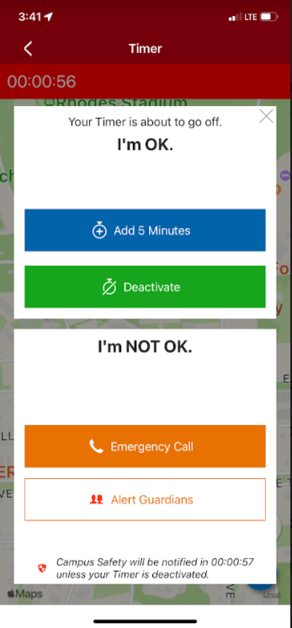
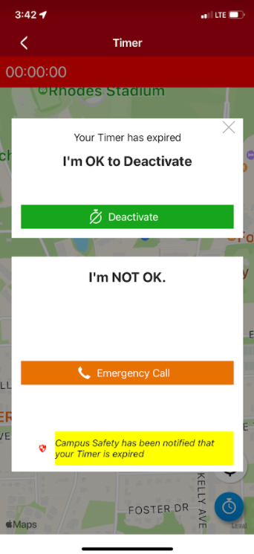
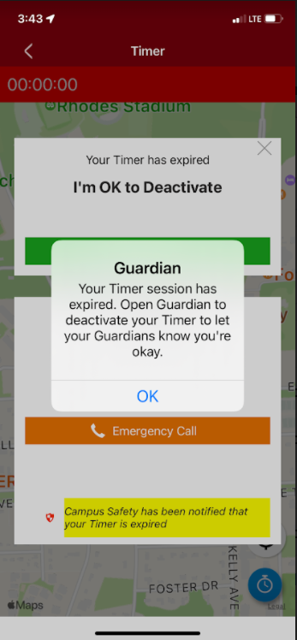

Slide 18
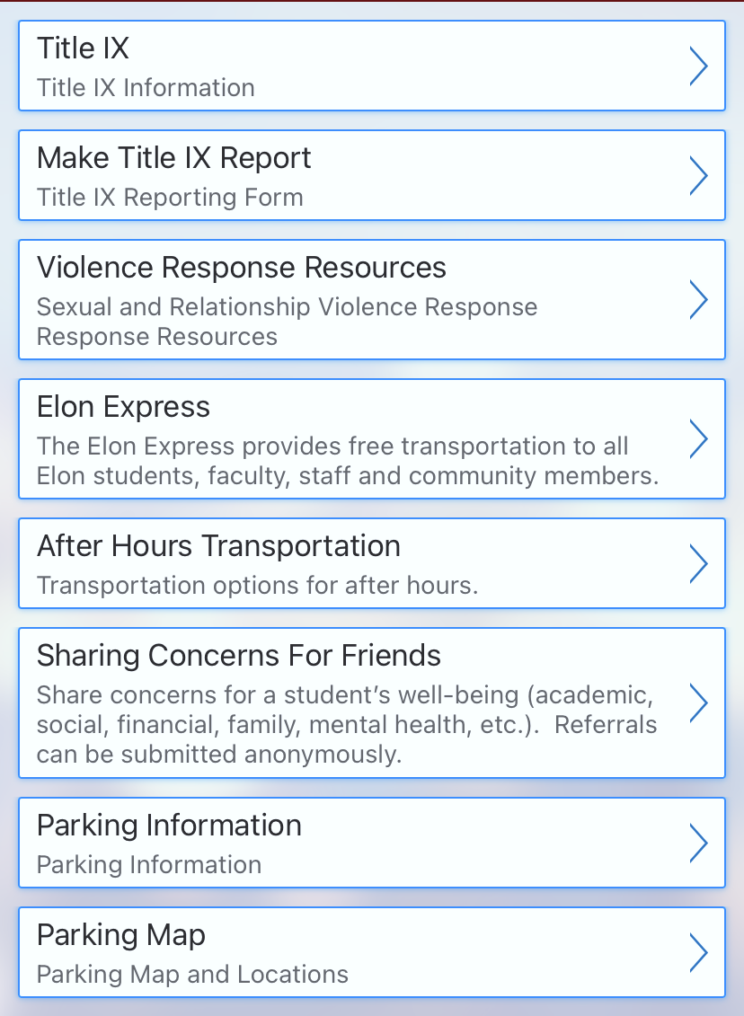
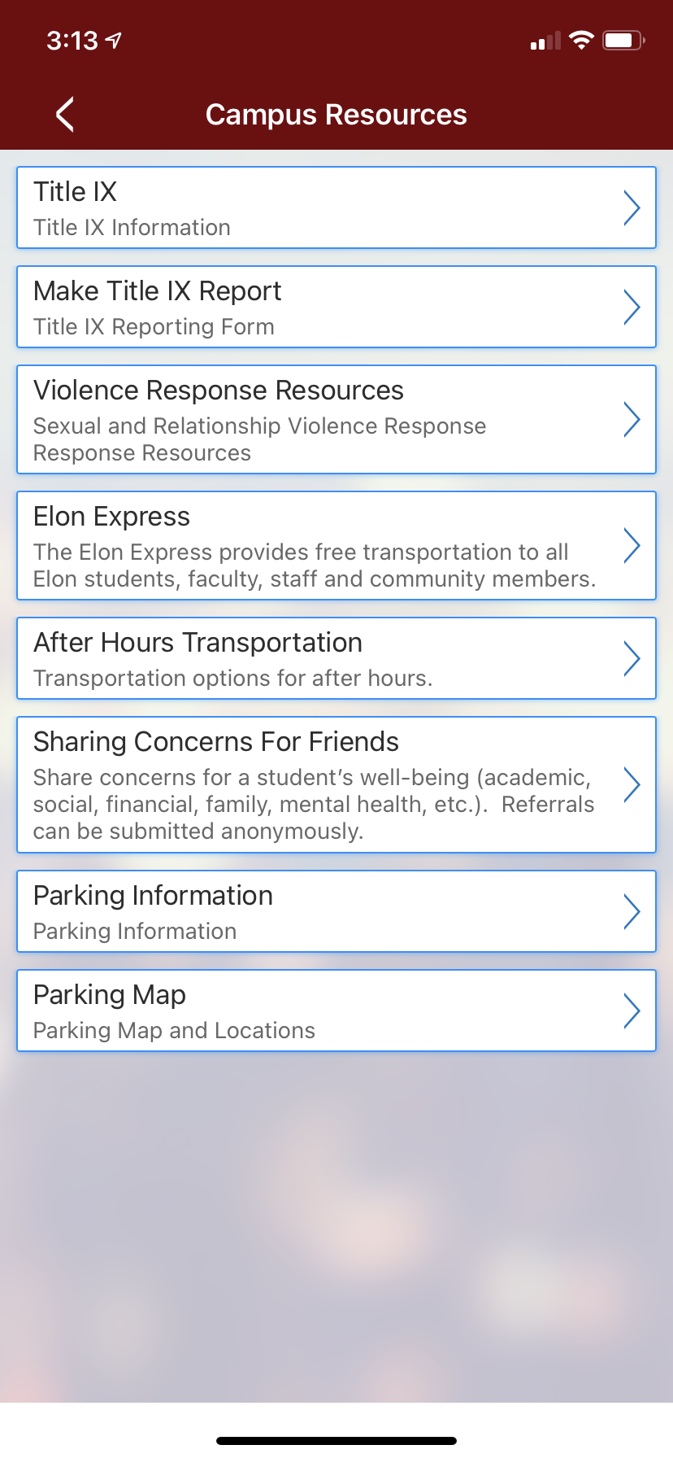
FIND THE RESOURCES YOU NEED
Access emergency procedures, schedules and other key documents in a custom content portal.
RESOURCES

Slide 19
MAKE THE RIGHT CALL
Easily find assistance and resources with a custom call directory of important to know phone numbers.

Slide 20
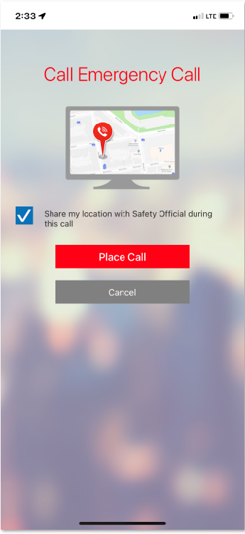
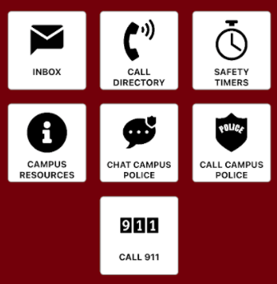
HELP IS ON THE WAY
With a push of a button, you can directly connect to campus safety or 911 in an emergency.

Slide 21
Questions regarding E-Alerts or RAVE Guardian can be sent to: campuspolice@elon.edu
*If you need immediate assistance, please call campus police at 336-278-5555 or call 911

