Slide 1
E-ALERTS
(Through RAVE)

Slide 2
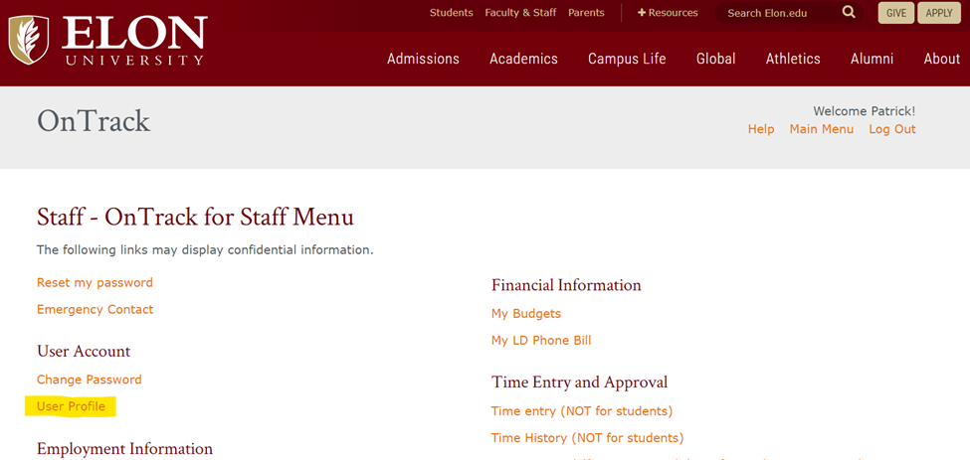
UPDATE/ADD YOUR CELL PHONE NUMBER
Login to Ontrack at https://www.elon.edu/ontrack
Click “User Profile” under the User Account section
This will load your User Information page

Slide 3
UPDATE/ADD YOUR CELL PHONE NUMBER
Scroll to section marked “Phone Numbers” and add or update your cell phone number. This number will sync with E-Alert every morning at 6:30am

