Slide 1
Understanding Sales Tax As It Relates To P-Card Transactions
Patrick Schwartz
Senior Buyer, Purchasing

Slide 2
Understanding Sales Tax As It Relates To P-Card Transactions
Elon University is a not-for-profit (nonprofit) company that IS NOT tax exempt.
That means Elon University is required to pay sales tax.
Although Elon pays sales tax, we can submit for reimbursement twice a year to reclaim North Carolina sales tax.

Slide 3
Understanding Sales Tax As It Relates To P-Card Transactions
Sales Tax cannot be refunded for the following items:
Airfare
Auto Rental
Fuel
Alcohol
Utilities (electricity, gas, phone (excluding equipment purchases), water/sewer, etc.)
Occupancy tax for lodging at NC hotels & motels
Reimbursement made to employees for sales tax paid for items purchased on behalf of the University (but not purchased by University)

Slide 4
Understanding Sales Tax As It Relates To P-Card Transactions
North Carolina is considered a “destination state”.
-This means that any goods or services purchased online with a ship to location of North Carolina, should include North Carolina Sales Tax.
-Elon is not able to reclaim sales tax outside of state.
We can only submit for reimbursement if tax is broken out as a separate line item on an invoice or receipt or if specified that sales tax is included in pricing.
Ensuring you have legible and itemized receipts becomes extremely important.

Slide 5
Understanding Sales Tax As It Relates To P-Card Transactions
With Purchase Orders and Check Requests, Accounting is able to charge the sales tax to a specific budget code when making the payment.
With p-card transactions, the sales tax is initially charged to the department’s budget and then pulled out by Accounting through a journal entry.
Without proper receipts (itemized), sales tax cannot be pulled out of the department’s budget.

Slide 6
Understanding Sales Tax As It Relates To P-Card Transactions
When eating at a restaurant in NC, make sure you have both the itemized receipt and credit card receipt.
-the itemized receipt is where the sales tax is shown.

Slide 7
Understanding Sales Tax As It Relates To P-Card Transactions
When a receipt does not break out the sales tax but has a message that the price includes sales tax, we are able to submit for reimbursement.
Divide the subtotal by 1.0675 to get the taxable amount and then subtract that from the subtotal to achieve the sales tax. (24 / 1.0675 = 22.48; 24 – 22.48 = 1.52 tax)

Slide 8
Understanding Sales Tax As It Relates To P-Card Transactions
Common p-card receipts/invoices submitted that are not itemized:
-The Oak House
-Restaurants
-IVARS
If you are not given an itemized receipt/invoice, ask for one.

Slide 9
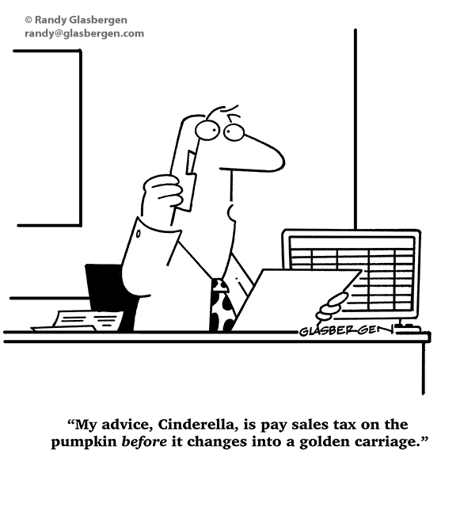
Understanding Sales Tax As It Relates To P-Card Transactions
Questions???
Contact Information:
Patrick Schwartz
pschwartz4@elon.edu
purchasing@elon.edu
336-278-5583

